Slide 1
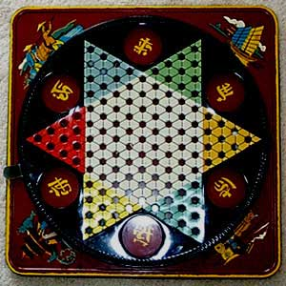
If Chinese Chequers is the answer, what is the question?

Slide 2
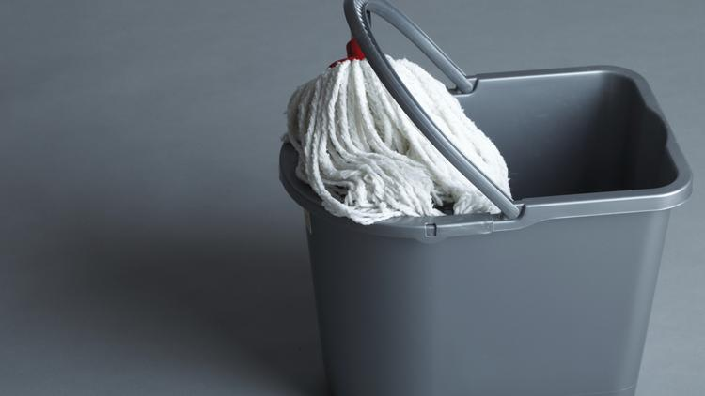
Why are we here?
During a visit to the NASA space center in 1962, President John F. Kennedy noticed a janitor carrying a broom. He interrupted his tour, walked over to the man and said, "Hi, I'm Jack Kennedy. What are you doing?"
"Well, Mr. President," the janitor responded, "I'm helping put a man on the moon.“
Notes:
Personal vision and purpose is essential

Slide 3
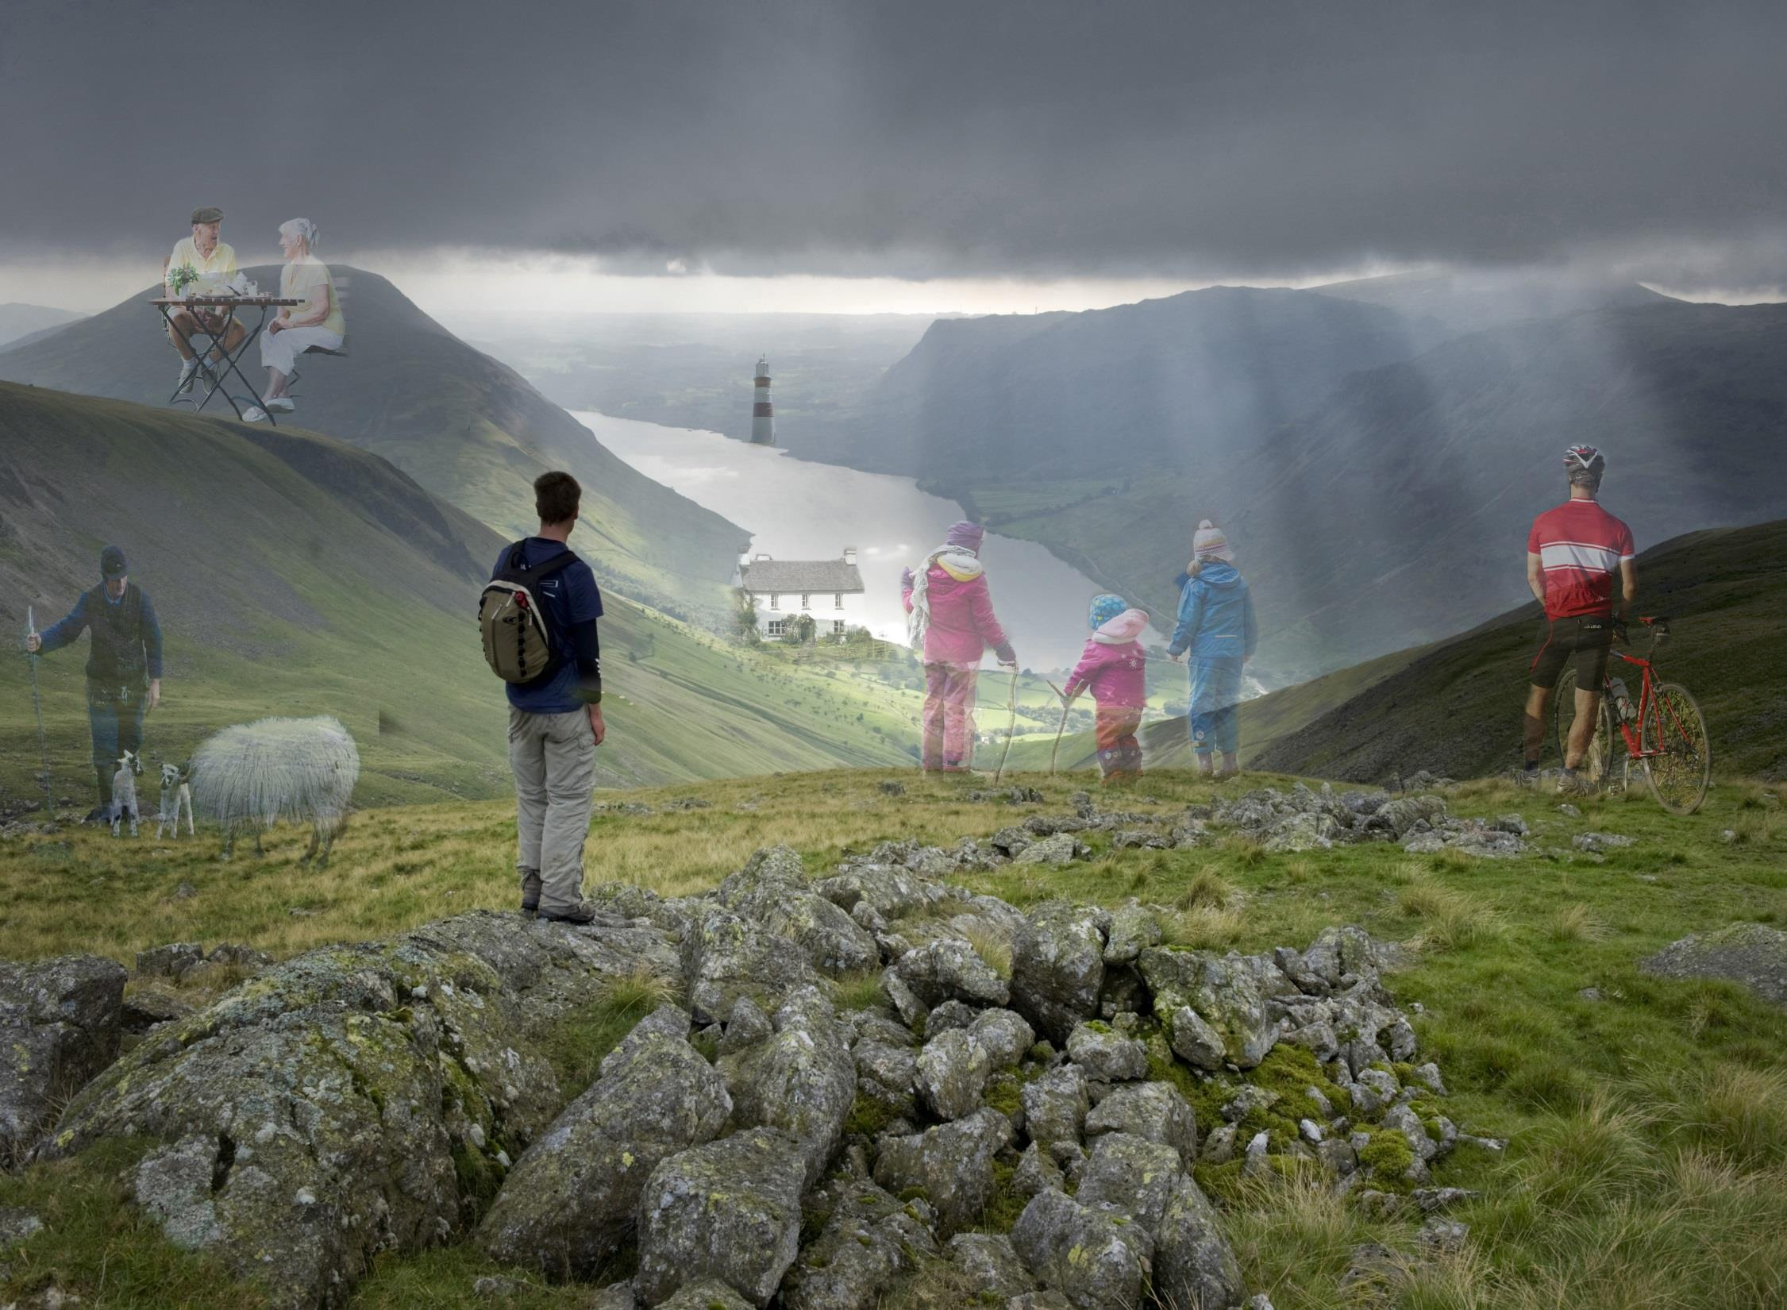
For ever, For everyone
National Trust Mission:
Protecting Special Places

Slide 4








In our care
1
0
271
Gardens
9
World Heritage sites
Factories
61
Lighthouses
59
Pubs
400
Villages
301
41
Historic Houses
Castles

Slide 5
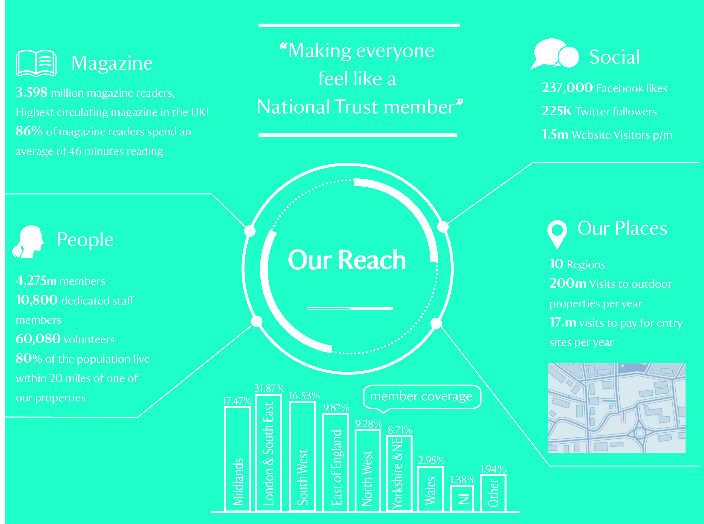

Slide 6
Our vision….
The National Trust helping build a nation where every individual and every community has the opportunity to make a difference for places and nature
A shift to become an organisation with Participation at its heart: in what we do and offer and how we work and operate
A transformation in our approach to volunteering: with an offer that is more flexible, dynamic and involves a more diverse range of people
Notes:
Big idea – needs big solutions

Slide 7
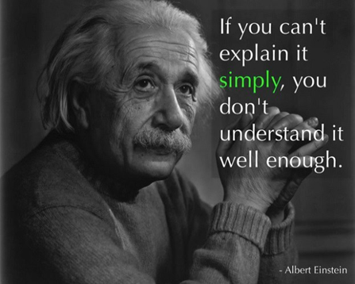
The 3 secrets of success
The 3 P’s

Slide 8
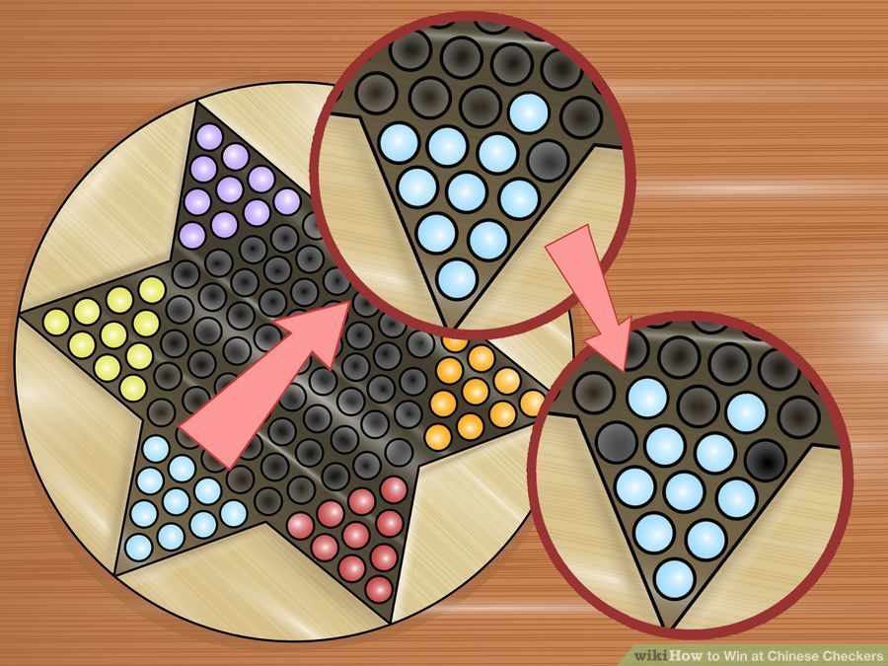
1. Purpose
Have a clear sense of direction
Notes:
Everything has to start with a CLEAR sense of direction and purpose

Slide 9
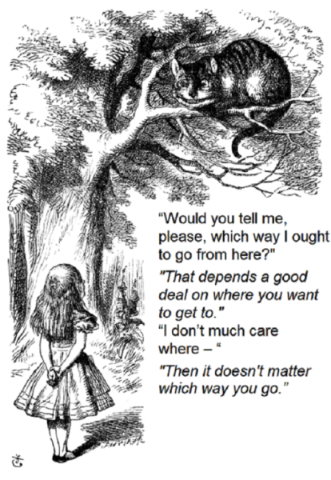

Where do you want to go?

Slide 10
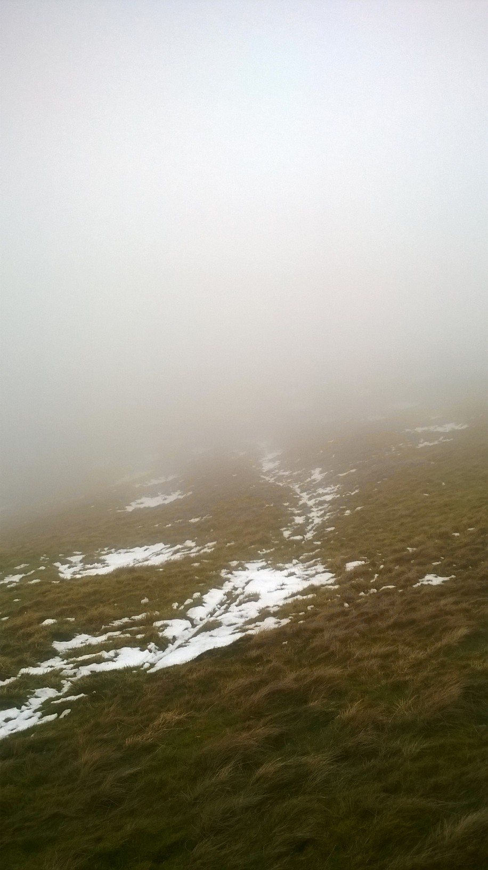
Seeing through the fog
Notes:
Proceed carefully in measured steps, when the way ahead is unclear

Slide 11
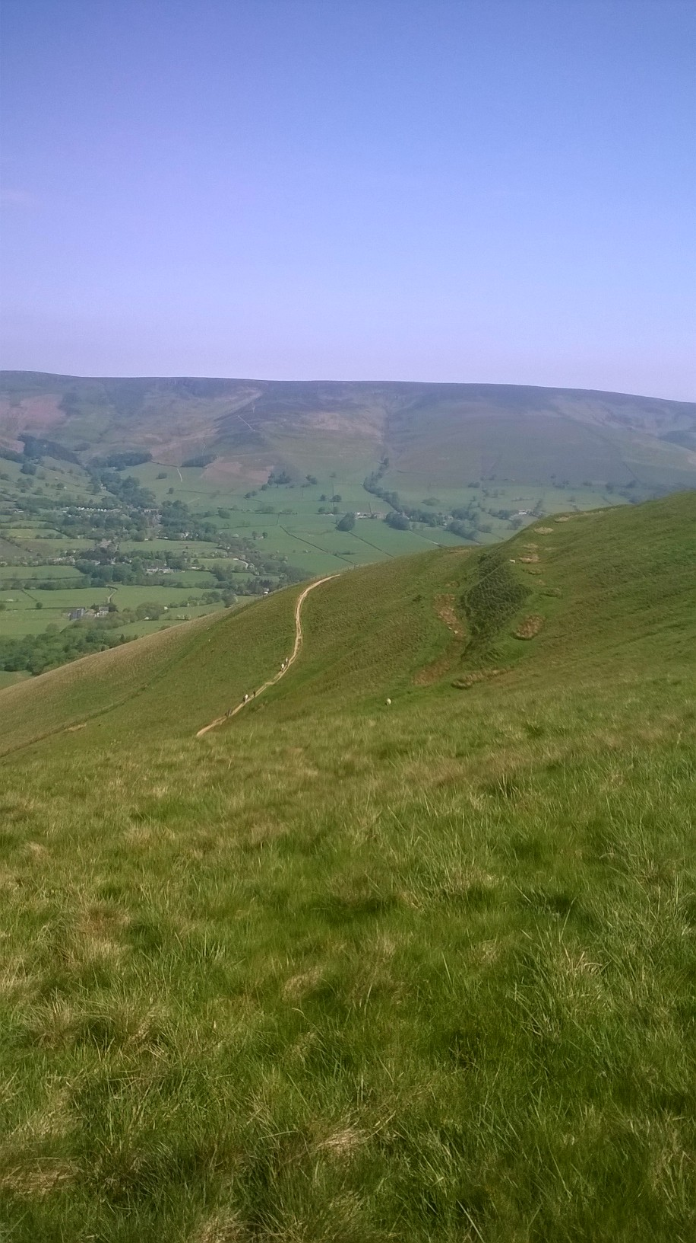
Move, Teach, Inspire
Notes:
Don’t forget to look at the far horizon

Slide 12
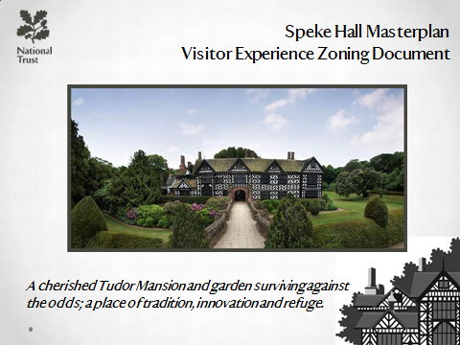
What’s the big idea
Spirit of Place
Speke Hall survives as a green oasis surrounded by urban sprawl and the neighbouring international airport. It tells the stories of two families from the house’s heyday in the Tudor period through to the Victorian era.
Speke Hall has survived through the determination and ambition of these families. It stands at the same time proud and homely, welcoming yet mysterious – a thought-provoking place to be discovered, (quietly or busily), on your own
terms.
Notes:
Spirit of Place decides the way forward

Slide 13
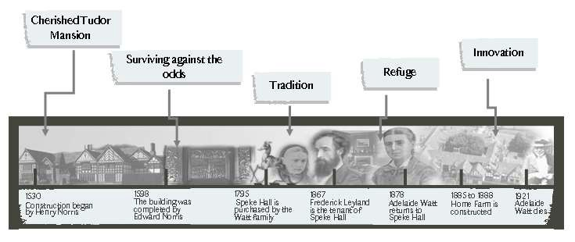
Speke Hall Masterplan
Spirit of Place: Lead Author: Adrian Tissier
A cherished Tudor Mansion and garden surviving against
the odds; a place of tradition, innovation and refuge.
Does the spirit shine through?

Slide 14
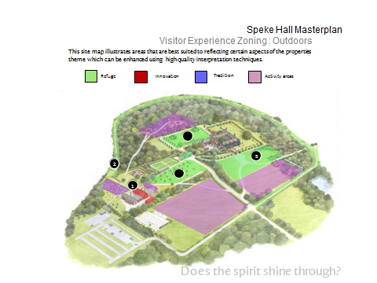
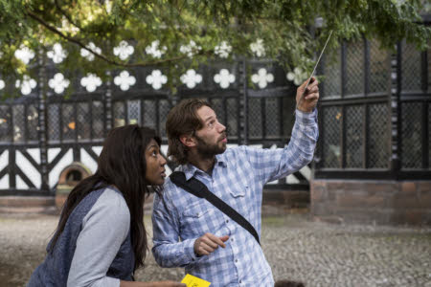
Finding the stories that have to be told
Notes:
Story-mapping provides a holistic view of the site

Slide 15
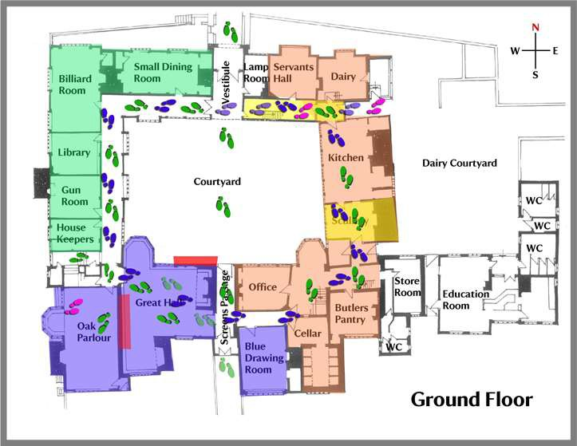
Speke Hall Masterplan
The Hall: Potential Visitor Routes

Slide 16
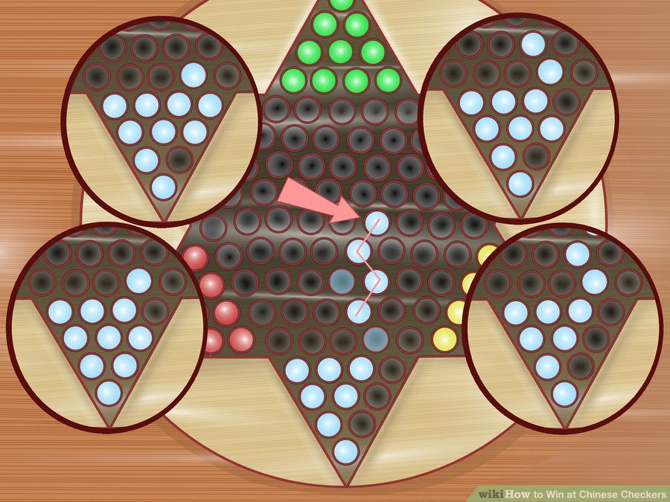
2. Participation
Build an effective support network
Notes:
Working together and avoiding silos is crucial

Slide 17
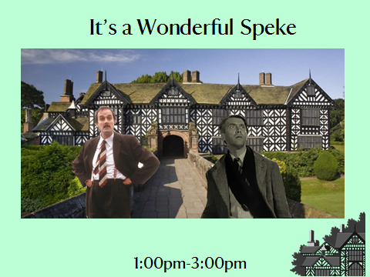
Exceptional service – the team approach

Slide 18
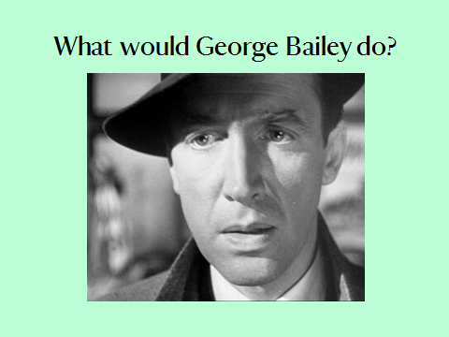
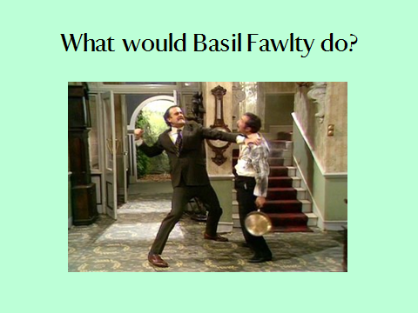
Setting a clear standard

Slide 19
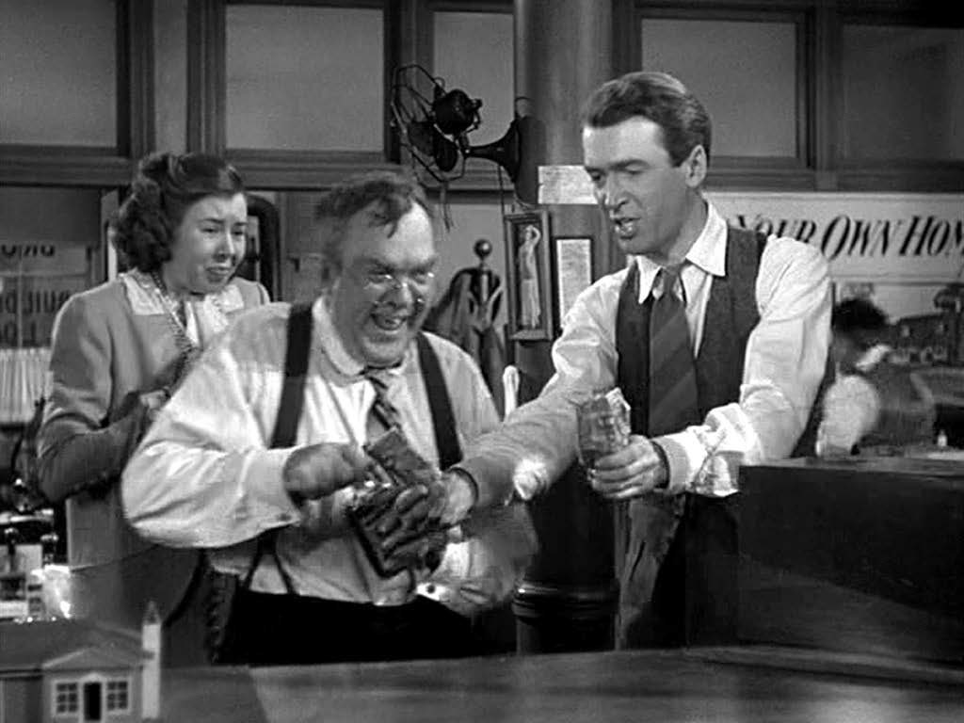
I'm happy because George is sharing with me! I love Speke Hall!
Sharing with someone

Slide 20
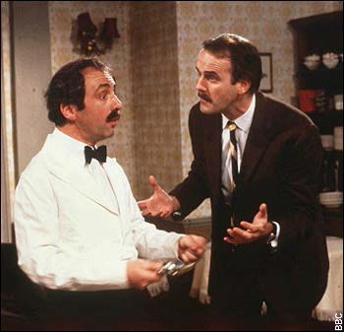

I'm off to English Heritage!
Telling someone

Slide 21
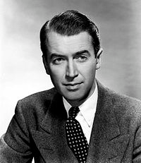
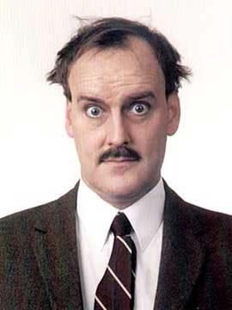
Service Promise Pyramid
Creating supporters for life! Everyone feels like a member!
Exceptional
Satisfied
Basic
Notes:
Creating a supportive service culture

Slide 22
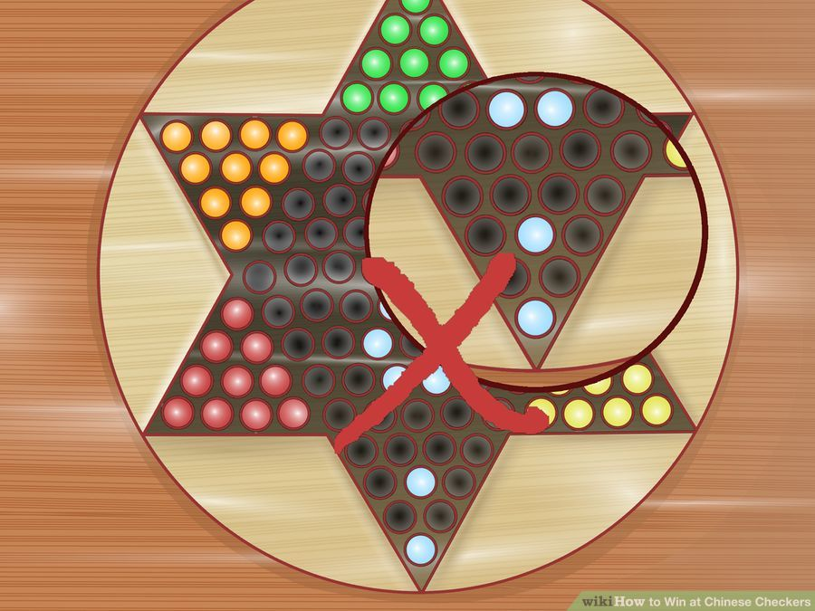
3. Plan
Forward thinking as a team
Notes:
Only produce the plan AFTER the vision and the team are establishes

Slide 23

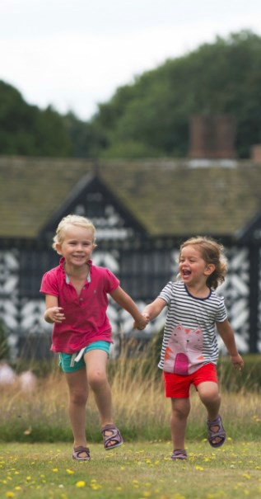
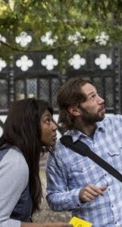
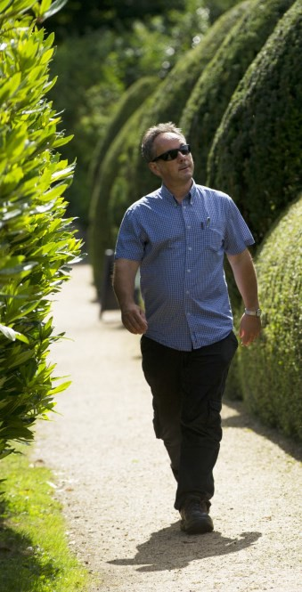

Masterplanning: Programming
Speke Hall: Programming & Audience Planning 2017

Slide 24





When would we like them to visit? Current Visitor Traffic Shape:
Speke Hall’s Annual Programming: Current Visitor Traffic (2015)
Feb Mar Apr May Jun July Aug Sep
Jan
Oct
Nov
Dec
Unclear Opening times:
Currently we open for February half term for one week and then close again, operate on weekends only until mid March, opening Wednesday– Sunday. This is proving to be very confusing to visitors and is causing a level of frustration both for our visitors and the property.
Unexplored Potential:
The property only operates at capacity during school holidays. The shoulder months feel very drastic in comparison to our busy periods with lots of room for development and growth.
The Big Dipper:
Currently our visitor traffic is functioning like a roller coaster ride. This is having a huge effect on our VE, commercial budgets, staffing resource and conservation work. When the property is at its peak it struggles to cope with the demand and facilities begin to creak.
The Bleak Mid Winter
The property makes huge losses over the winter period and throughout the shoulder months. We must create a programming offer which will entice visitors to come and support our property through this difficult time and help support the budgetary demands.

Slide 25

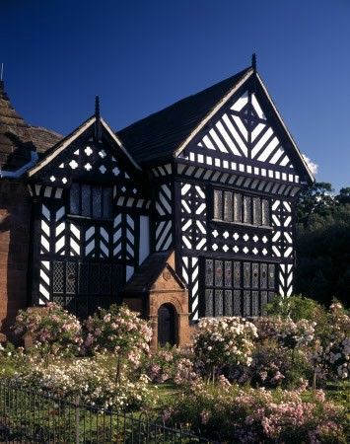


Programming Planning 2017
Untold Tales of Speke Hall: Curious Minds & Out and Abouts
We will unlock the secrets of Speke Hall’s haunting past by exposing a part of the Hall’s history when it was in a state of ruin and decay. This season we will reveal the truth behind one of Liverpool’s most famous ghost stories…starting with the untold Tale of Mary Norris and working throughout the year until we reach the romantic tale of Richard and Ada Watt. Each of the stories will be revealed in the form of chapters, beginning with Chapter One: Seduction and Decay.
Programming: Chapter Break Down
∗
Chapter One: Seduction and Decay: from 22nd February –March: This Chapter will explore the Beauclerk story, a real page turner in terms of fascinating characters with twists and turns this section of programming can be likened to the Wuthering Heights tale.
Chapter Two: Wealth and Wiles: from April –May: This Chapter will explore the rise of the Watt family. It will present the tale of a self made man and how he rose to his wealthy status and became the owner of Speke Hall.
Chapter Three: Rent and Ruin: from June–early July: This Chapter will explore when the Hall plunges into a ruin, the uncertainity of the Watt line and how it abused; cows and horses wandering the corridors and ivy working its way inside.
Chapter Four: Romance and Revival: from September–December: The season will end on a happy note, capturing and exploring the happiness between Richard Watt V and Ada, it will focus on their impact on the Hall and provide an opportunity to discover more about our notable gothic collection.
∗
∗
∗

Slide 26













The Potential Programming 2017: Seasonal Highlights
Indoors:
Due to conservation work the house will need to be presented under dust sheets.
For the first time the house will be opening mid week-Feb- March for guided tour only. This will increase light hours.
Indoors:
House begins normal opening with some conservation work being continued including scaffolding.
Jan
Feb
Mar
Apr
May
Jun
July
Aug
Sep
Oct
Nov
Dec
Outdoors:
Fresh winter morning jogs and snowy afternoon walks are an attractive option at this time.
The drive begins to come alive with snow drops & daffodils
Outdoors:
Launch of the Secret Garden
Borders start blooming
Birds begin nesting, singing and returning home
Outdoors:
North Lawn Rhododendrons begin to bloom
Blue bells in mid May!
Birds, butterflies and bees
Outdoors:
South Lawn in bloom and rose garden
Birds, butterflies and bees
Border & kitchen garden in bloom.
Wild flowers bloom.
Outdoors:
Orchard looks fantastic
Moat Gardens and South Lawn highlights.
Hay meadow cut.
Swallows, swifts and house martins.
Outdoors:
Estate looks beautiful in autumn colours, perfect for talks, walks and tours.

Slide 27

The Big Idea
If we communicate just one big idea to our visitors it is that, the Industrial Revolution changed our world forever.
Our Key Message
Quarry Bank is a complete community of the early industrial revolution when society stood at a turning point. It is a story of the power of nature and human
ingenuity; of rich and poor whose voices survive and resonate today.

Slide 28
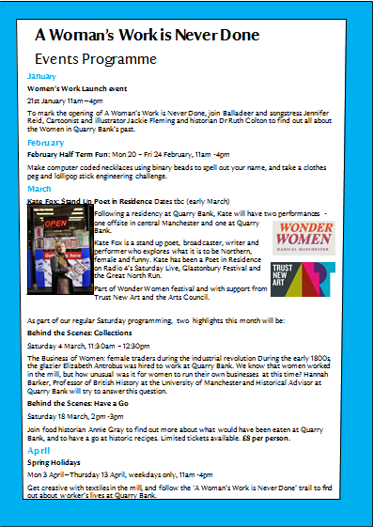

Slide 29
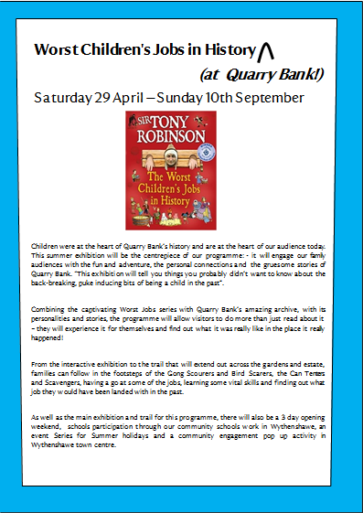

Slide 30
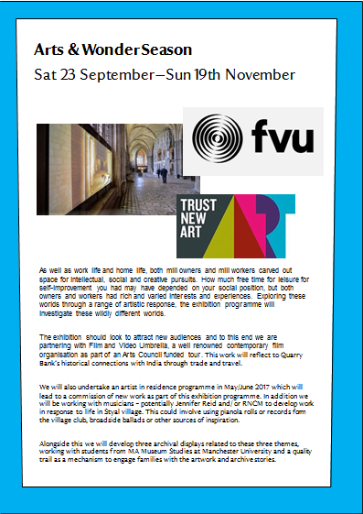

Slide 31
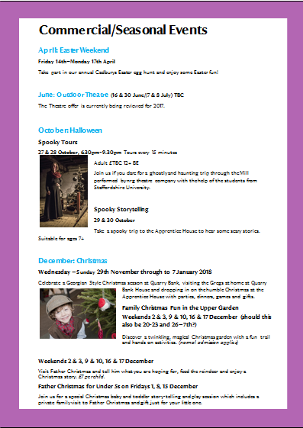

Slide 32
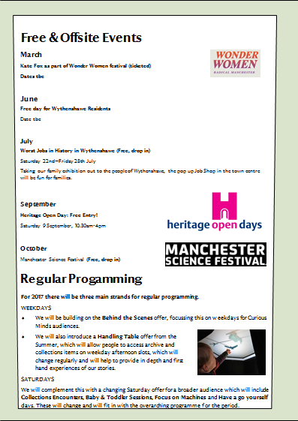

Slide 33
Challenging Histories
2016 | Europe and Us (pilot)
2017 | LGBTQ heritage – Prejudice and Pride (50 years since partial decriminalisation in England)
2018 | Women’s history and suffrage (100 years of women first gaining vote)
2019 | Radical Landscapes (Peterloo Massacre at 200, Runnymede, Tolpuddle Martyrs’ tree, Kinder Scout, Divis and Black Mountain )
2020 | NT at 125 Cause ( health and wellbeing tbc)
2021 | Class and social mobility (detail tbc)
2022 | Legacies of colonialism (detail tbc) Slavery, India at 75

Slide 34
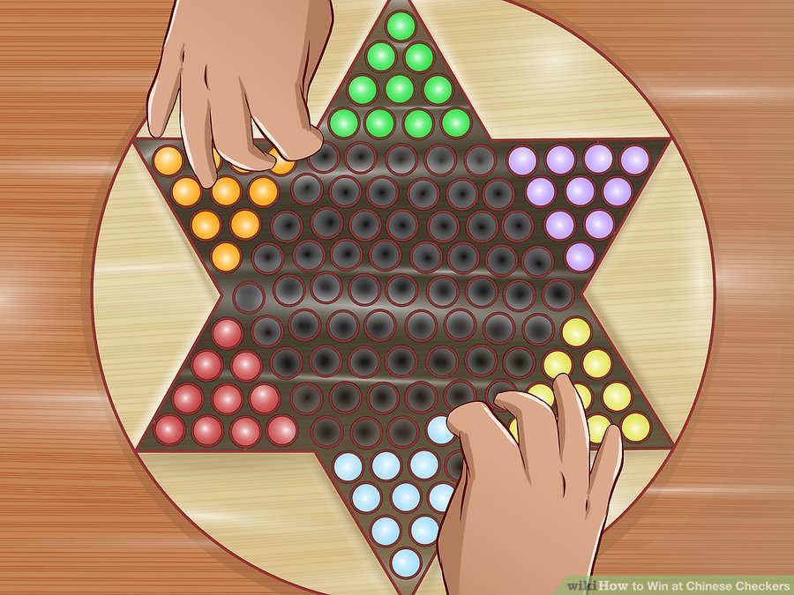
Success

Slide 35
The 3 P’s transformed
Purpose x Place= Relevance
Participation x People = Engagement
Plan x Programme = Inspiration

Slide 36
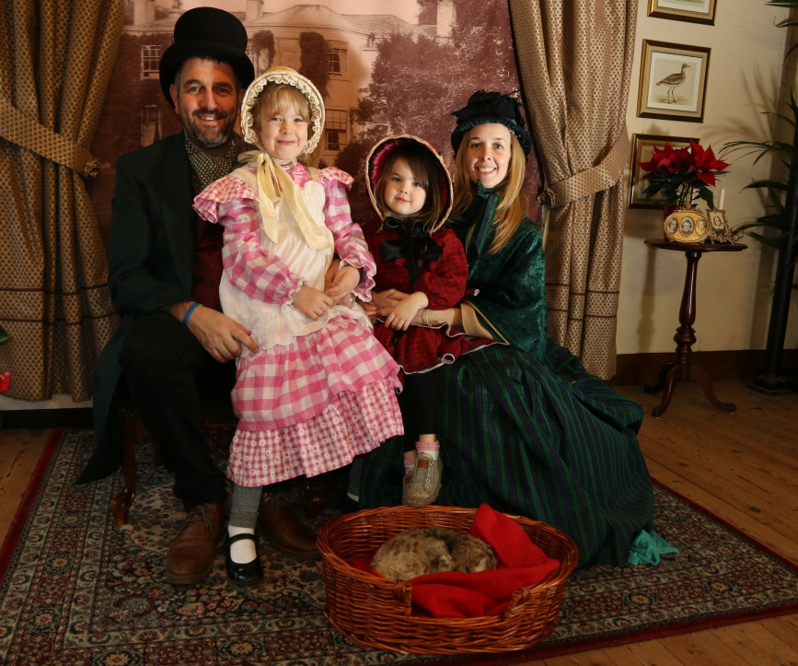
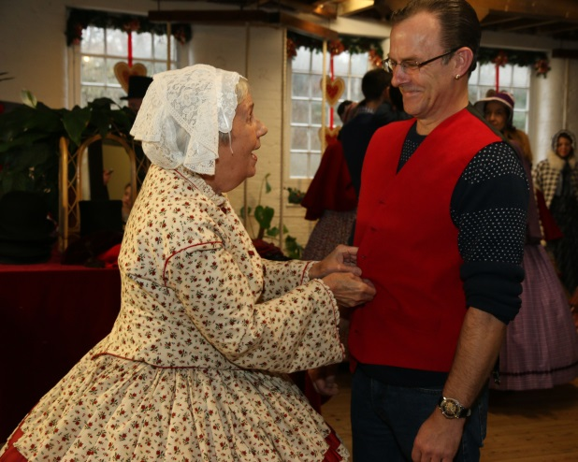
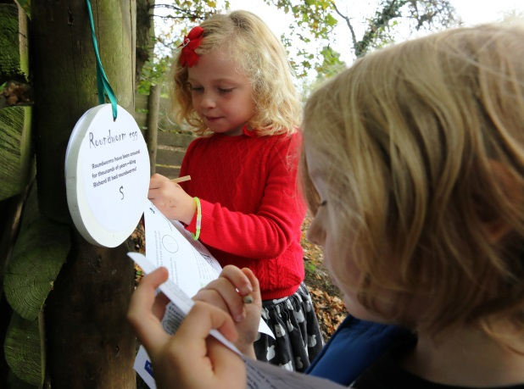
Inspiring our audiences
“
“There was absolutely nothing to dislike, from the greeting we received from the ladies manning the hot Tudor drinks, to the ladies in period costumes to the lovely gentlemen who knew so much about the hall, I totally enjoyed it all. I enjoyed it so much I am considering, when I finish work in June, applying to do some voluntary work there”

Slide 37
Impact
Staff satisfaction 52% 61%
Volunteer recommendation 70% 80%
Visitor Very Enjoyable 51% 58%
Speke Hall Survey KPIs 2014-2016

Slide 38
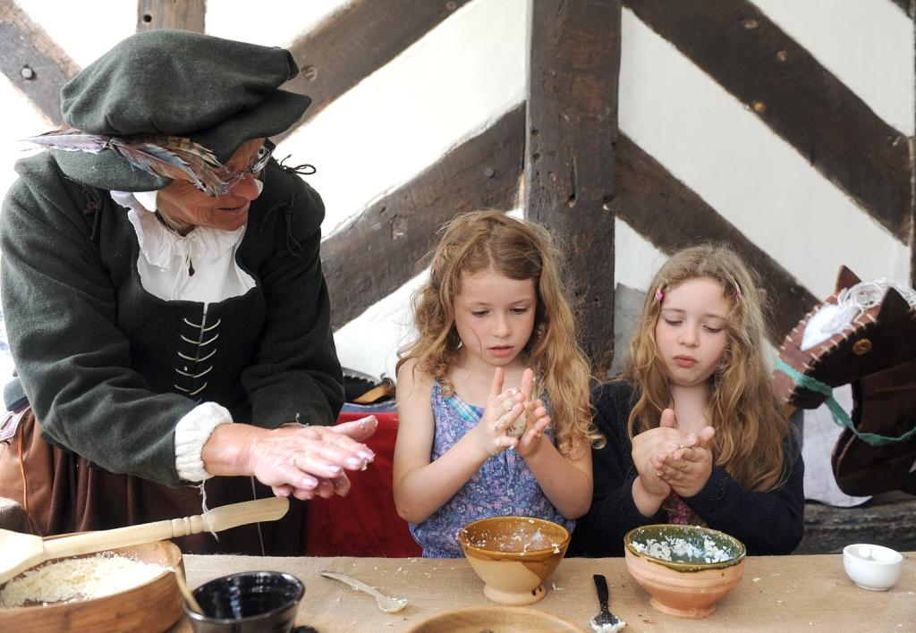
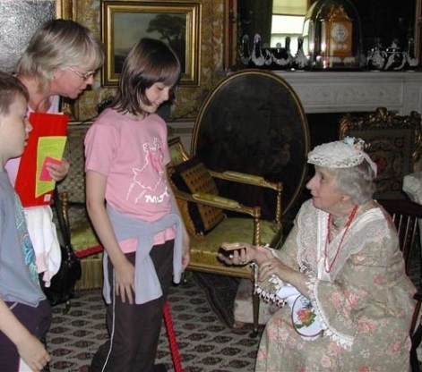
Move, teach, inspire

Slide 39
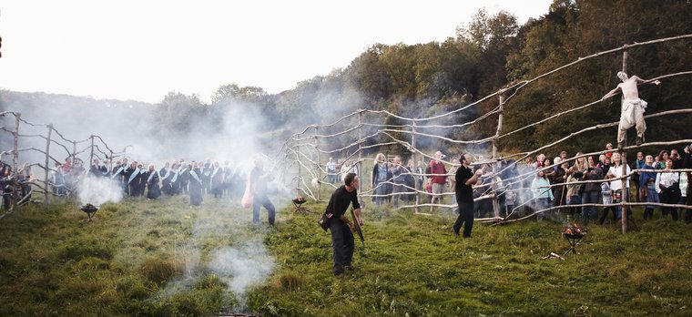
Deepening the engagement
“Over 10,000
people have
enjoyed the sculptures
and walks – they are
the most successful
we have run. The project
has brought together
the natural habitat,
tradition and local skills.”
Jane Cecil GM

Slide 40
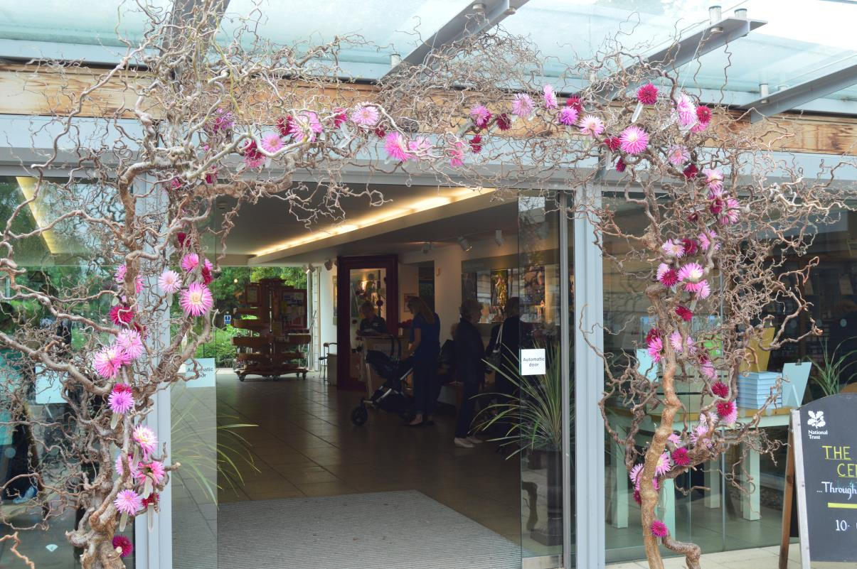
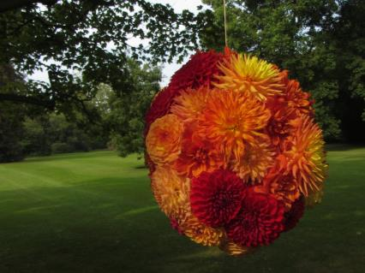
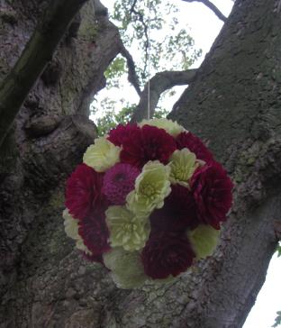
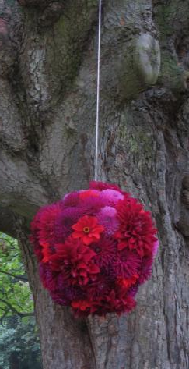
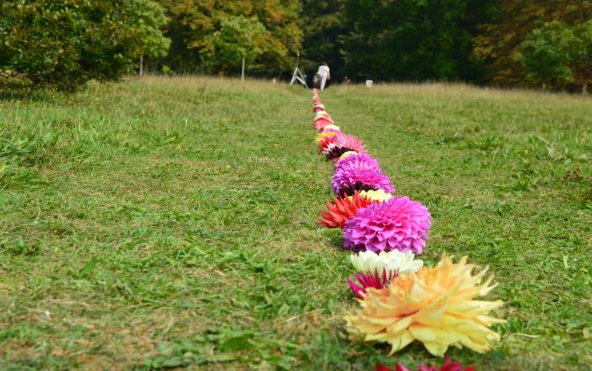
The Dahlia Line & Hanging Dahlias
Visitors were encouraged to pick up a dahlia from reception and ‘plant’ it in the line – this raised £118 in donations

Slide 41
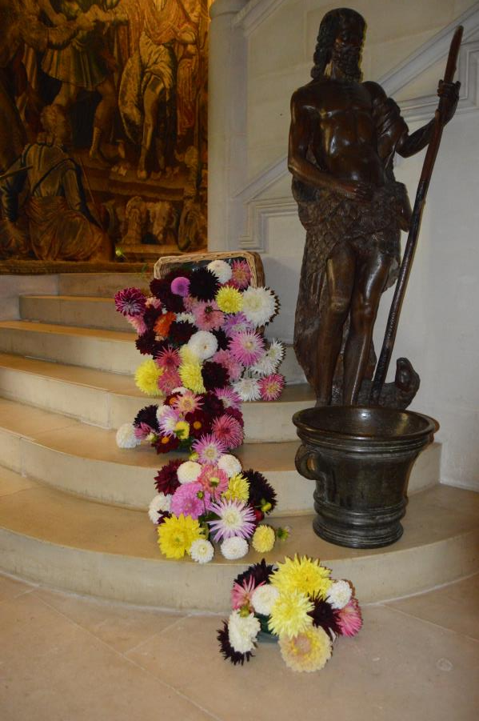
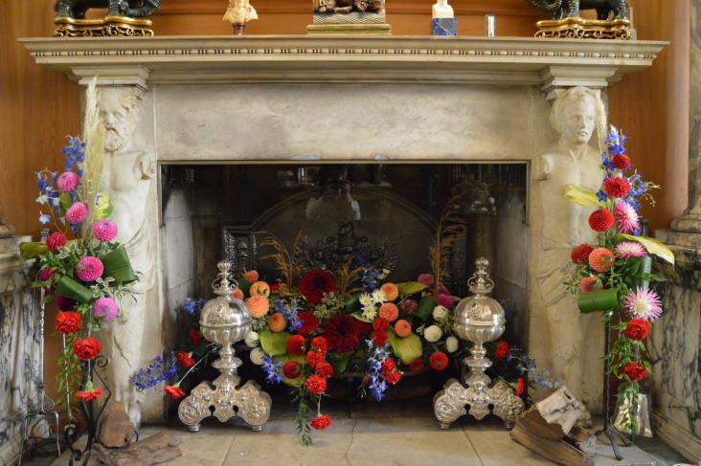
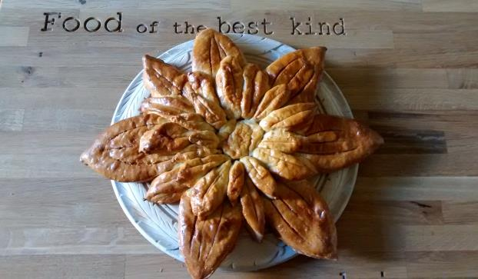
The House & Domestic Wing

Slide 42
The results
Property Income:
Visitor numbers:
Visitor experience:
59% September 2015
70% September 2016
2015 | 2016 | % increase
£106,518 | £154,414 | 44%
2015 | 2016 | % increase
11,526 | 18,580 | 64%

