Slide 1


How 15 philly museums are leveraging mobile audio tours to strengthen connections with teen audiences

Slide 2




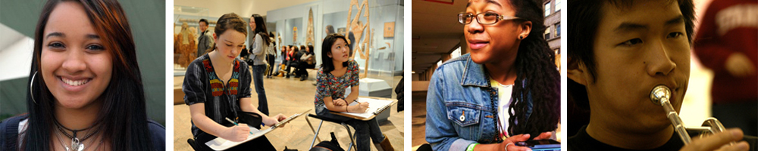
This program is made possible by:
Notes:
Welcome – What is STAMP
Logistics
Pass
Website
Teen Council
History
Why we started STAMP – why & how
We are in a unique position as an arts service org to create the types of relationships and collaborations to make this project work

Slide 3
Participating STAMP Museums
Academy of Natural Sciences
African American Museum in Philadelphia
The Barnes Foundation
Bartram’s Garden
Eastern State Penitentiary
Fabric Workshop & Museum
The Franklin Institute
Institute of Contemporary Art
Mutter Museum
National Constitution Center
National Liberty Museum
National Museum of
American Jewish History
Penn Museum
Pennsylvania Academy
of the Fine Arts
Philadelphia History Museum
Philadelphia Museum of Art
Philadelphia Zoo
Notes:
Participation Museums
We’ve also been able to provide learning programs in support of STAMP to museum educators and visitor service staff related to teen visitor experience

Slide 4
AmeriHealth Caritas Partnership
And Still I Rise Youth Development Program (ASIR)
Arts Academy at Benjamin Rush
The Attic Youth Center
Big Brothers Big Sisters Southeastern Pennsylvania
Blues Babe Foundation
Build On Philadelphia
Buzz Marketing Group
CASA Philadelphia
City Year Philadelphia
Communities in Schools Philadelphia
Community College of Philadelphia
Creative Art and Aging Network
Eagles Youth Partnership
Ed Snider Youth Hockey Foundation
Education Works
The Enterprise Center
Faith in the Future Foundation
Federation of Neighborhood Centers/Teens 4 Good
Foundations of The Union League
Free Library of Philadelphia
Girl Scouts of Eastern Pennsylvania
Independence Visitor Center Corporation
Junior Music Executive
KMC Empowering Educational Corporation, INC.
Mastery Charter Schools
Mayor’s Office of Education
Mighty Writers
Network for Teaching Entrepreneurship
NW EPIC Stakeholders Group – PathWays PA
Office of Mayor Jim Kenney
Philadelphia Academies Inc.
Philadelphia Education Fund
Philadelphia Freedom Valley YMCA
Philadelphia School Partnership
Philadelphia Stories Jr.
Philadelphia Works
Philadelphia Youth Commission
Philadelphia Youth Network
PhillyGoes2College
PhillyRising
Police Athletic League
Public Health Management Corporation
School District of Philadelphia
Science Leadership Academy
Southeast Philadelphia Collaborative
Summer Search Philadelphia
That’s So Philly
United Way of Greater Phila and Southern New Jersey
The University of the Arts Pre-College Programs
Urban Affairs Coalition
Urban League of Philadelphia
Variety—The Children’s Charity
STAMP Community
Partners
Notes:
Community Partners

Slide 5
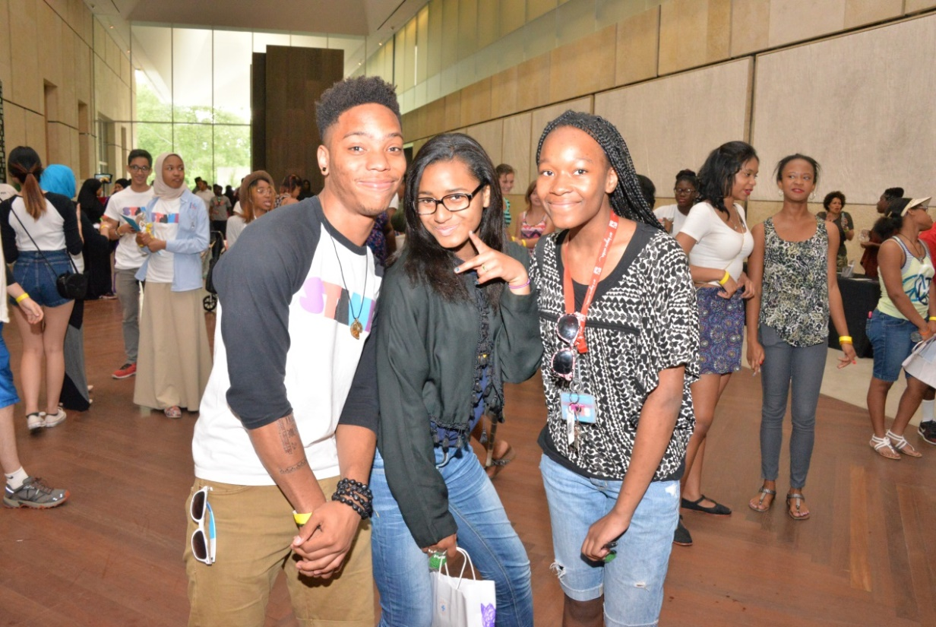
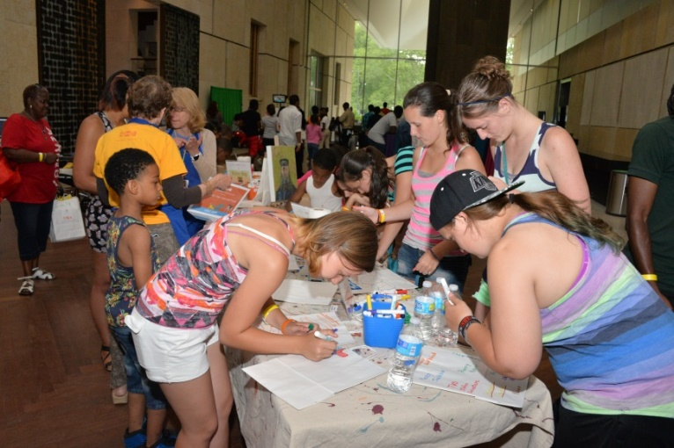
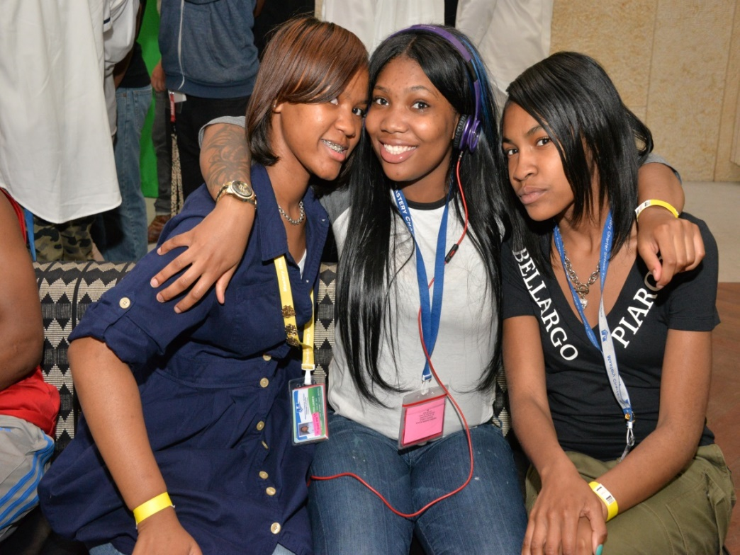
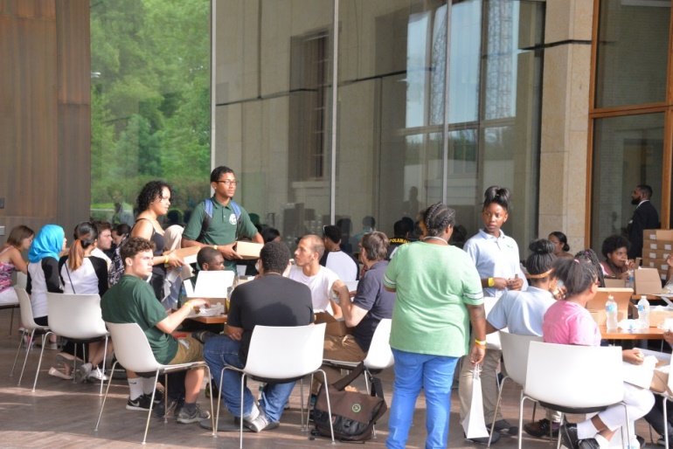
Notes:
STAMP Teen Council
Structure & Duties

Slide 6
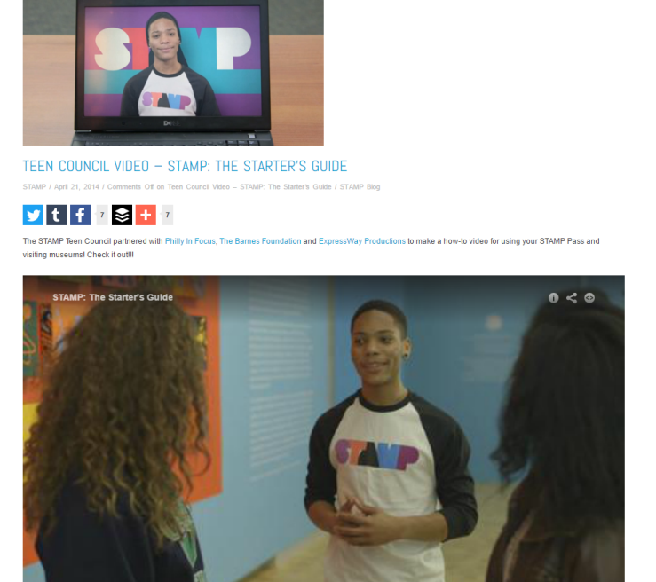



STAMP Video: The Starters Guide
http://phillystamppass.org
Notes:
Content Creation
A vital strategy for engagement

Slide 7
How 15 philly museums are leveraging mobile audio tours to strengthen connections with teen audiences

Slide 8
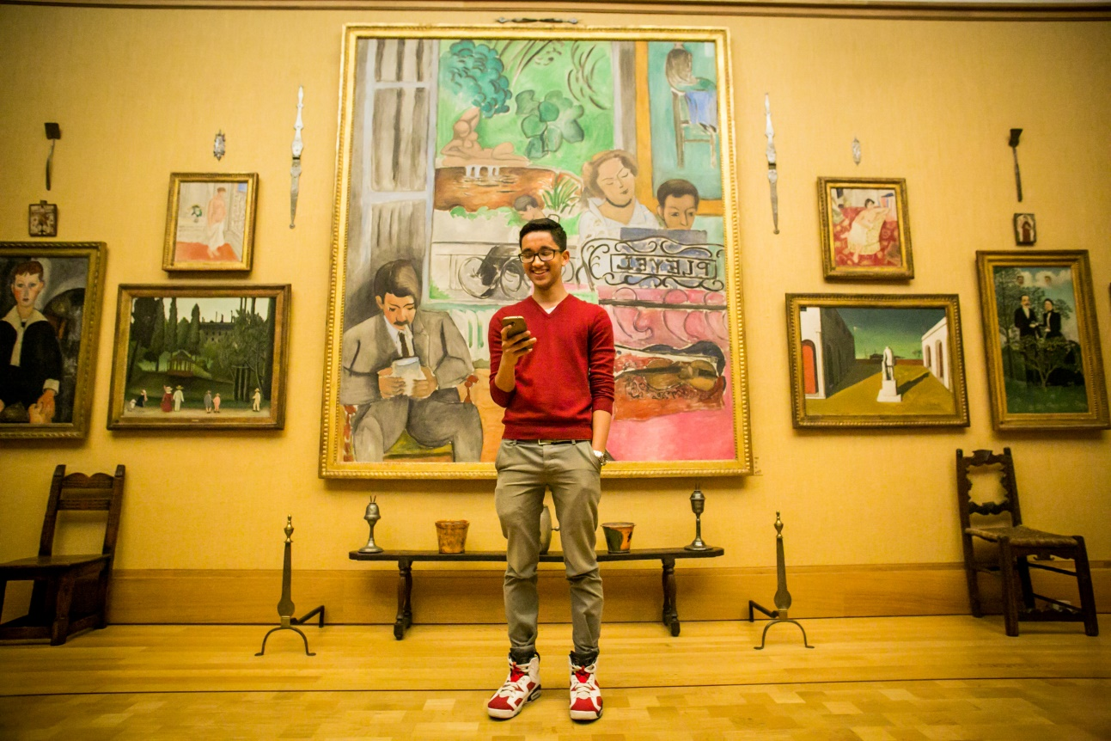

Slide 9
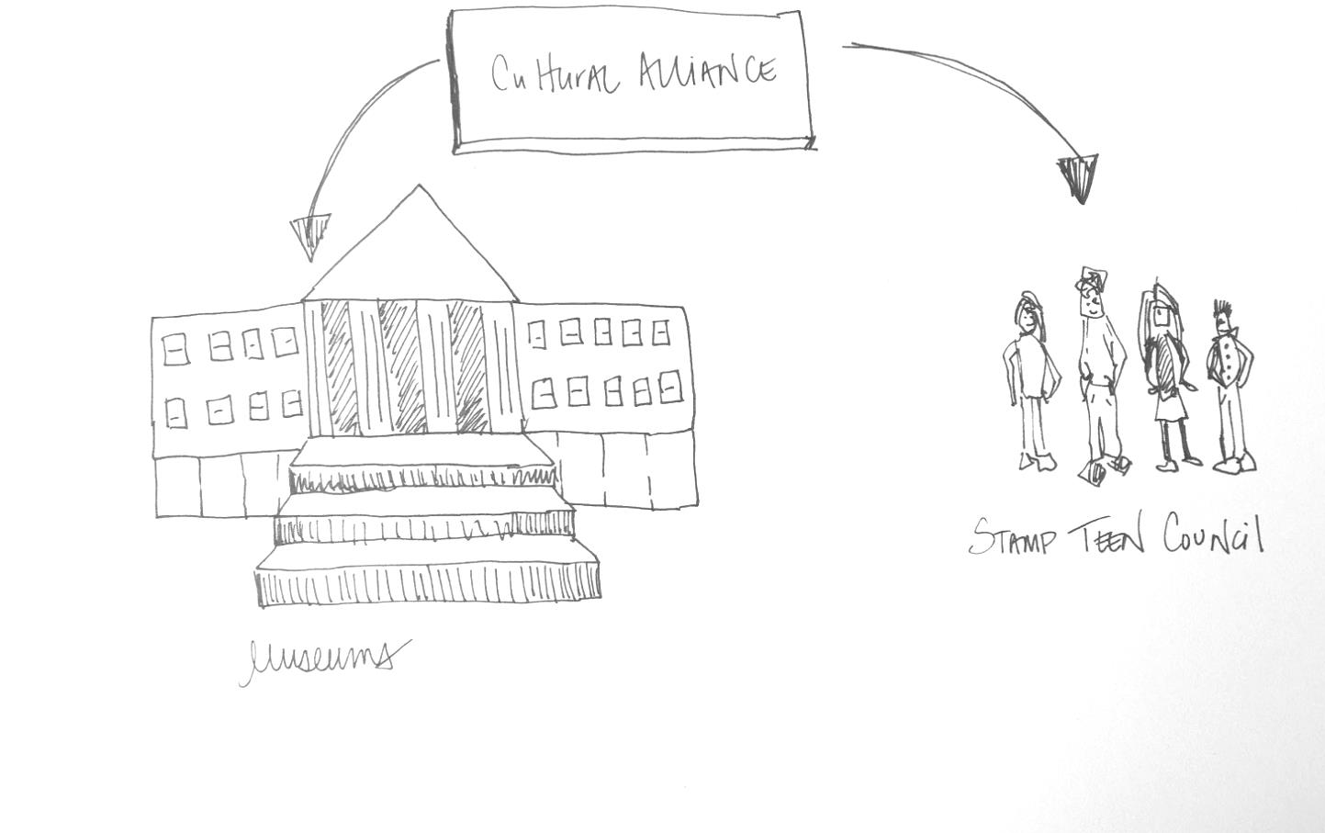

Slide 10
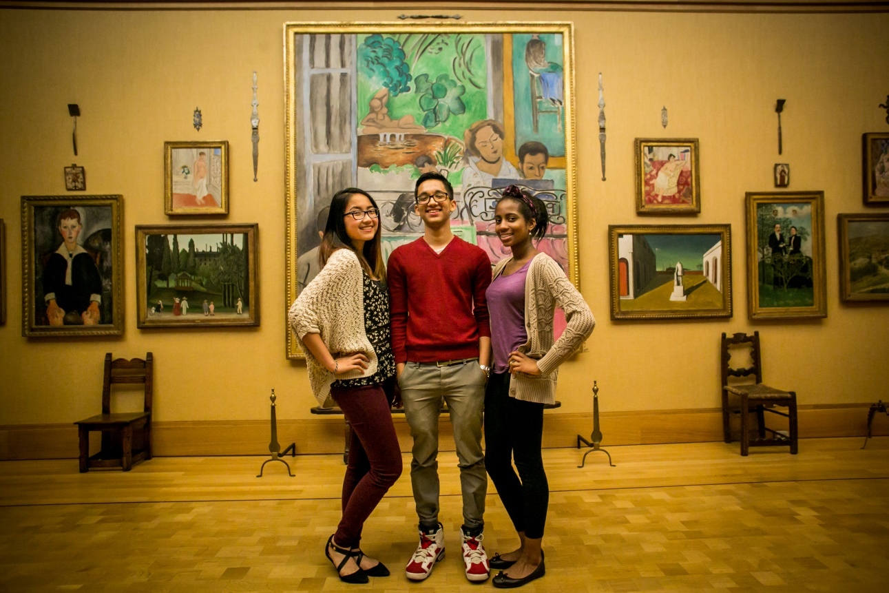

Slide 11
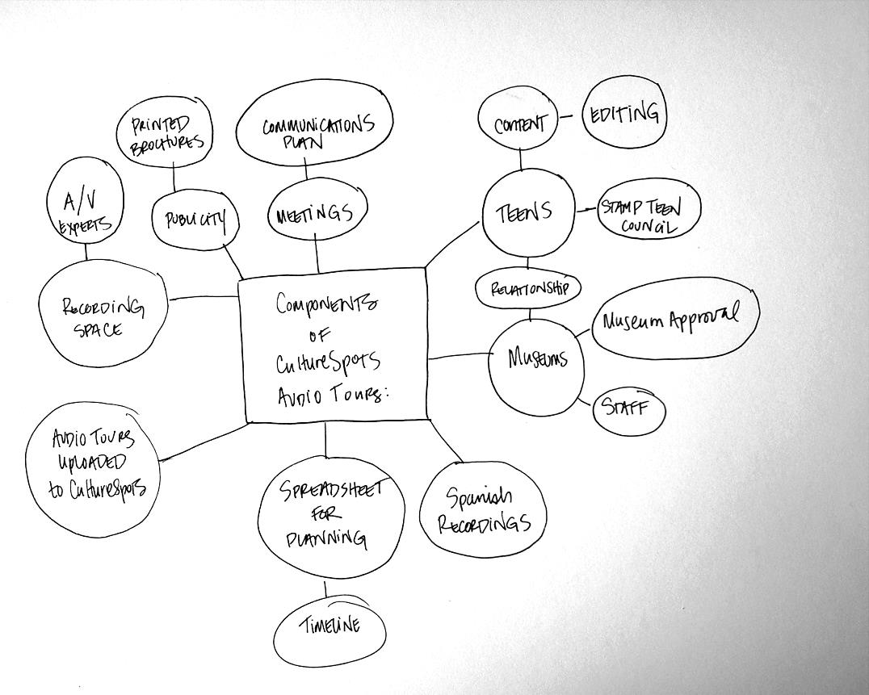

Slide 12
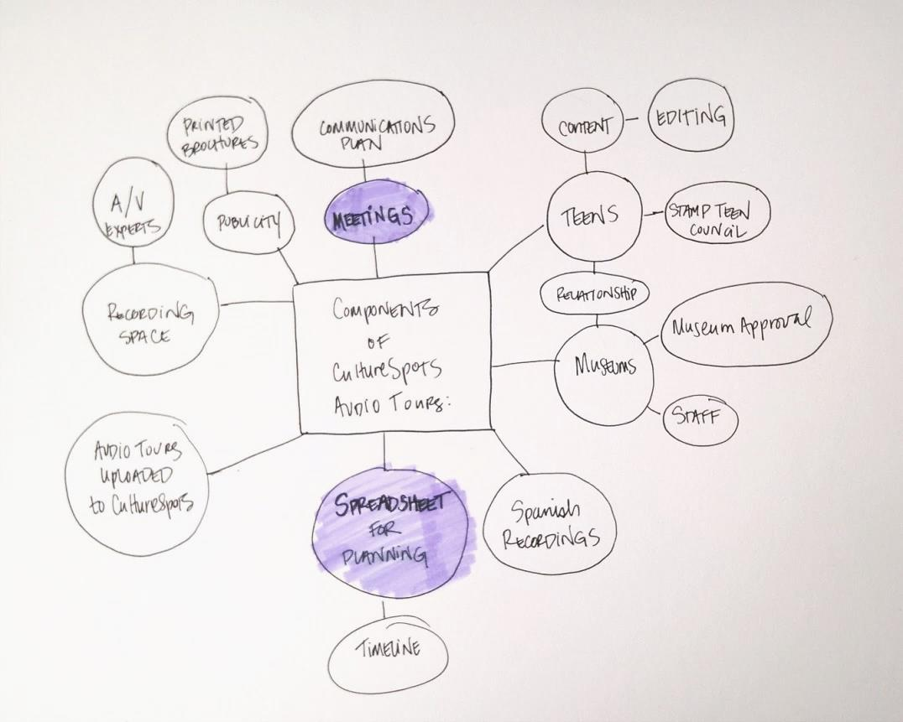

Slide 13
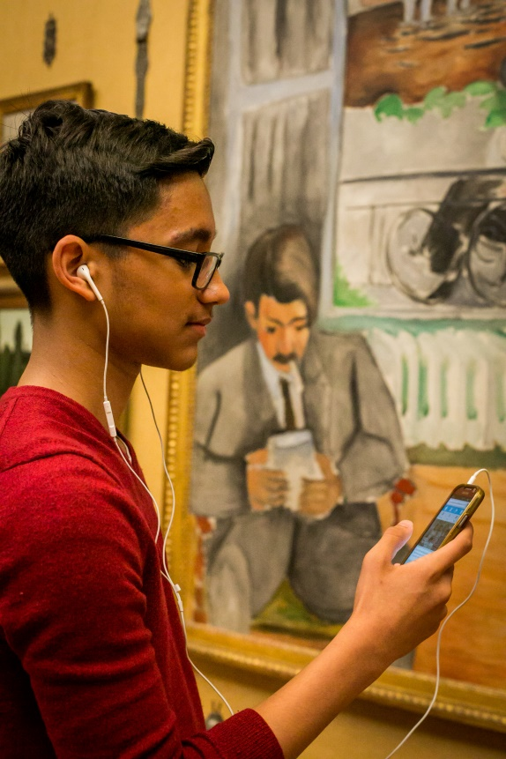


Slide 15
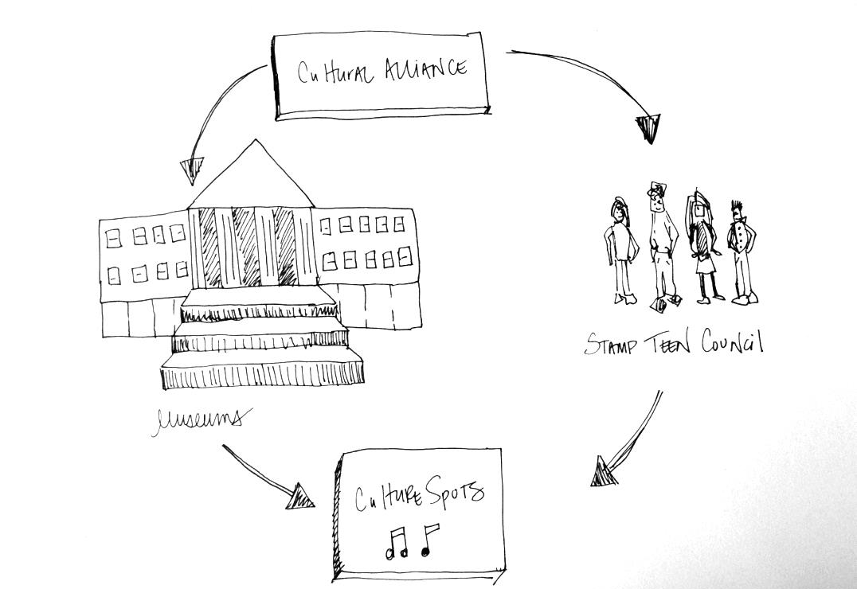

Slide 16
Visitor Experience Conference 2016
“How 15 Philly Museums Are Leveraging Mobile Audio Tour Production Projects to Strengthen Connections with Teen Audiences”
Part III
by Cliff Stevens, Founder & President/CEO, CultureSpots
www.CultureSpots.com - cliff@culturespots.com -
@culturespots on Facebook, Twitter, Instagram and YouTube -
(215) 948 - 2879

Slide 17
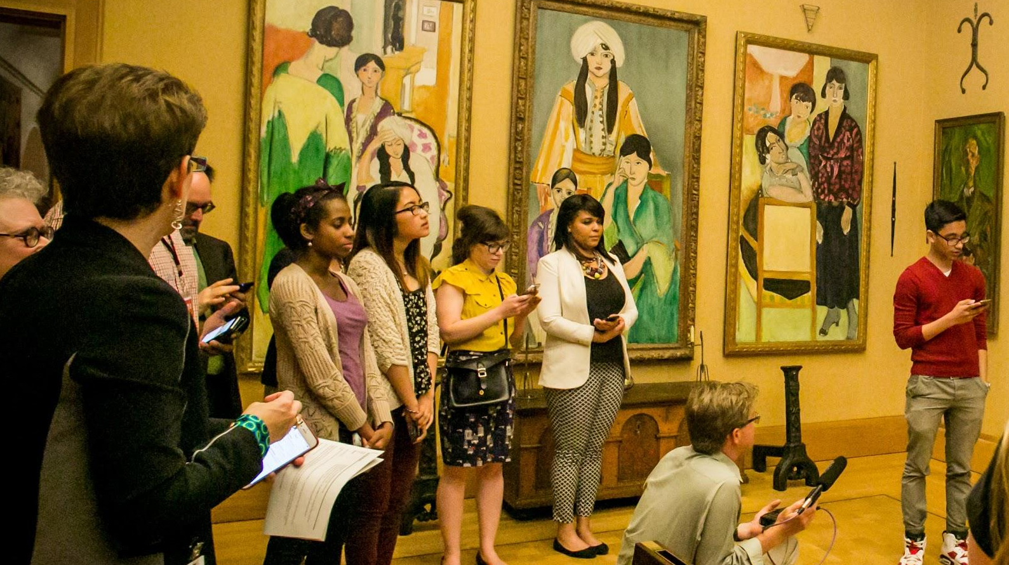
Presentation topics:
What about CultureSpots uniquely empowered the teens participation?
How did the Cultural Alliance/STAMP interface with CultureSpots?
How did the teens interface with CultureSpots?
How did the museums interface with CultureSpots?
Where are there opportunities to improve upon and extend these kinds of collaborations?
BONUS: Who else is doing this with CultureSpots?

Slide 18
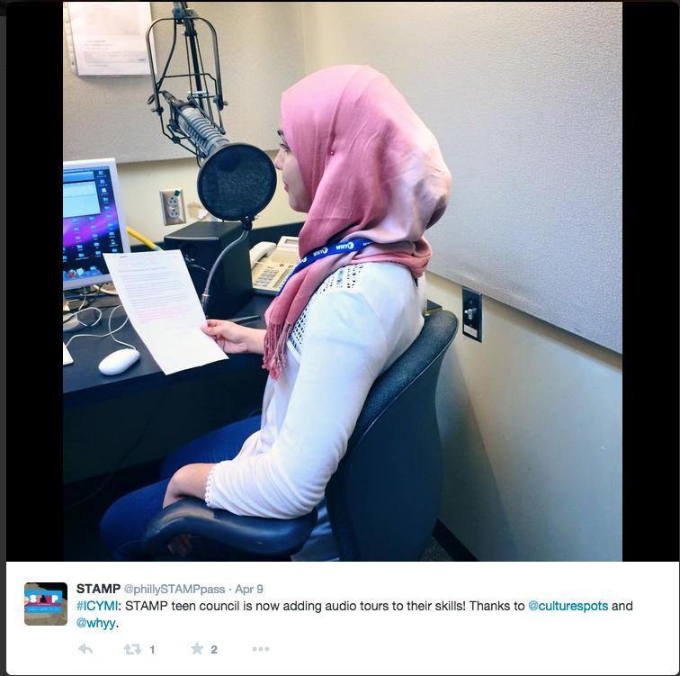
STAMP + CultureSpots empowers young audiences with “DIY - Do It Yourself” and “UGC - User Generated Content”
What about CultureSpots uniquely empowered the teens participation?

Slide 19
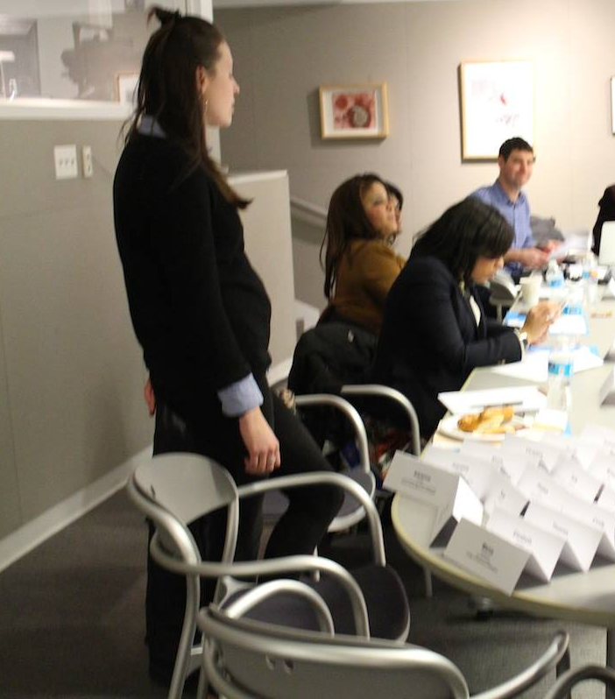
CultureSpots
client support for the Cultural Alliance keeps lines of communication open, flexible, personal and reliable.
How did the Cultural Alliance/STAMP interface with CultureSpots?
Notes:
In person initial system demonstration to organization decision-makers
Staff training and ongoing support
Software system setup, customization/implementation
Online system training via teleconference and remote desktop-sharing
Content publishing, updates and management
Audio editing and production
Image editing
Content production consulting and training
Workshops and Events
Social media, publicity and promotions
Vendor partnering and collaborations
Third party software training (ex: Audacity)
Signage, labels and printed material design/consulting
Copy writing/editing/coaching

Slide 20
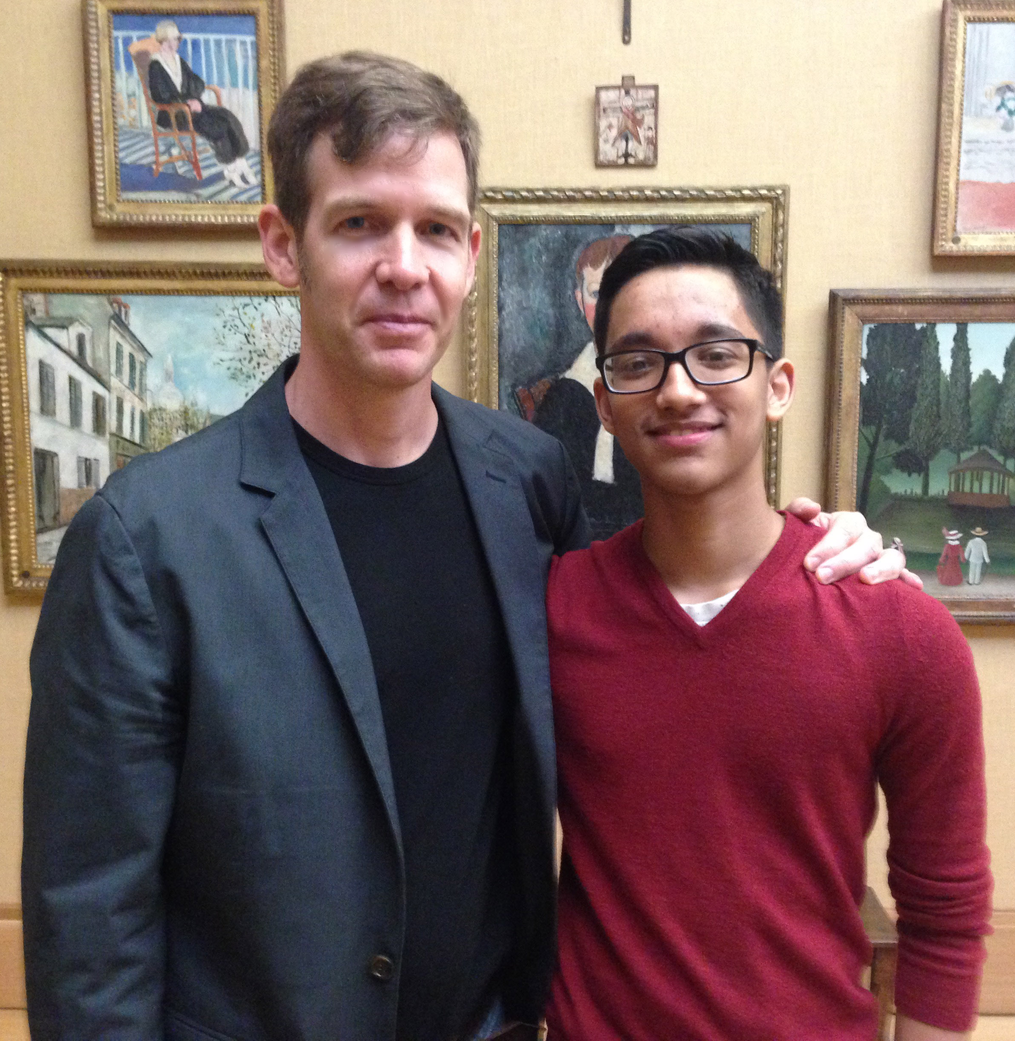
STAMP + CultureSpots provides Teen Council members with in-person, hands-on audio tour production training, best practices workshops, events and txt/email availability.
How did the teens interface with CultureSpots?
Cliff Stevens, CultureSpots Founder/CEO & Asef Khurshan, STAMP Teen Council

Slide 21

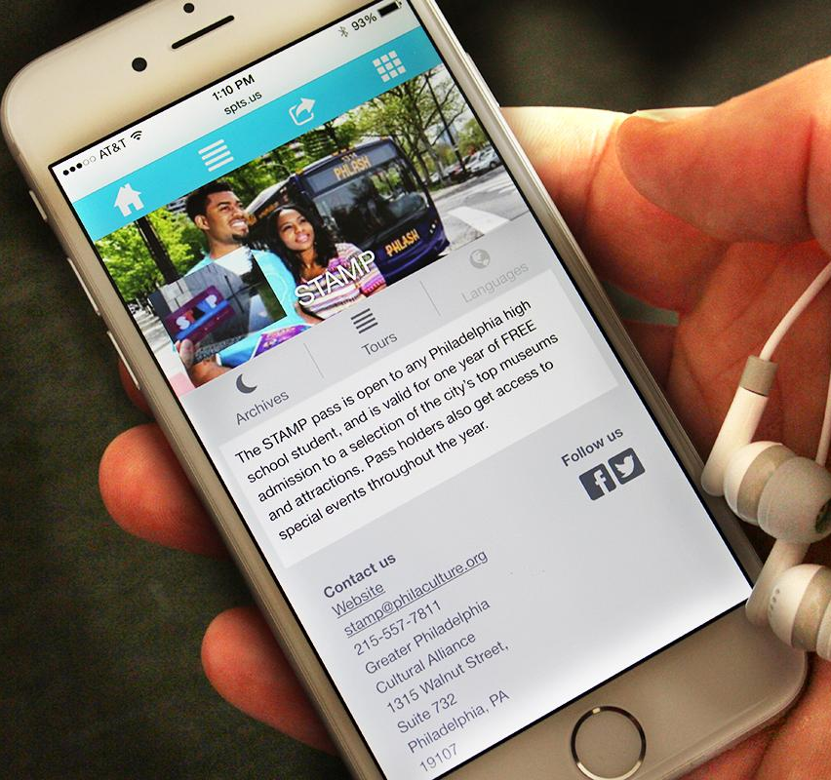
STAMP + CultureSpots
enabled museums to connect with young audiences by leveraging the web and mobile technologies they already know and love.
How did the museums interface with CultureSpots?
Notes:
In this case, GPCA interfaced with museums, BUT we DID help with:
System demonstration and best practices workshop
Tour design and management
Printed material design consulting (signage, handouts, labels, etc.)
Teen Council member training and coaching

Slide 22
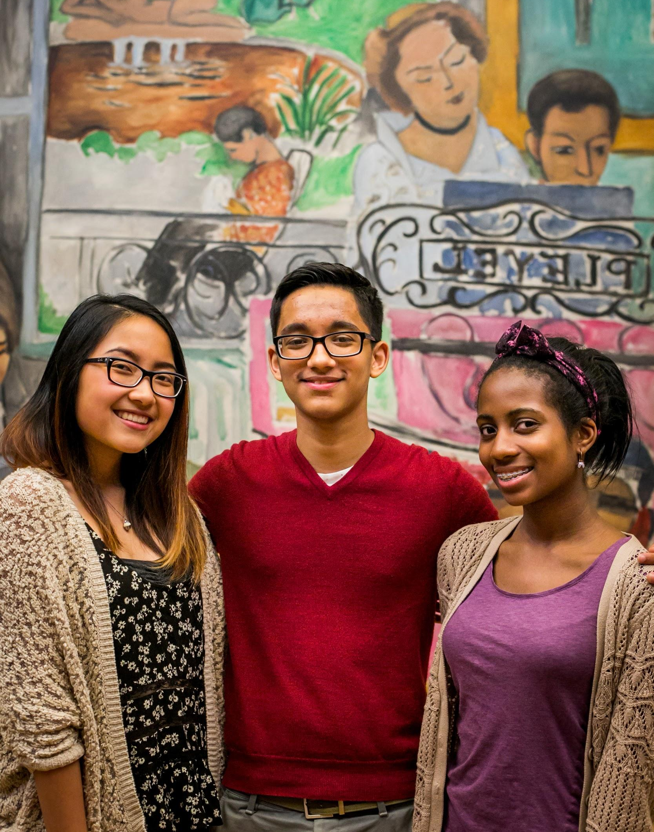
Where are there opportunities to improve upon and extend these kinds of collaborations?
Notes:
More advance preparation and planning.
More and better printed materials, signage, labels.
More and better online marketing and promotion.
Better photography.
More in-house audio production.
More access to museum staff.
More risk-taking.

Slide 23
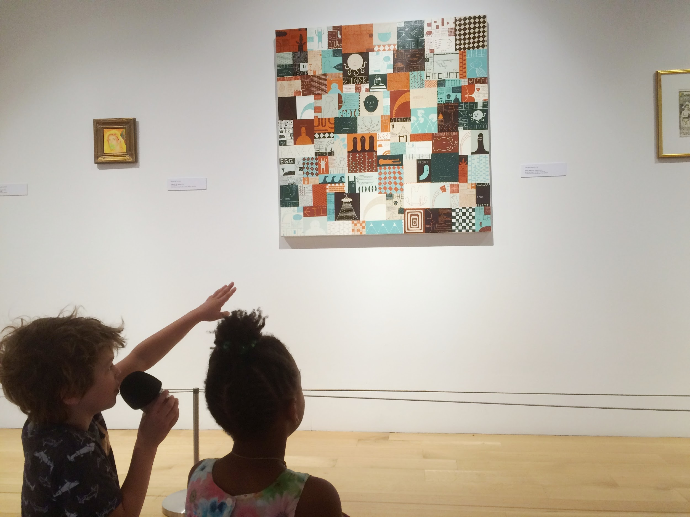
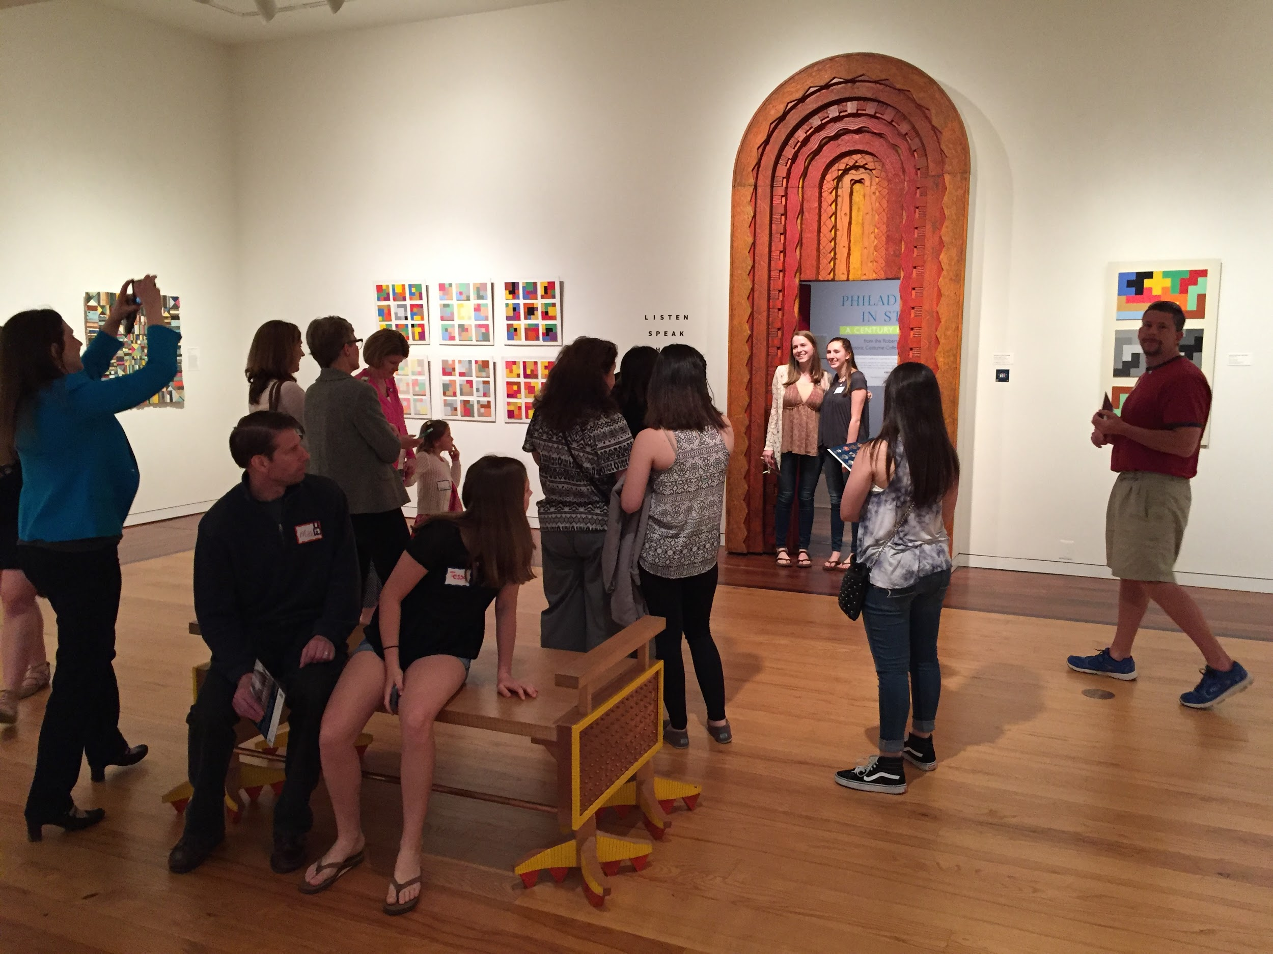
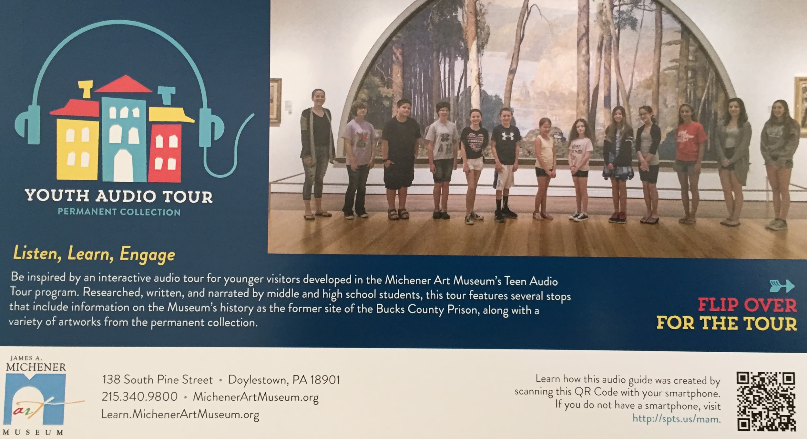
BONUS: Who else is doing this nearby?
PAFA: “Tiny Voices”
Michener Art Museum: “Youth Audio Tour”
LISTEN HERE: spts.us/pafa
LISTEN HERE: spts.us/mam
Notes:
Here’s who else is doing this with CultureSpots… (PLAY EXAMPLES TO THE AUDIENCE)
PAFA - “Tiny Voices” - http://spts.us/pafa - Elizabeth Hamilton (Teen Programs Coordinator)
> Article in Philly Voice = http://www.phillyvoice.com/pafa-got-children-critique-art-cute-youd-expect/
Michener Art Museum - “Youth Audio Tour” - http://spts.us/mam - Ruth Anderson (Director of Arts Education), Adrienne Neszmelyi-Romano (Director of Interpretation and Innovation)
> Press release = http://www.michenerartmuseum.org/article/1819/michener-art-museum-launches-youth-audio-tour/
> “Researched, written, and recorded by student docents, the audio tour provides visitors with detailed descriptions of various pieces included in the Museum’s Permanent Collection. With guidance from Michener teachers and college interns, these students (ages 10-15) have delivered unique but concise perspectives on art within the Michener’s galleries.”
University of Pennsylvania, Arthur Ross Gallery - http://spts.us/arg - Sara Stewart (Assistant Director of Development and Marketing)
OTHERS:
University of New Hampshire, Museum of Art - http://spts.us/moaunh
University of Mary Washington, UMWGalleries - http://spts.us/umwgalleries
Randolph College, Maier Museum of Art - http://spts.us/maier-museum
Lynchburg College, Daura Gallery - http://spts.us/dg
Utah State University, Nora Eccles Harrison Museum of Art - http://spts.us/nehma
Kent State, SLIS MuseLab - http://spts.us/muselab
SOON:
Moore College of Art
Peeler Art Center, DePauw University
Cape Elizabeth High School (Maine)
ARCHIVED/INACTIVE:
Vanderbilt University, Fine Arts Gallery - http://spts.us/vfa
As per Rachel @ UMW: our first use of Culturespots we were lucky to have arranged a Statewide exhibition from the Virginia Museum of Fine Arts entitled, The French Horse from Romanticism to Surrealism: Works from the Virginia Museum of Fine Arts. This exhibition was actually also a collaborative/ pilot endeavor with art history students from Universities all over Virginia that participated in a curatorial class at the Virginia Museum of Fine Arts. Under the guidance of the VMFA Curator, Mitchell Merling and the Statewide organizers these undergraduate students wrote the wall labels for the exhibit. The exhibit was then a part of the VMFA statewide exhibition program and went to the University of Richmond, the National Sporting Museum, and finally, to the UMW Galleries. Since it had been traveling for a year, many of the students had graduated or were not interested in the show anymore but I did get a few to record the labels that they wrote. I also recorded a few to even out the exhibition.
So these students were not teens per say, but it does provide an example of students producing the text (under supervision ) and then recording the audio.
I want to use Culturespots to suite our exhibitions, that necessarily means adapting to the exhibit. Since the galleries have a very active exhibition cycle that shows historical exhibitions (like the French Horse) to contemporary art (like our upcoming show, “Creative Zoology” each audio tour will be different. In the spring semester for example, we have all of our student exhibitions, and I think it would be really great to have the seniors record their artist statements so that visitors can listen and walk around instead of having a half-dozen page long statements to read.

Slide 24
3 Takeaways:
1.Understanding your stakeholders
2.Planning good communications
3.Audience development

Slide 25
Thank you!
Tracy Buchanan – tracyb@philaculture.org
Erin De Rosa – erind@philaculture.org
Cliff Stevens - cliff@culturespots.com

