Slide 1

Guest Experience is a
Community Project
Notes:
Connie will start-Good Morning… My name is Connie McCaw and I would like to take a moment to thank the team of dedicated volunteers and organizers of this Visitor Experience Conference, let us give them a round of recognition!
When I found out this year’s theme for the Visitors Experience Conference was Collaboration I immediately thought my positive experiences working with community, cultural institutions and setting the stage in delivering guest experience. Delivering Guest Experience Excellence is a community project.

Slide 2
Goals of Session
Build a guest experience model for your community.
Foster collaboration with your local tourism entity, cultural attractions and localities to promote and create a brand of guest experience excellence.
Become brand ambassadors by delivering guest excellence and reap the benefits of economic wealth.
Notes:
Our goal is to promote the idea of working together with your local tourism entity, your neighbors, cultural institutions, local businesses with one goal=deliver an exceptional guest experience to gain guest loyalty and transform your guest in to brand ambassadors be inviting, give the guest reason to come back by creating a positive community experience….

Slide 3

Shared Vision
Guest Experience is everyone’s project
Notes:
Every guest touch point is part of the experience, the cab ride, the local bistro, the hotel, the web-site

Slide 4



Introductions
Notes:
Each of us has worked together in our separate entities but act collaboratively with one goal-Guest Experience Excellence -Connie Introduces Susan by saying- Susan Hamley is the Executive Director of the Chester County Conference & Visitors Bureau, I had the pleasure of working with Susan while serving on the Board of Directors during my tenure at Longwood Gardens, it was my first experience working with a Bureau, Susan is an exceptional leader who is a risk taker has actively promotes collaboration between her fellow tourism professionals. Susan loves fresh mushrooms so it’s only fitting that she lives in Kennett Square, the Mushroom Capital of the World. Susan introduces Carol, Carol is a highly respected cultural consultant who works with all types of organizations to increase their understanding of the intricacies and impact of culture and unique cultural differences. Our Visitor’s Bureau has engaged Carol’s firm to educate our partners about Cultural Sensitivity, especially as we embrace the growing number of international visitors, so the experience is welcoming to all regardless of cultural practices and beliefs. I understand she is quite fond of chocolate. Carol introduces Connie, Carol I am a member of Longwood Gardens and approached Connie about international strategy and …...Connie is exceptional at working with organizations in connecting basic practices for front line staff to CEO’s in creating guest focused cultures...Connie began her customer service career at the age of 8 while working at her parents dog kennel waiting on customers even the four legged kind…..

Slide 5

Imagine
Notes:
Connie-Put your sunglasses on and If you like close your eyes….IMAGINE this ..you have just traveled from Ireland and have never been to the US before …you have just landed at the Philadelphia Airport and the airline attendant at your gate says “welcome to Philadelphia” the city of brotherly love, let me know how I can help you …you proceed to get your luggage which arrives just as you reach the pick up area..a airport staff person is directing arrivals to the various pick up points, you have arranged for a ride on uber, the driver is waiting for you and greets you by name “Patrick “opens the door takes your bag and says welcome to Philadelphia what brings you to the US, you reply I am here on vacation and am spending time in Philadelphia going to the Barnes, Philadelphia Art Museum and see some of the country side. The uber driver pulls out the Bureau visit guide and starts talking about the area and personally recommends Longwood Gardens, Brandywine River Museum you pull up to the Hilton where a staff person has just finished cleaning the windows they stop what they are doing and say welcome and show you the way to the front desk, your check in is flawless and the hotel is offering flavored waters with fruit and cookies the lobby is bustling with activity, you take the elevator and again see an ad for places to visit in Philadelphia and Chester County.arrive at your room your room is clean, there is a complimentary water in the mini fridge, you sit the bed ah it has one of those pillow top covers, resting for just a moment you decide to begin exploring the city step out on to Broad street and the front door staff say where are you headed, you reply I don’t know first time here..I am a little hungry for local Philadelphia food what do you recommend? Well Philly has every food you can imagine …on the return flight home you think to your self what a welcoming City and beautiful countryside I got to see everything I read about and everyone was so friendly, my friends at home loved my posts on Facebook and twitter posts Patrick returns to the office and tells 10 of his closest colleagues about his visit to the US

Slide 6
Quiz
What is the number one reason a customer will not go back to a restaurant?
Bad food
Dirty restroom
Rude Service-ignored
Notes:
Connie Audience interacts with cell phone or can just call it out (get them talking)

Slide 7
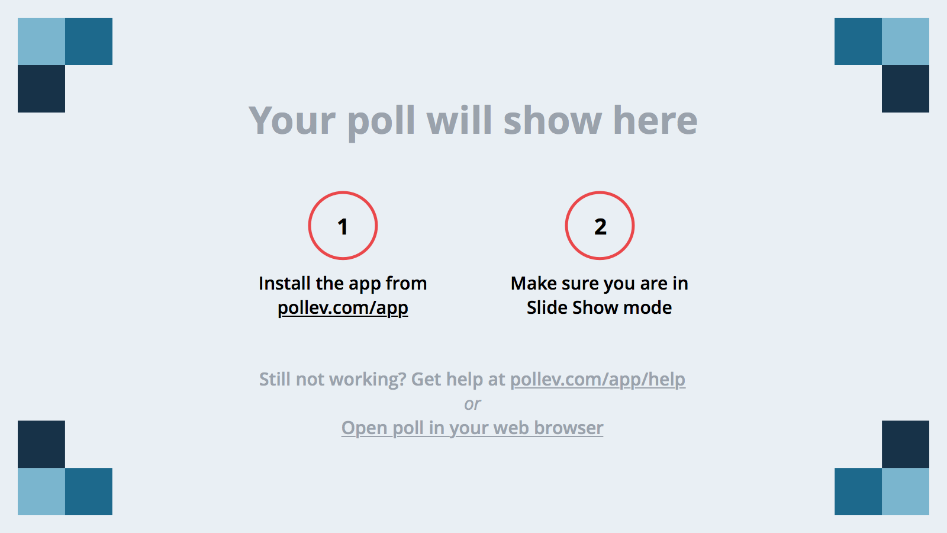
Notes:
Poll Title: What is the number one reason a customer will not go back to a restaurant?
https://www.polleverywhere.com/multiple_choice_polls/eFfzMmwKJDzGKcB

Slide 8
Quiz
How many Chinese visitors are expected to travel overseas in 2020?
1) 20 million
2) 65 million
3) 100 million

Slide 9
Notes:
Poll Title: How many Chinese visitors are expected to travel overseas in 2020?
https://www.polleverywhere.com/multiple_choice_polls/P9daAw1vyhLBtAT

Slide 10
Quiz
Which of the following are tourism businesses?
Restaurants
Hotels
Retail Shops
Transportation
All of the above
Notes:
Tourism is one of the largest industries in the U.S. And yes, all of the above are tourism businesses. But so are other industries that don’t come as easily to mind, like, landscapers who keep the ground manicured, tent rental companies for larger events, farmers supplying food to restaurants, audit and law firms … you get the picture.

Slide 11
Notes:
Poll Title: Which of the following are tourism businesses?
https://www.polleverywhere.com/multiple_choice_polls/VqQnW6de9eIwb2f

Slide 12
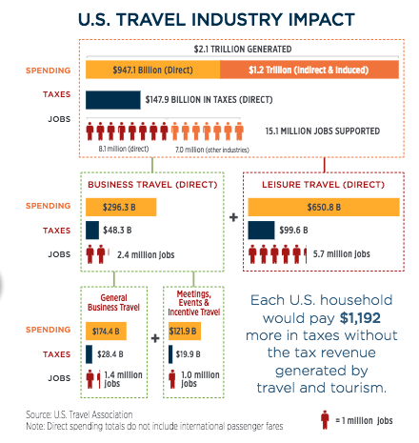
Notes:
Here are some stats that illustrate the viral impact of tourism on our economy. In Chester County where I live and work, it’s the #2 economic driver.

Slide 13
Linking Experiences =
Positive Community Impact
Pre-
Visit
Community
Brand Ambassadors
Guest Loyalty
During Visit
Cultural Attraction
Shared
Vision
Post-
Visit
Notes:
For the purposes of today’s discussion we are sharing tips and actual examples of how preparing for the guest, delivering during the visit and managing the post visit will result in guest loyalty. How many of you have made a guest happy or tour group happy because your team was prepared and the visit was well planned and how many of you have been faced with a guest who has not had a good experience, what was the difference in the guest visit? Susan, Carol and I believe that if you set standards, train your staff and work together as a community to deliver guest excellence, our community as cultural institutions will thrive, we will experience happier guest, increase loyalty and experience better visitation rates, equaling economic impact.

Slide 14
Community Guest Experience Excellence
Pre-Visit
During
Post-Visit
Memorable Experience
Brand Ambassador
Loyalty

Slide 15
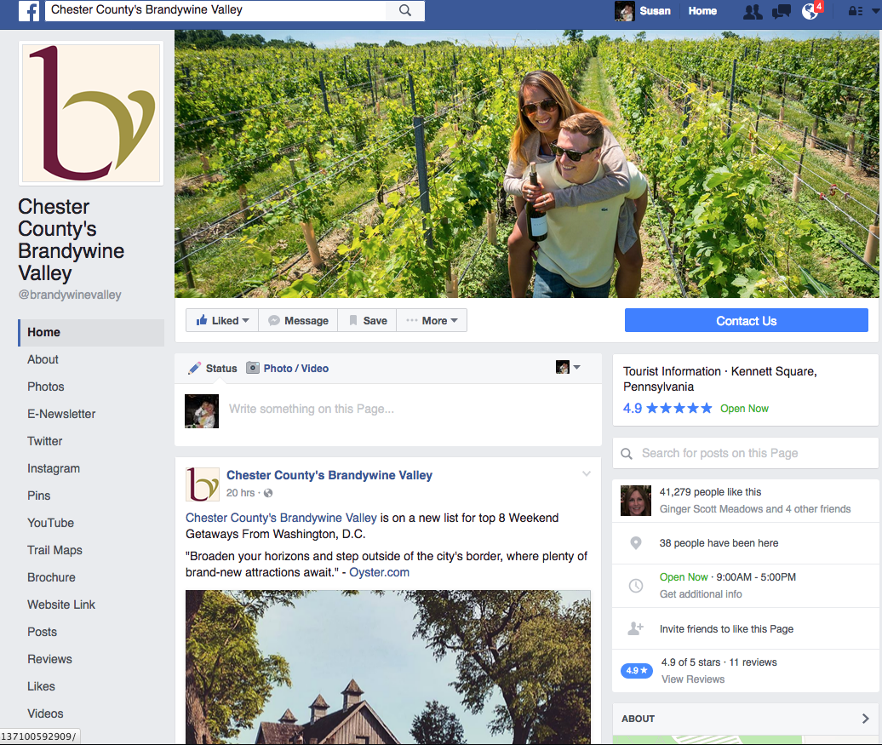
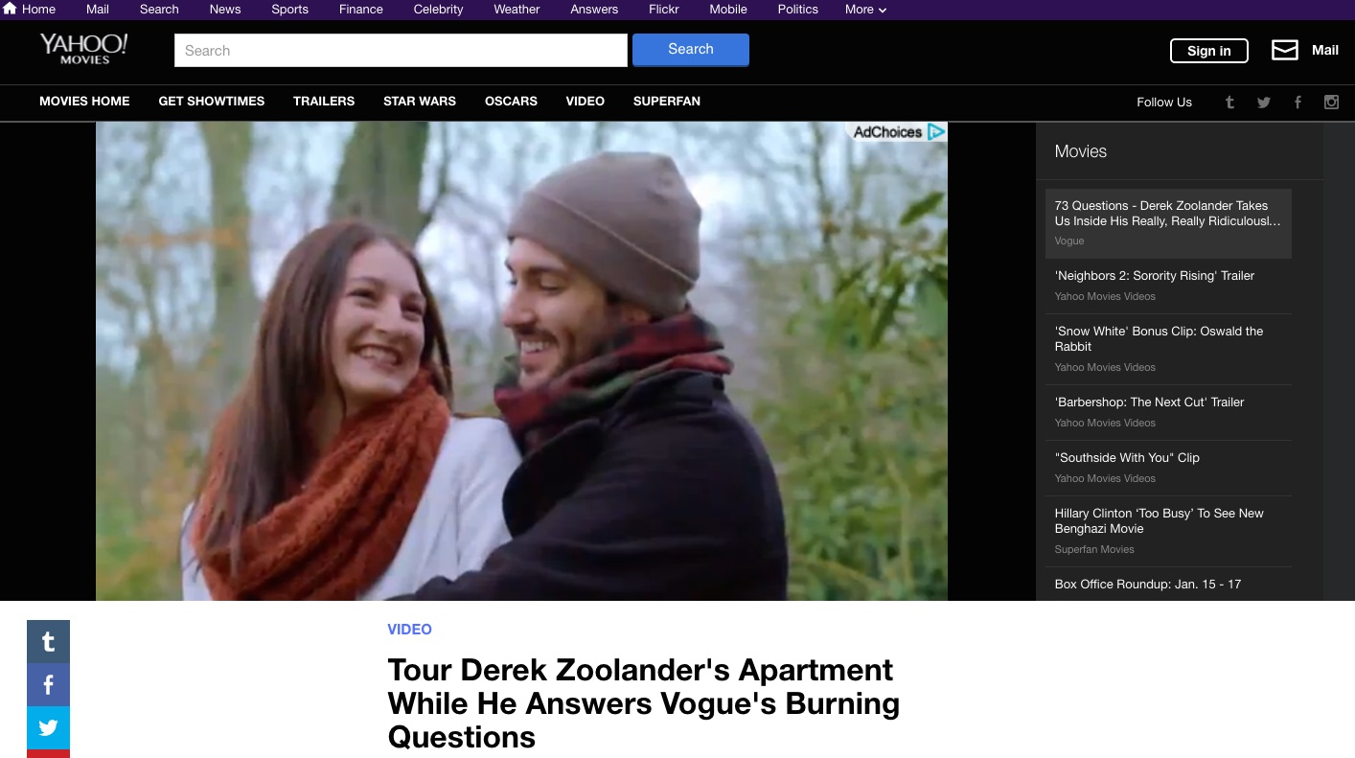
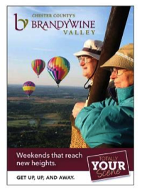



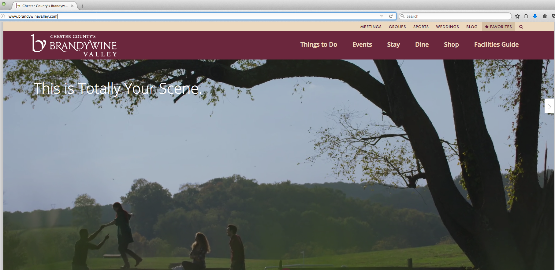
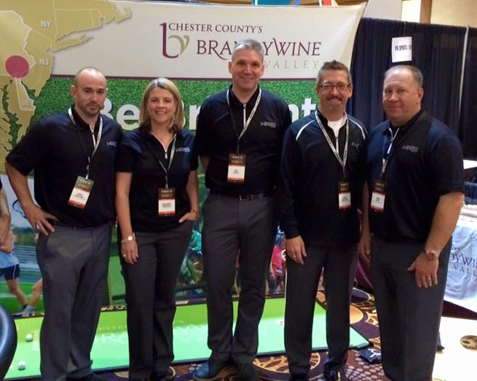
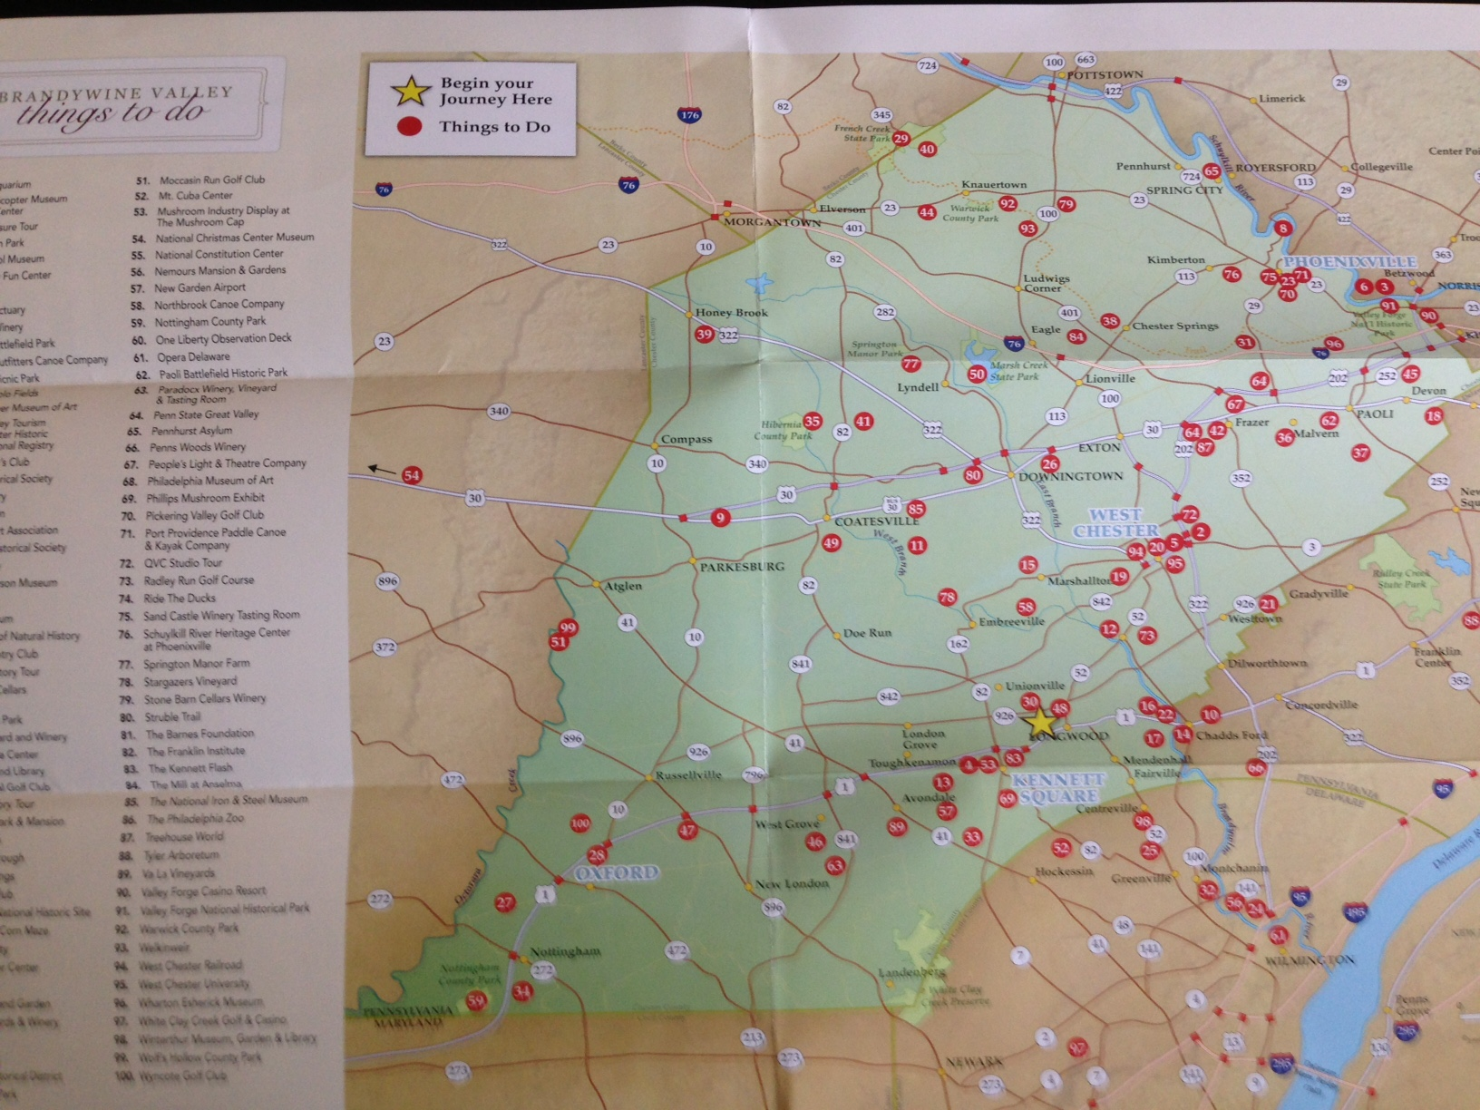
Pre-Visit
Notes:
Various types and levels of advertising and promotion speak to potential visitors to influence them on making a decision to come to your attraction. Your CVB produces a vacation guide, as your own attraction likely does. Online banner ads, social media, radio & t.v. commercials, highway billboards in key markets, magazine articles that come from hosting media. You may have sales people at trade shows selling to leisure travelers and groups. Hopefully it works to get attention and generate interest in a visit. And where does the rubber meet the road?

Slide 16

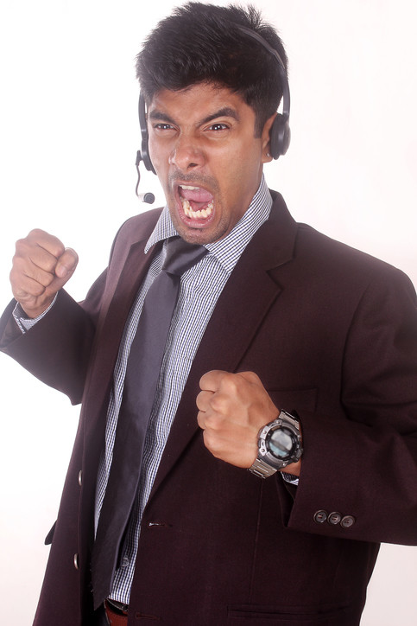
Notes:
Guest Services. When someone calls the phone number in response to the marketing they saw to ask a question or get planning advice, how are they greeted? Do they get this guy who hasn’t had his coffee yet … or this one?

Slide 17


Notes:
This girl who can’t wait to get rid of the caller so she can attend to more important things … or this one who’s genuinely happy to deliver on the brand promise made in marketing communications and help to plan the guest’s perfect experience before they arrive?

Slide 18

Notes:
How fast is the phone answered and messages returned? How quick is the fulfillment turn-around to those requesting a Vacation Guide? Guest Services representatives can make all the difference between solidifying that visit … or losing them entirely to someplace else. And they can make the difference in turning day trippers into overnight stays by suggesting other attractions to visit while they’re in the area for even greater economic impact for everyone – guests don’t care about or want to be bound by geographic lines. So be sure to be their complete guide – chances are they don’t know the lay of the land -- and offer up other ideas beyond your own attraction for a richer experience that they’ll want to tell others about.

Slide 19
GEMS-Guest Experience Model-Pre-Visit
People
Board
CEO
Community
Interns
Staff
Volunteers
Experience
Brand
Standards
Contact Points
Resolution Process
Tools
Systems
Communication
Methods
Training
Values
Feedback
Customer Surveys
Front-line staff
Social Media
Print Media
Goal
Loyalty
Impact
Reputation
Finances
Notes:
Connie-Preparing for the guest-
Connie- Is your cultural institution ready to make a great first impression- Let me take a moment and ask the audience-how many minutes does it take for a person to form an opinion or a first impression ? It actually takes 3 seconds over the phone and 5 seconds in person, so let us take a moment and ask ourselves, how we are preparing for the guest prior to the arrival 1- Web accuracy especially home and ticket page 2- Who ever is answering the phone 3-

Slide 20

Tend to be Domestic/Self Centric
Need to see our interactions through a different lens
Be aware of your own cultural and biases
Observe and understand rationale for counterparts view point
Identify gaps and adapt
Notes:
Carol

Slide 21
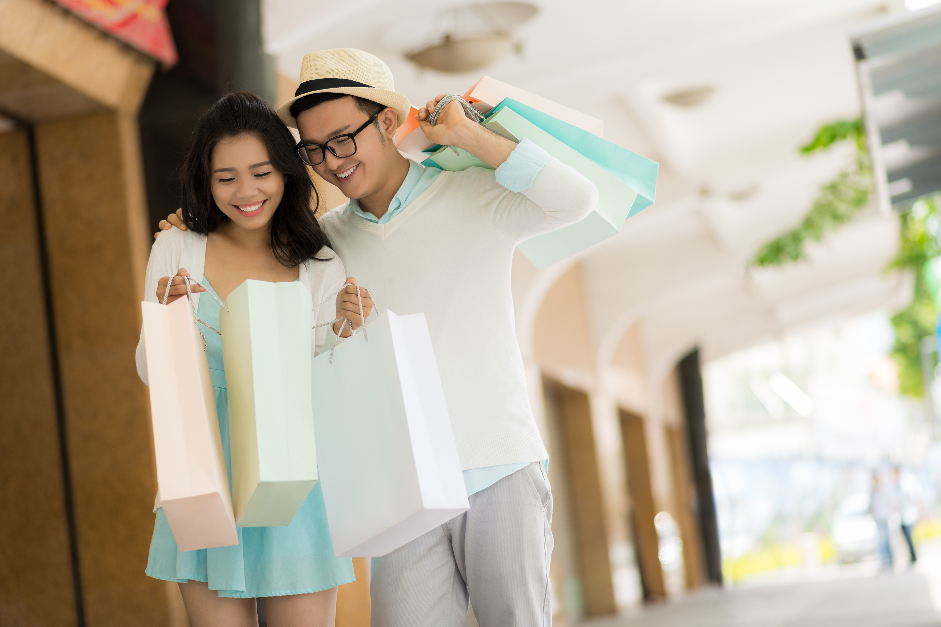
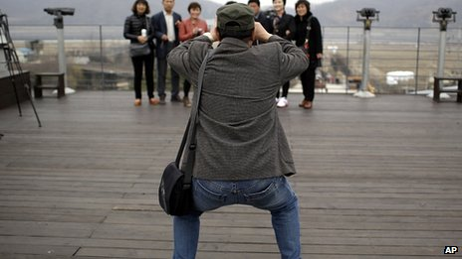
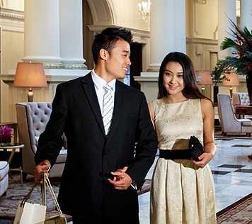
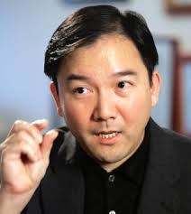
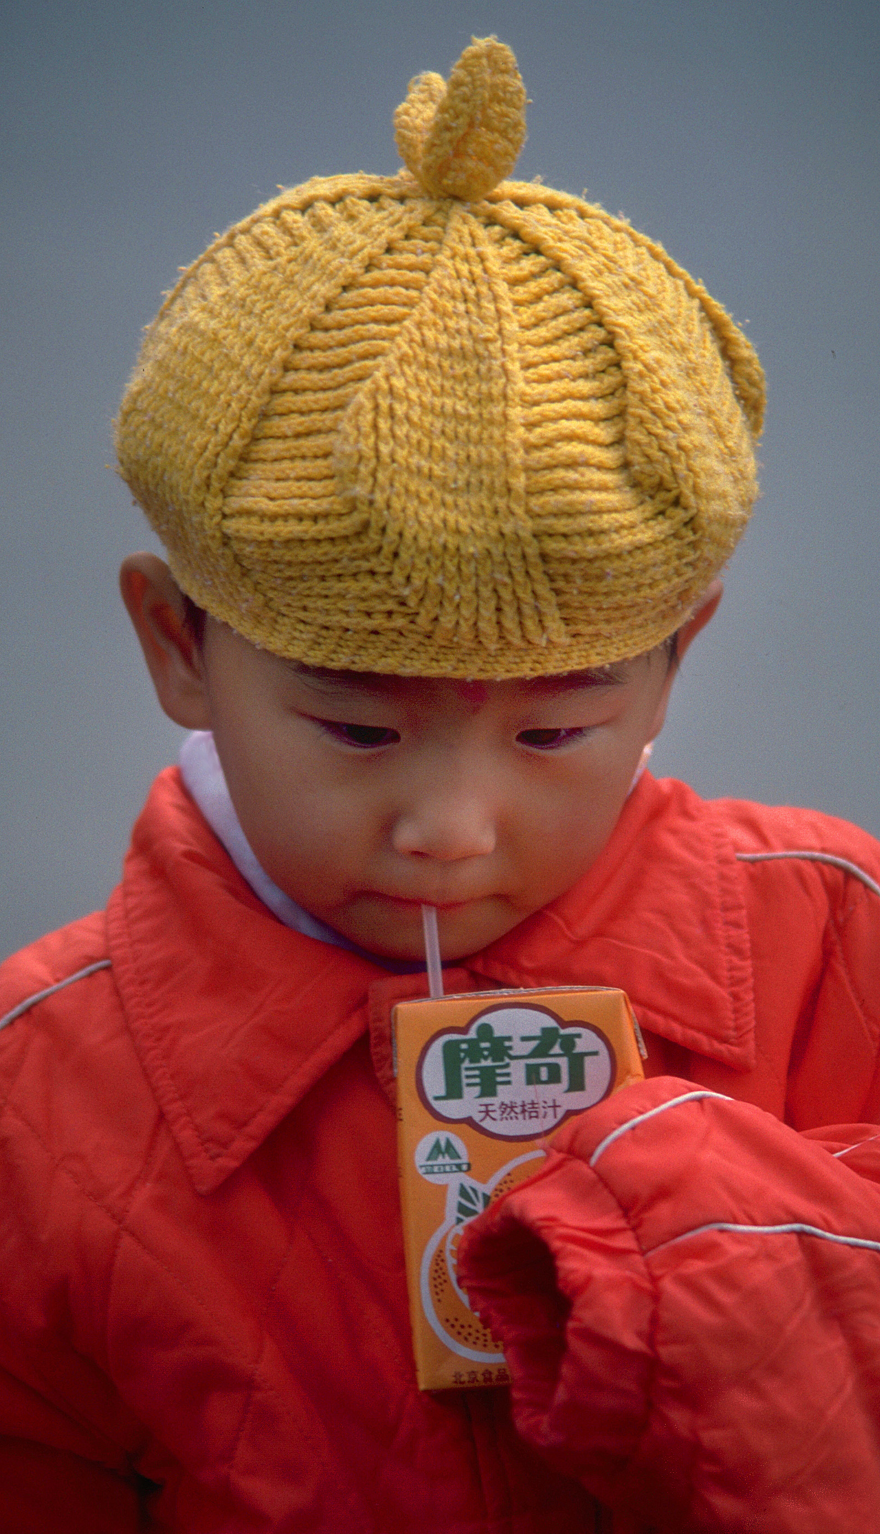
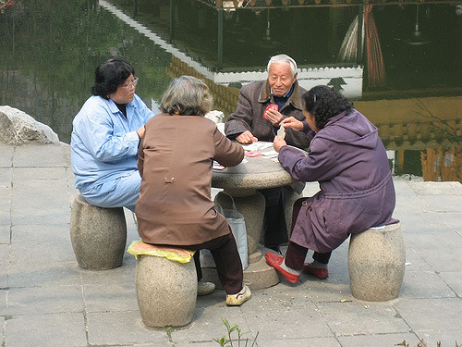

Slide 22
What Do They Need?
“We like genuine western hotels, but we would appreciate a Chinese touch in the conception of breakfast menus, or the fact that the staff can speak a few words in our language.”
“We want to experience America and American ways but want to feel comfortable and know that Americans respect our culture, and provide us with what we need to enjoy the experience.”
Notes:
Carol

Slide 23
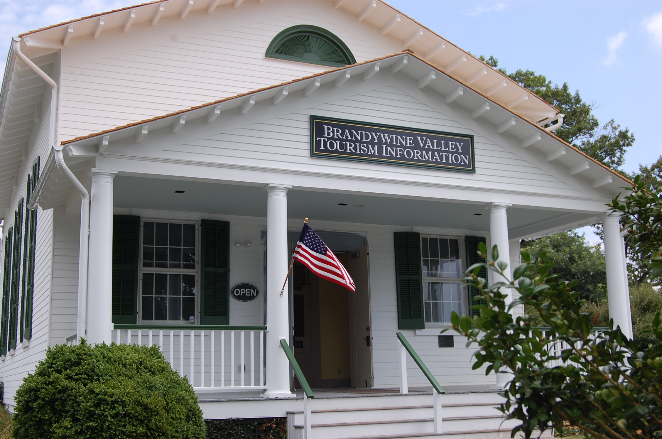
During
Notes:
So people have seen the advertising and made a decision to visit. Often the first stop is the Visitors Bureau so they can fine-tune their trip and learn about what else there is to see and do other than any specific places that drew them in. Make sure your Visitors Center is stocked with your brochures. Let them know in advance about any special events you’re having and if there are promotional deals so they can share with these guests and encourage them to add your attraction to their itinerary if they came for something else. Their job is to promote you and they need your tools.

Slide 24

During the Visit
Notes:
So the guests have arrived. Every touch point makes an impression on them – positive, or negative – and comes from the level of empathy they get from who greets them first. We’ve had people make our Visitors Center their first stop to be able to vent if they drove through a rainstorm and the kids are tired and, well, they’re grouchy. These folks need an extra level of TLC so we’re prepared with a clean restroom so they can wash up, free treats from Herr’s Snack Factory and a small welcome gift to help them realize we think they’re special. Offer to take a family photo with their cell phone. Our Guest Services reps help them re-plan their stay to make sure they have the best experience possible even with set-backs.

Slide 25
GEMS-Guest Experience Model-During Visit
People
Board
CEO
Community
Interns
Staff
Volunteers
Experience
Brand
Standards
Contact Points
Resolution Process
Tools
Systems
Communication
Methods
Training
Values
Feedback
Customer Surveys
Front-line staff
Social Media
Print Media
Goal
Loyalty
Impact
Reputation
Finances
Notes:
Connie- Is your cultural institution ready to make a great first impression- Your guest will 5 seconds in person, so let us take a moment and ask ourselves, how we are preparing for the guest here are some specifics that will help you make a great first impression 1) before they get to the door ensure the path to your place is clean and well lit 2) staff are representing your brand can a guest tell who the staff are 3) engage appropriately do your staff know how to communicate to guest with different needs? Physical abilities such as hearing or sight impaired 4) tip of the day find a way to invite them back or recommend your cultural neighbor

Slide 26
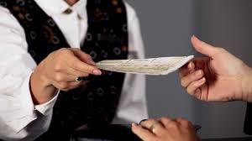
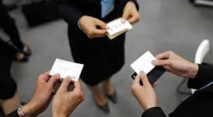

Slide 27
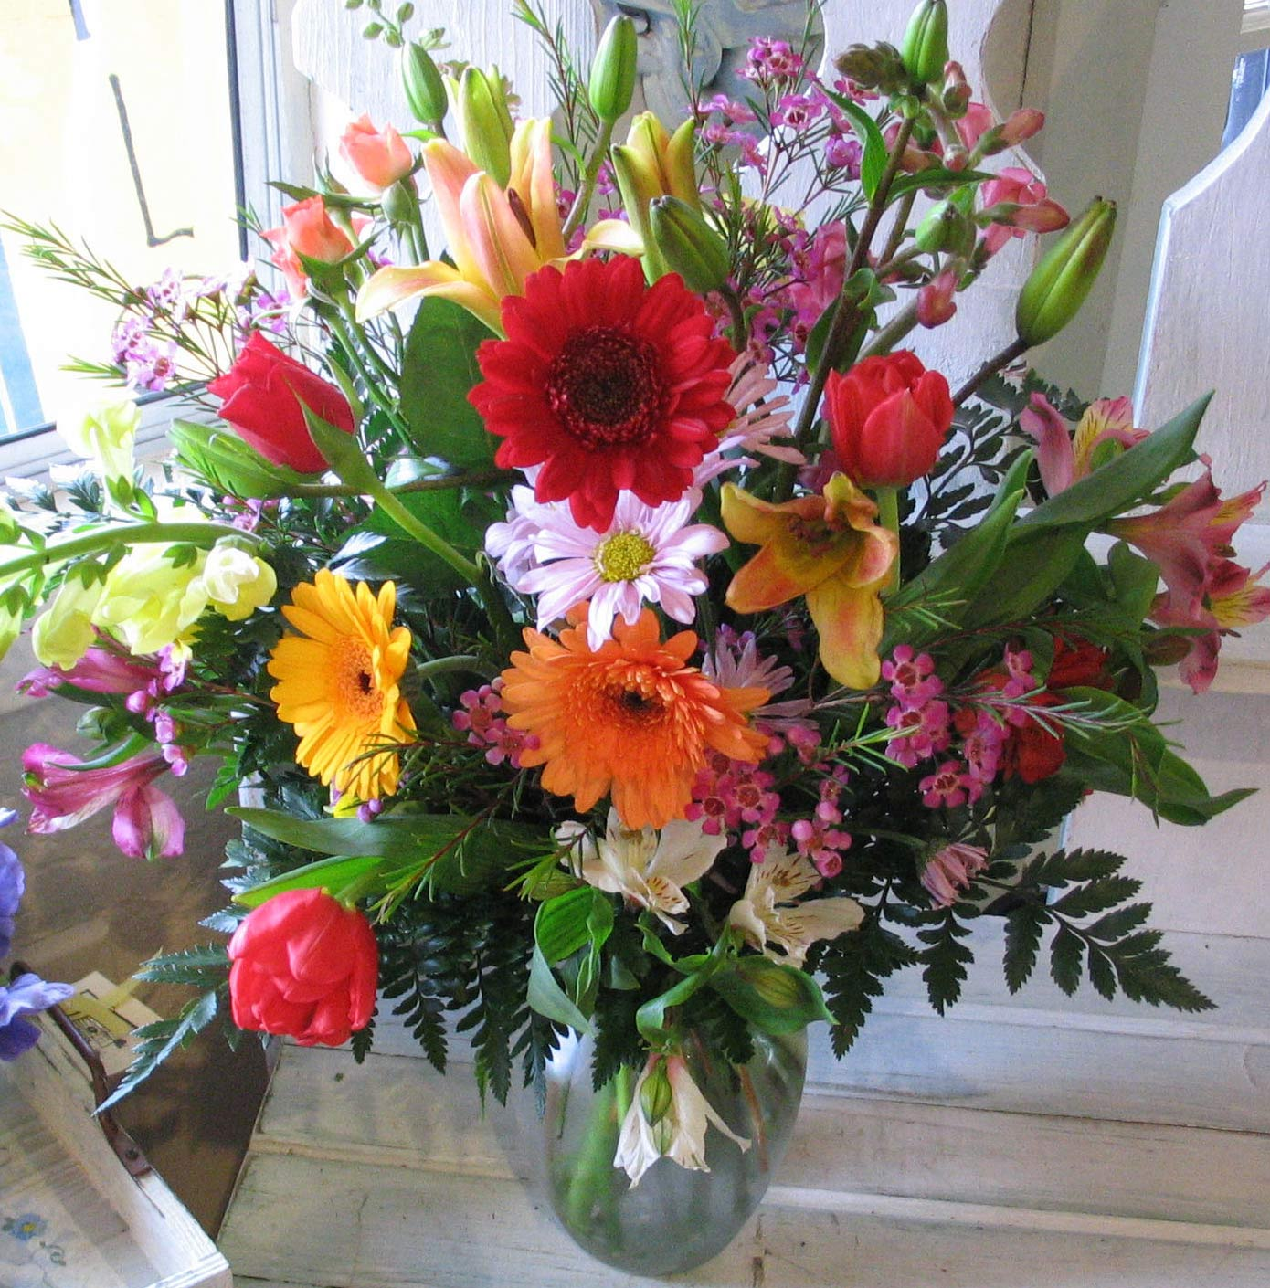


Slide 28

Post Visit
Notes:
Capture their info while they’re here and give them good reasons to engage with your company after they’ve gone, including emails with special deals and posts about the types of things that would interest them to return for. Send a poll to ask for their feedback and suggestions. Also, because your team is the face to these visitors and have seen and heard it all, I encourage you to enlighten your entire organization on feedback and trends Operations or other departments can act on that knowledge. Lastly, CVB’s, attractions, hotels & B&B’s – your visitors may have had a splendid time but we all need to remind them of that and INVITE THEM back. Which takes us full circle back to Pre-Visit.

Slide 29
GEMS-Guest Experience Model-Post Visit
People
Board
CEO
Community
Interns
Staff
Volunteers
Experience
Brand
Standards
Contact Points
Resolution Process
Tools
Systems
Communication
Methods
Training
Values
Feedback
Customer Surveys
Front-line staff
Social Media
Print Media
Goal
Loyalty
Impact
Reputation
Finances
Notes:
Connie How you respond to guest feedback is critical to your business model, Story tell I have had my share of angry guest stories in the last 25 years but this story is a love story ….

Slide 30

Less than 5 % of customers report a problem to management
45% of customers complain to the front line
50% do not bother to complain or go social
Source-TARP, John Goodman
jOhn
tARP
Notes:
Above the surface
At the surface –your best feedback tool – so listen
Below the surface- or worse yet change slide to social media

Slide 31
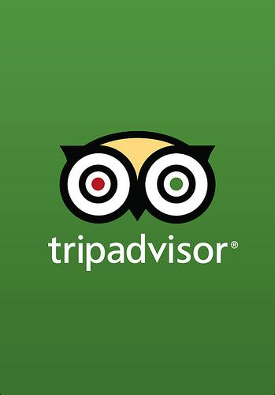







Listen, Learn, Share, Respond = Loyalty
Notes:
How you respond to a guest how quickly you respond and what solution will determine if you earn loyalty

Slide 32

Notes:
Carol, How do we make this sustainable

Slide 33

I will make a commitment to
Guest Experience Excellence……
Notes:
Carol,
Resources-sheet, contact info
Make a commitment-take action
Volunteer will help pass out sheets

Slide 34

Questions
Notes:
Questions from the audience???? THANK YOU FOR ATTENDING OUR SESSION WE WILL ALL BE AT LUNCH TODAY IF YOU HAVE ANY OTHER QUESTIONS

Slide 35

Notes:
You have been a great audience!! We will be staying for lunch so please feel free to connect with us after this session.

