Slide 1

Making Peace with Your Self(ie):
Incorporating Smartphones into the Tour Experience for Fun and Profit
By Michelle Baxter, Heather Dooley, and Samantha Kirk of the National Liberty Museum

Slide 2
Let’s keep the conversation going…
About us
Concept museum
Relatively new to the social media world
Twitter: @LibertyMuseum
Facebook: @NationalLibertyMuseum

Slide 3
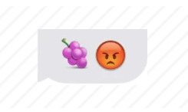
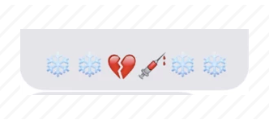
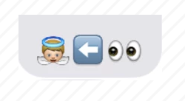
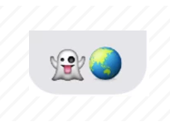
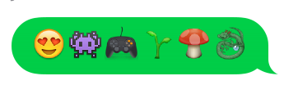
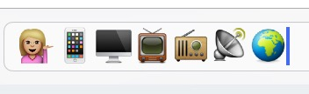

Make an emoji (or emoticon, we won’t judge) sentence and share it with an attendee!

Slide 4
Smartphones: Love ‘Em or Hate ‘Em?
Museum leadership and staff see that mobile device use has potential…but for what?
Museums want to increase engagement using mobile technology; revenue generation is usually a secondary goal
Can strategies to achieve these two goals work synergistically?

Slide 5
Before the Tour
Connect!
Check in about phone use
Create a secure location for phones

Slide 6
During the Tour
Phone as educational tool:
  Explore it
  Observe visitors’ use of it
    #TeamAlan
  Be creative!
Challenges
  Platform incompatibility
  Disengagement

Slide 7
Resources
To share with group leaders
For your institution, or for you personally
http://learning.instructure.com/2014/01/5-apps-to-make-your-school-field-trip-a-success/
http://www.edweek.org/ew/articles/2013/05/15/31fieldtrip.h32.html
Animoto
CultureSpots
Scavify (Android)
Klikaklu (iPhone)
http://www.scholasticatravel.com/2015/05/06/philadelphia-apps/

Slide 8
…but what if there wasn’t a tour?
After the Tour
Connect with group leaders via social media
Photo policy
Again, social media provides a great way to connect with visitors who did not take a guided tour

Slide 9
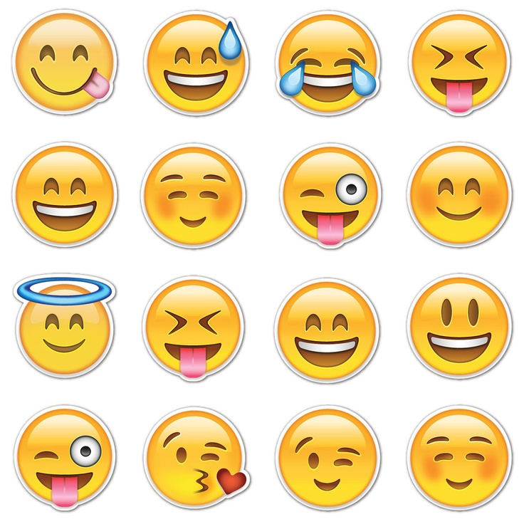
Open Forum

