Slide 1
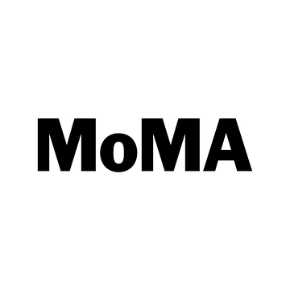
Improving the Visitor Experience through Cross-Departmental Experimentation
MoMA’s Lobby Task Force:
Chiara Bernasconi, Assistant Director, Digital Media
Eliana Glicklich, Project Manager, Building Expansion
Sonya Shrier, Assistant Director, Visitor Services

Slide 2
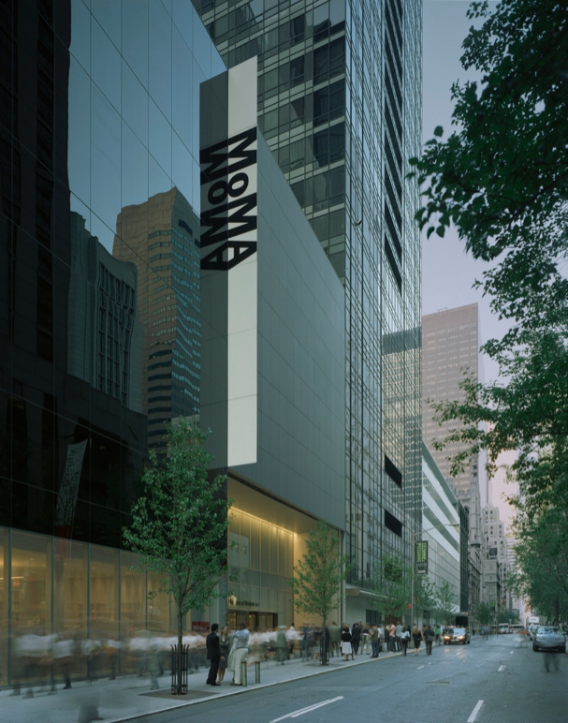
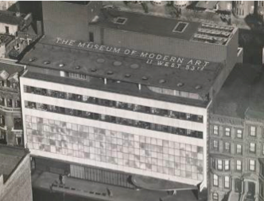
Our ambition:
to be the most engaging museum of modern and contemporary art – for everyone
Notes:
The Museum of Modern art was founded in 1929 as an educational institution – link to the mission
--Our ambition -- To be the most engaging museum of modern and contemporary art – for everyone.

Slide 3
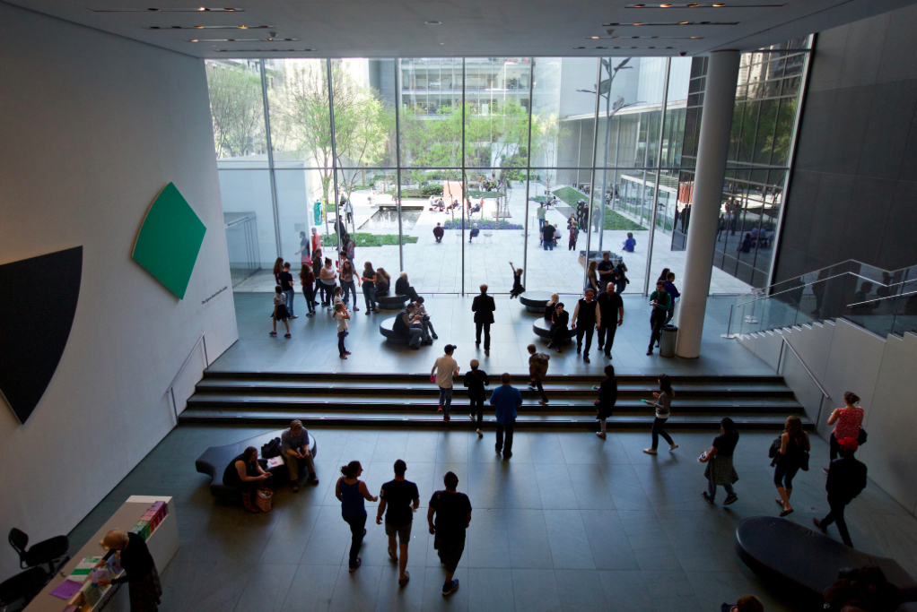
The most welcoming museum
Notes:
Our desire is to create a welcoming entry experience
Why did we form the lobby task force?
The overall driver came from MoMA’s goal to be the most engaging museum in the world. The way you feel at entry and throughout your visit has a very significant impact on the quality of your interaction with the art and your overall impression of the institution

Slide 4
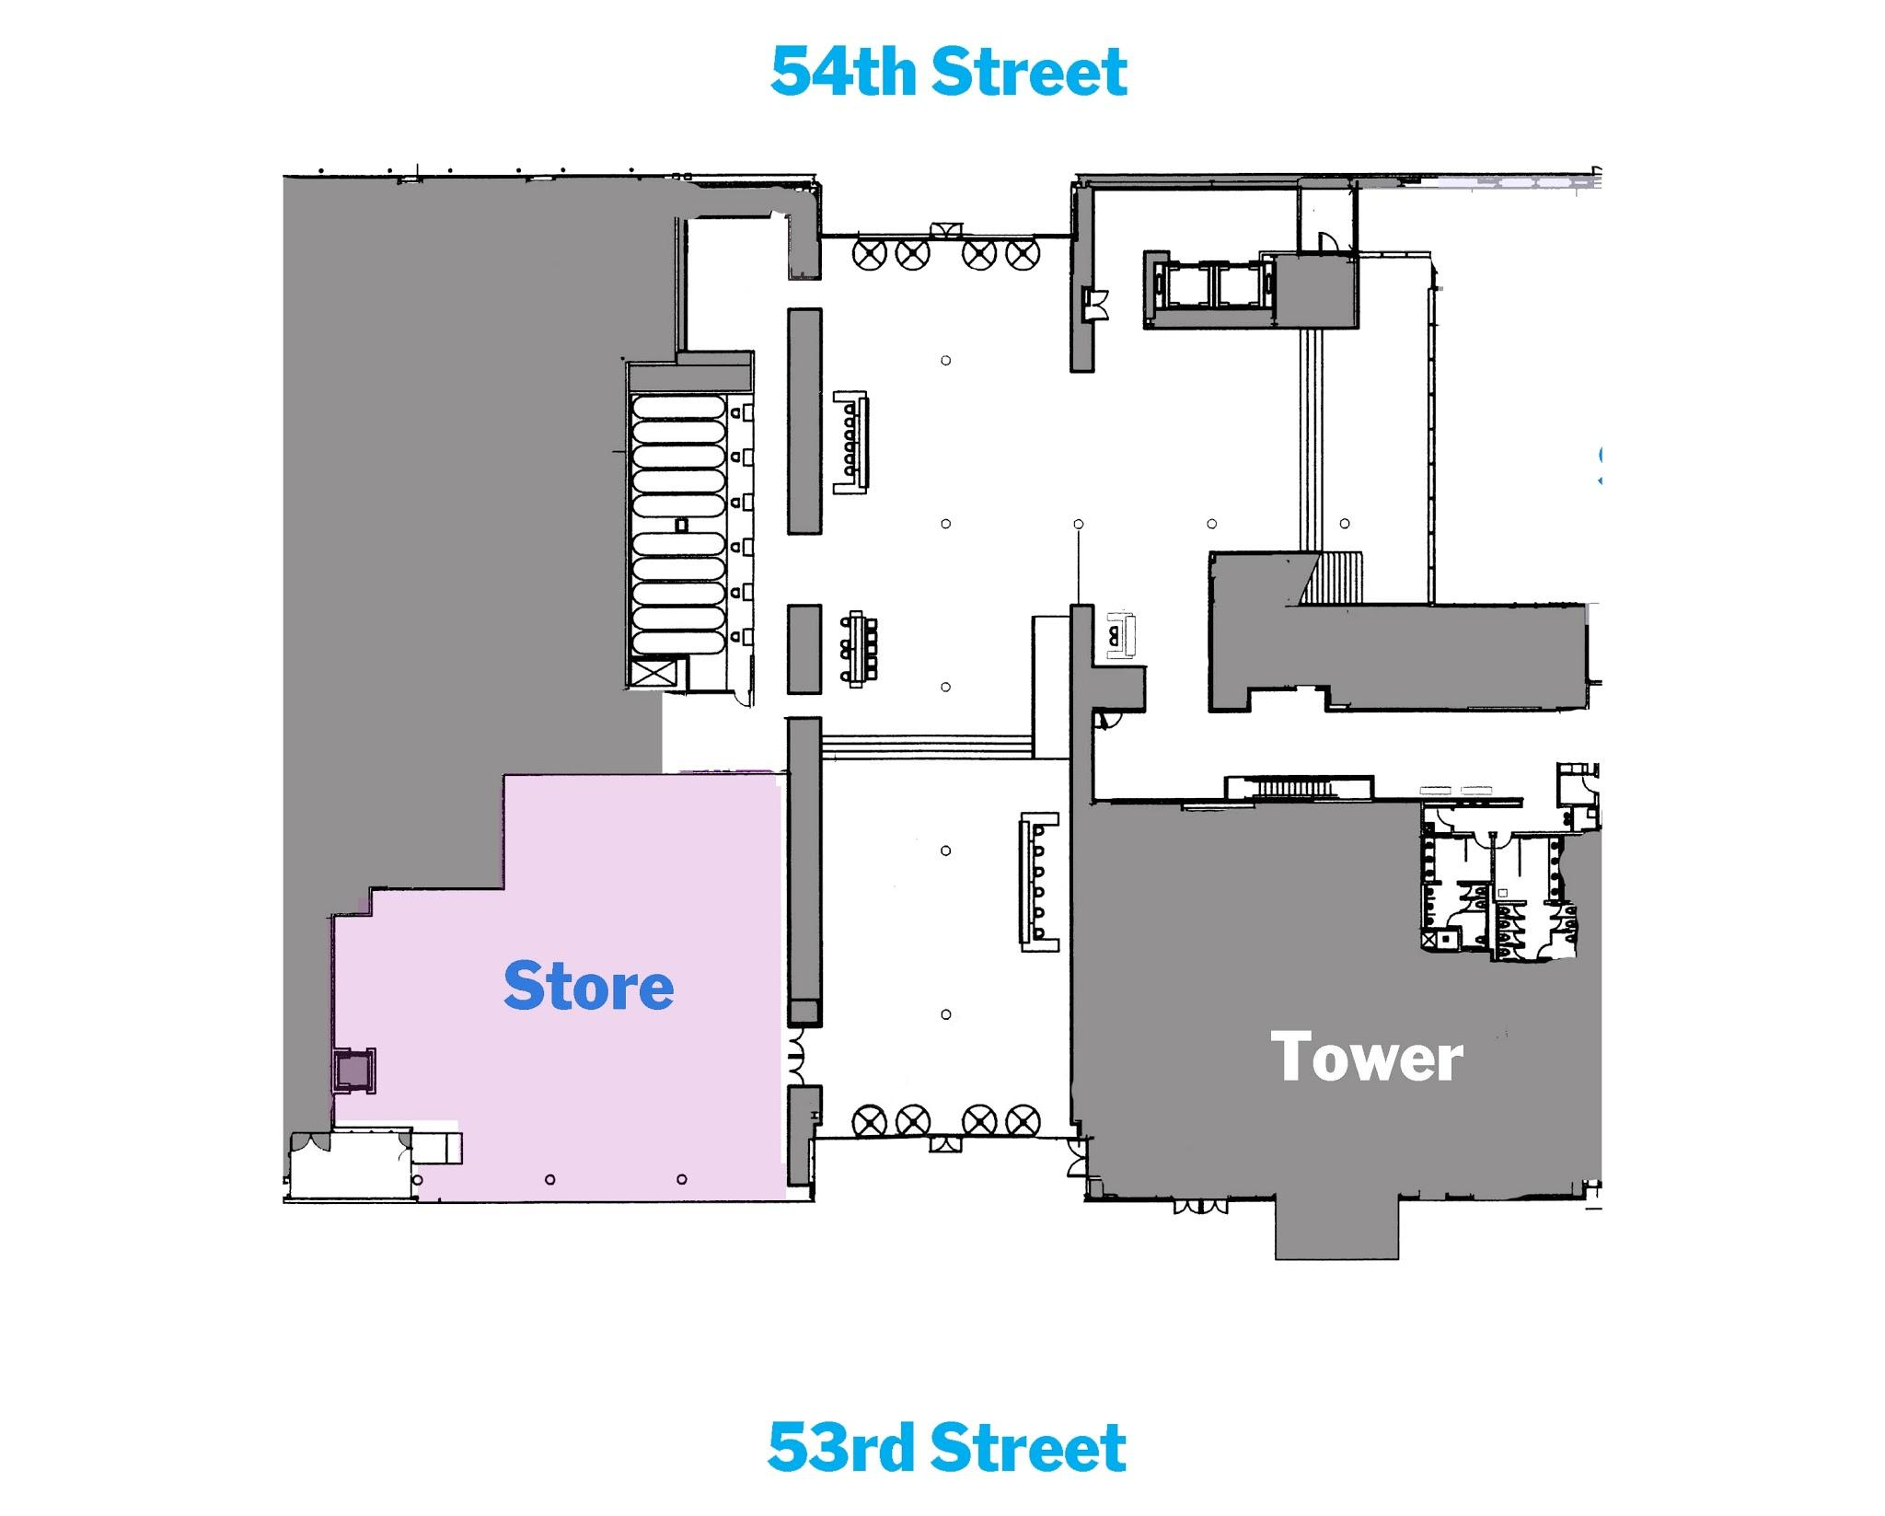
Main lobby
Notes:
The following are the challenges we’re working with:
Multiple entry points to the building and to the galleries make the entry experience inherently complex (walk through the floor plan)
A very robust and varied exhibition program including films, performance and sometimes challenging are requires us to be especial good and communicating what's on and making visits feel comfortable her so they can enjoy the program to the fullest- program changing daily
Growing attendance requires increased efficiencies
Diverse and constantly changing visitor demographics requires us to adapt

Slide 5
Departments represented in the
Lobby Task Force
Audio Visual
Building Expansion
Facilities and Safely
Digital Media
Education
Security
Exhibition Design and Production
Membership
Visitor Services
Graphic Design and Marketing
Information Technology
Finance
Notes:
Chiara: Cross departmental group – people came together to form the lobby task force, was initially formed to tackle peak time issues- started meeting weekly and worked with an outside consultant initially to help us define goals and parameters, to identify different areas requiring attention and what we hoped to accomplish to improve visitor experience
The problem of visitor experience is inherently cross departmental

Slide 6
Visitor Experience Goals
Welcoming
Hospitality and human touch central to the lobby experience
Exceed expectations at every moment
Clear
Entry legible to diverse and non-English speaker visitor base
Simplicity as a guiding principle
Cohesive
Avoid information overload
Project Museum’s identity and create a sense of arrival
Art in the lobby should be present
Notes:
Eliana:
How we determined and agreed on these goals– helped us be all on the same page and everything we did/prioritization was governed by this set of goals
Welcoming
Make hospitality and the human touch central to the lobby experience
Exceed expectations at every moment
Clear
Entry must be legible to diverse and non-English speaker visitor base
Simplicity should be a guiding principle
Cohesive
Avoid information overload
Project the Museum’s identity and create a sense of arrival
Art in the lobby should be integral

Slide 7
Methodology
Iterative, flexible and efficient testing informing longer term goals
(Failure is part of the process!)
Testing and evaluation include:
Visitor surveys
Staff observations
Lobby staff focus groups
Notes:
Eliana:
Regular tests should be iterative. Being comfortable with failure is an important part of the process
Learning from tests should inform longer term goals and provide evidence for the need for larger projects when applicable
All models tested must be flexible and adaptable to respond to changing programs and physical building
Testing and evaluation
Visitor Surveys
Observations
Lobby Staff Focus Groups

Slide 8
Initiatives we will be discussing today
How can the Museum provide the most welcoming and informative experience at entry?
How can we increase use-your-own-device adoption for audio tours?
How can we use technology to make the checkroom process more efficient and enjoyable?
Notes:
Sonya:
Lobby task force was recording the current issues that we were experiencing and we had identified some areas in the lobby that were confusing, unwelcoming…
Among other initiatives we have selected the three most impactful, from which we have learned more…

Slide 9
Question 1: How can the Museum provide the most welcoming and informative experience at entry?
Elements of test:
Create more welcoming language at entry door
Directory of Museum programs at lobby entrance
Directory of programs on each floor at elevator bank
Relocate Information desk to lobby
Redesign admission ticket
Notes:
Explain problem:

Slide 10
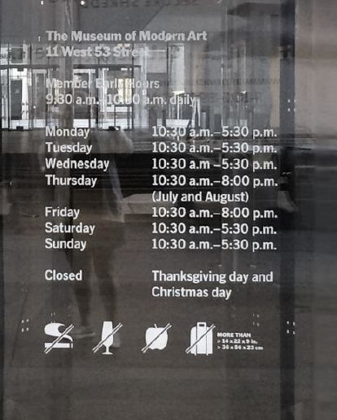
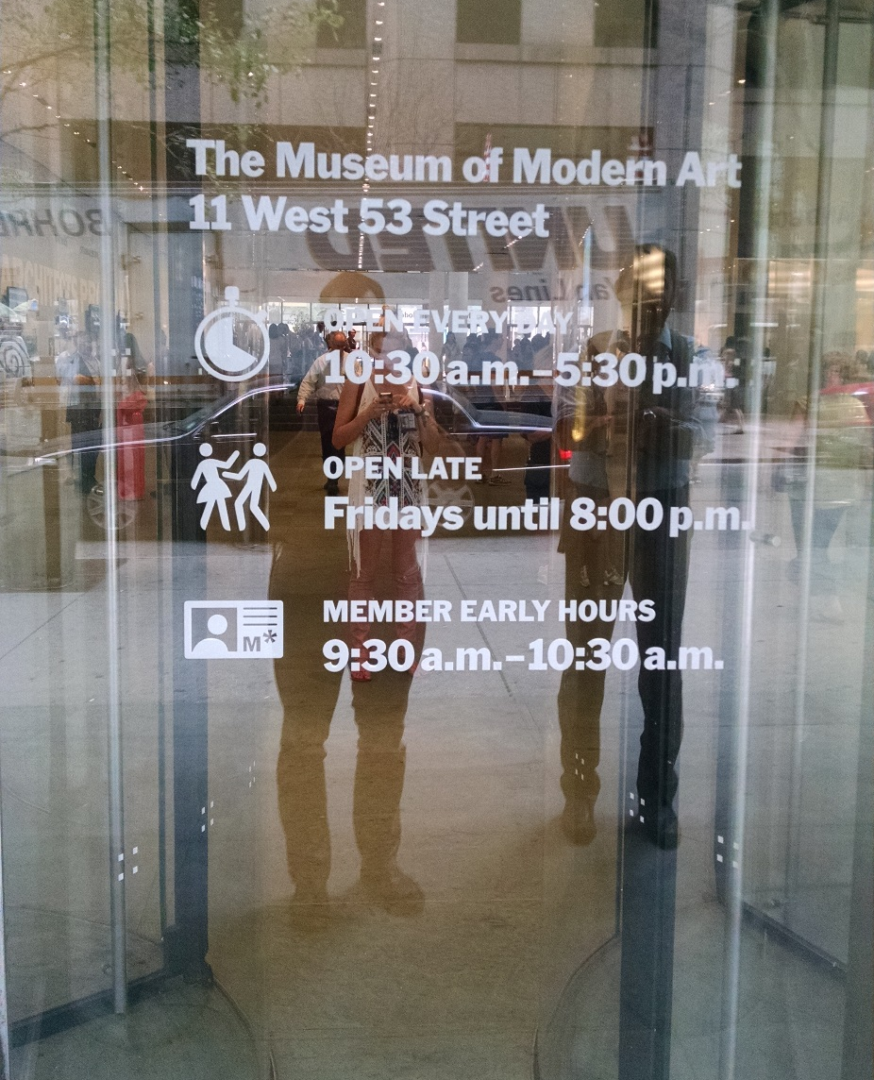


Simplify and reduce, make friendlier
Notes:
Create more welcoming language at entry door
Changed, larger font size
Simplified, easier to understand language
Friendly icons, eliminated the no language

Slide 11
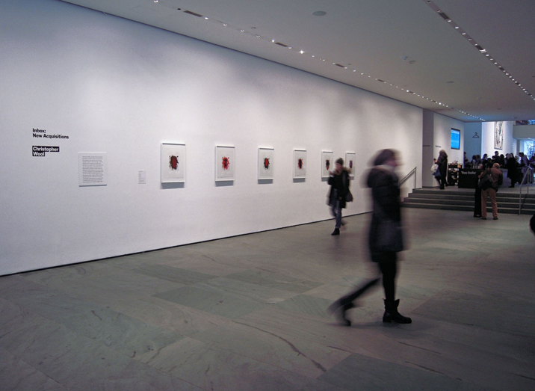
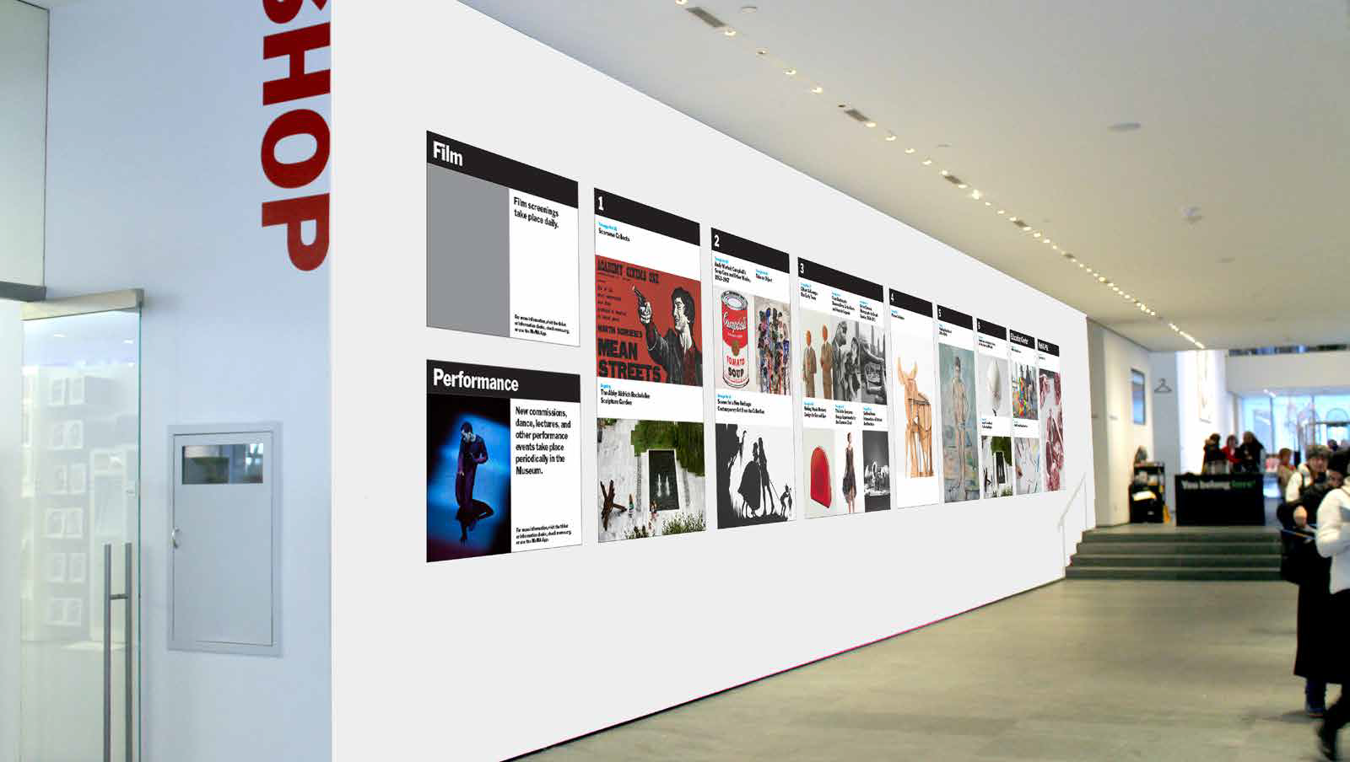
Install Directory of programs at lobby entrance
Notes:
Determined that while there is a clear need for program information in the lobby, the 53rd street entrance is not the right location
1. Notes for point 1
There was a 25% increase of average daily questions in the lobby after the program wall was installed. Of those, directional questions to the galleries increased 42% telling us it wasn’t serving its wayfinding purpose
Visitors were focused on purchasing tickets and checking their coats at that point in the lobby and couldn’t focus on program information

Slide 12
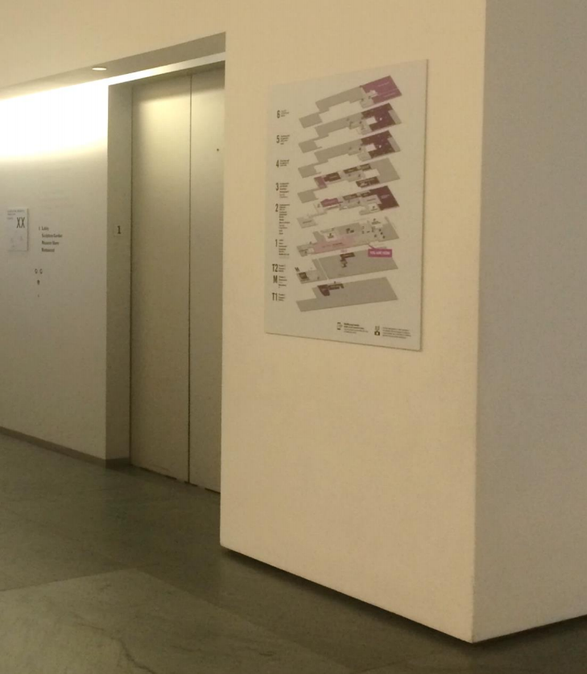
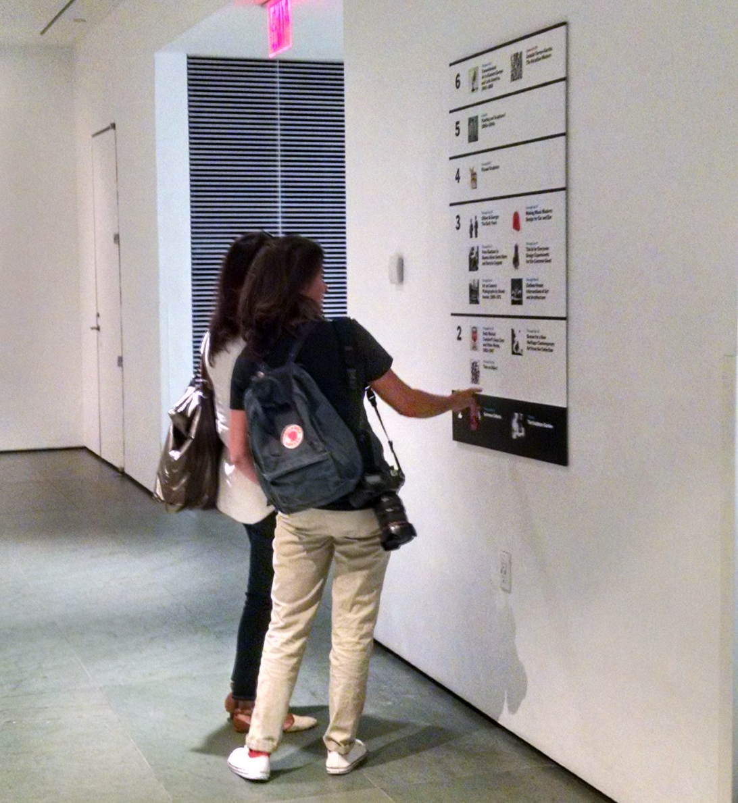
Install directory of programs on each floor
Notes:
It’s by the elevators, they were identified as a good location because they are used often and they create a core of vertical information for the visitor looking for the next space to visit
Second slide: This was a resounding success however in order to be feasible for the long-term, the directory must be digital as it is too time consuming and expensive to update in physical form

Slide 13
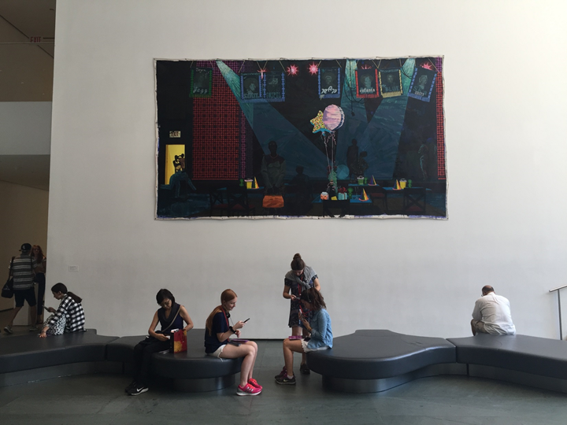
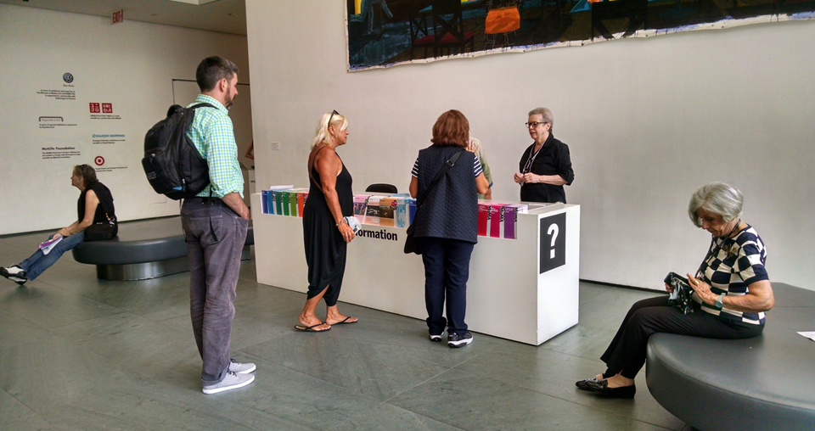
Move Information Desk closer to entry points
Notes:
Prior to this experiment the information desks were tucked away, under the escalators, so not very easy to find upon entry, not as welcoming, we wanted to
Provide a desk that could offer a more human touch in a more central location (do we have an image of the desk under the escalator?)
The information desk placement filled a needed function by creating a space for more relaxed conversations and taking stress away from the staff at the entry points and ticket-selling locations
2. Notes for point 2
30% of all questions (informational and directional) in the lobby were absorbed at the new information desk. Questions at the north gallery entrance / scanner position decreased.

Slide 14
Conclusions
The program wall was effective, but the location was not.
The new information desk placement provided a friendlier interaction for the visitor.
A number of different displays will be tested over the next year to inform a dynamic system Digital Media is building
Notes:
What we found out through evaluation/survey is that the program wall was effective in introducing visitors to new program information, however it was placed too early in the journey through the lobby

Slide 15
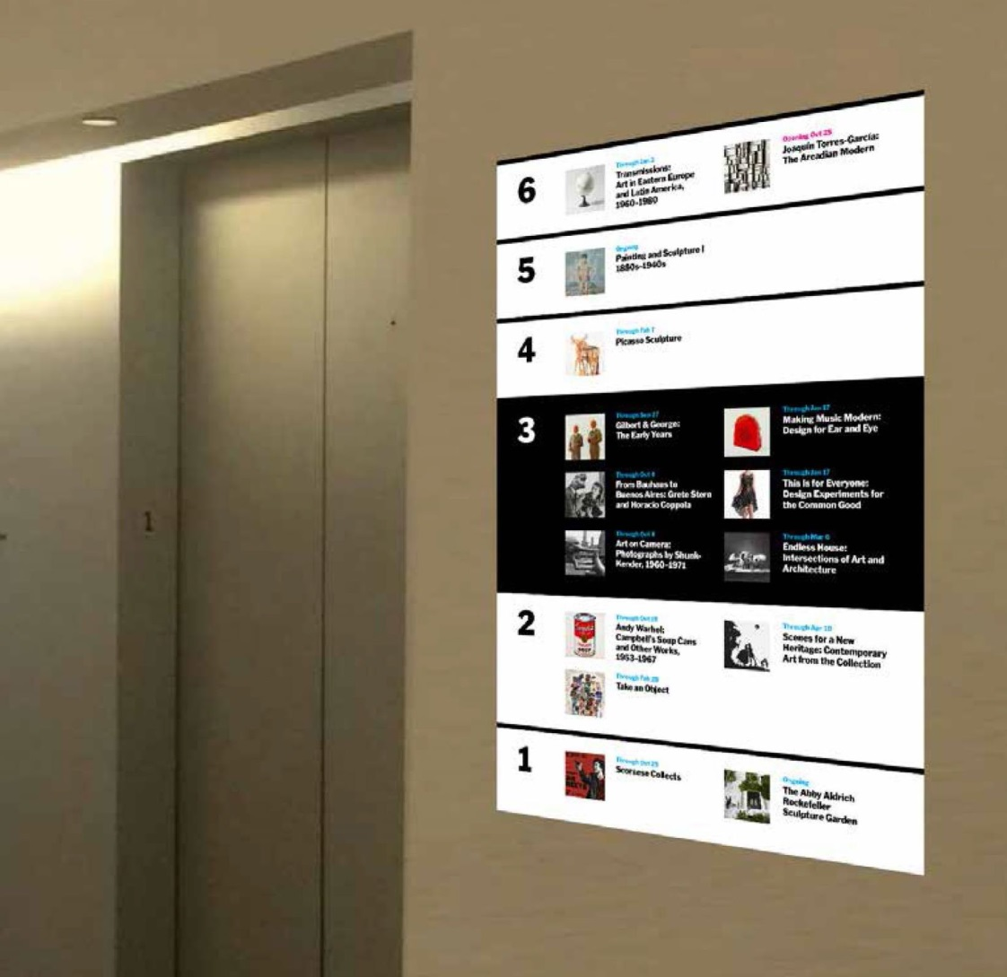
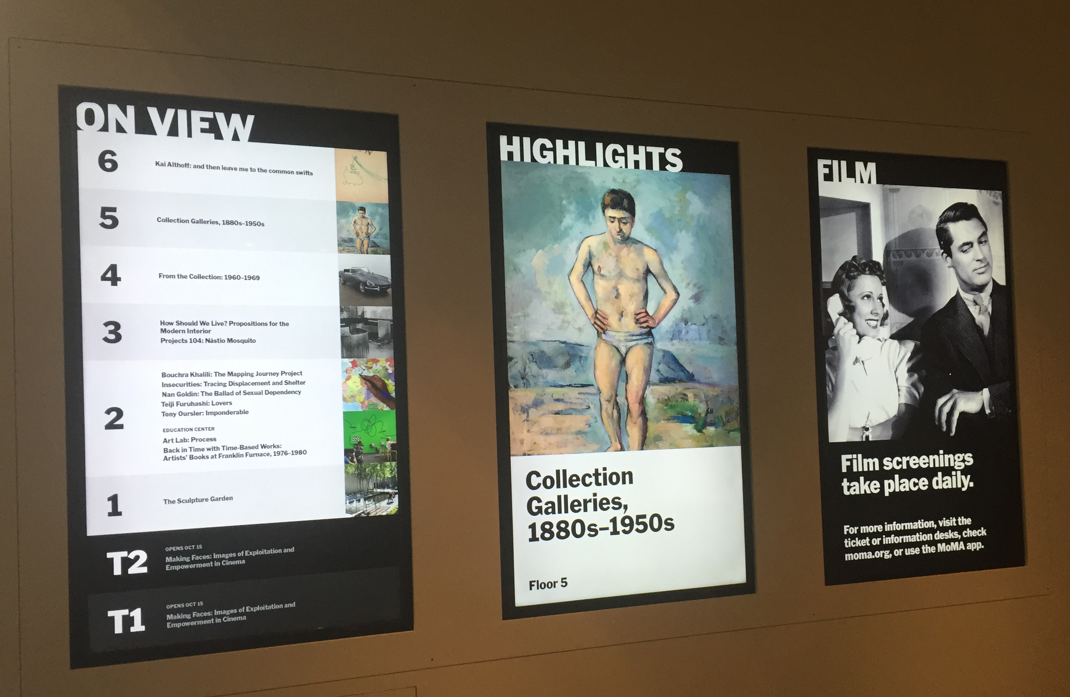
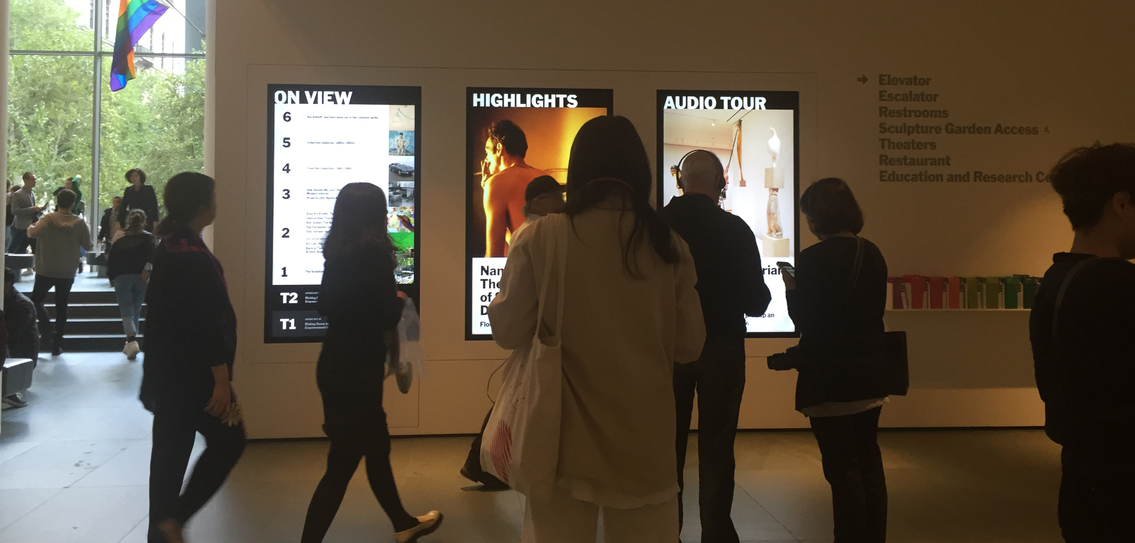
Based on our learnings
Notes:
Chiara
A number of different displays will be tested over the next year to inform a dynamic system Digital Media is building
We will be installing digital program directories on each floor at the elevators
We installed digital program screens further into the lobby at a central location
Results from recent observational study: We experimented with content, design and rotation times to determine what is most effective and we found that:
The On view slide is by far the most used
The screens are not useful to international visitors
This is very desirable real estate for different constituencies across the Museum so a clear mission for the screens is necessary to keep them uncluttered and focused

Slide 16
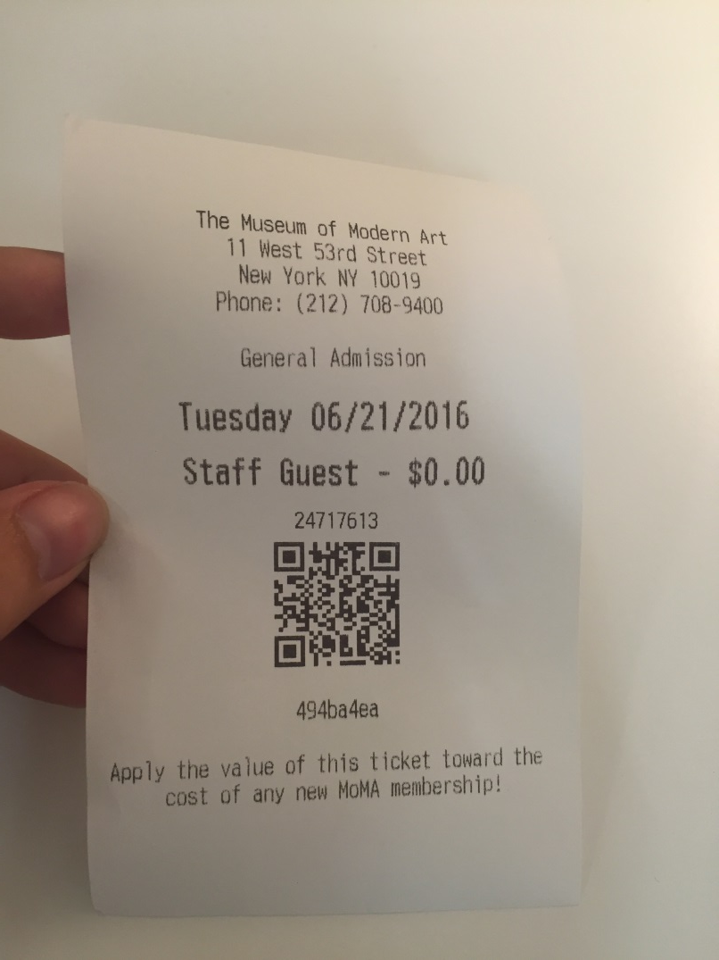
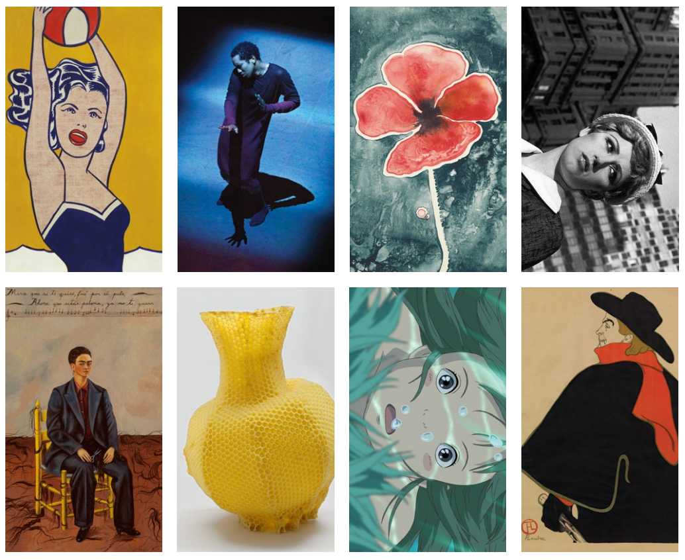
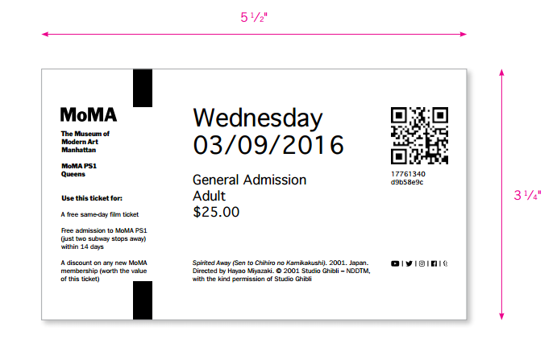
Admission Ticket Redesign
Notes:
Sonya:
Another initiative to make a lasting impression for the visitor is the redesign of new tickets
In summer 2015 we switched to receipt paper tickets, as a test, with the launch of our new Acme ticketing system
Our research has shown that visitors are confused and disappointed by this kind of ticket (it was worth a shot to try something new though!)
Goal with the next admission ticket is to provide a more attractive keepsake, recognizing that the ticket is an important “touch point” and shapes how the visitor feels about the Museum
The design concept is showing the range across all collecting departments
Is surprising the visitors that use tickets as souvenirs and collectables

Slide 17
Question 2: How can we increase use-your-own-device adoption for audio tours?
Elements of test:
Staff Training
Simplified messaging for digital offerings
Automatic redirect to Audio tours on mobile devices
Incorporate additional messaging in galleries
Moved audio distribution desk to a less prominent area and promoted use-your-own-device information
Notes:
Chiara
When we launched our audio tours app we had 2000 devices that were distributed by Antenna with pretty good daily take up rate. The cost for maintaining museum devices had been a very big portion of our budget and we wanted to streamline the visitor experience (avoid lines) …we wanted to experiment encouraging the use of visitors devices to access content.
To make it as easy as possible, we tested….

Slide 18
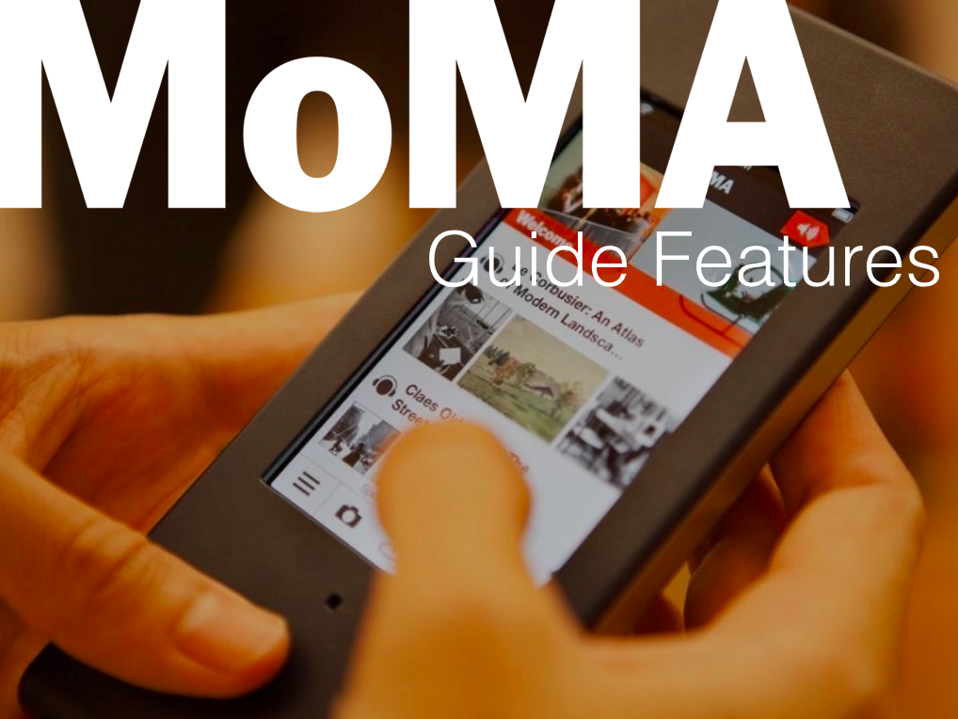
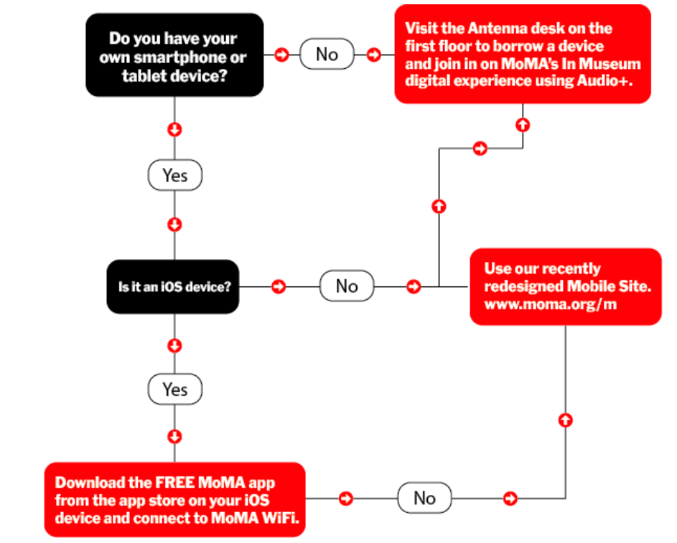
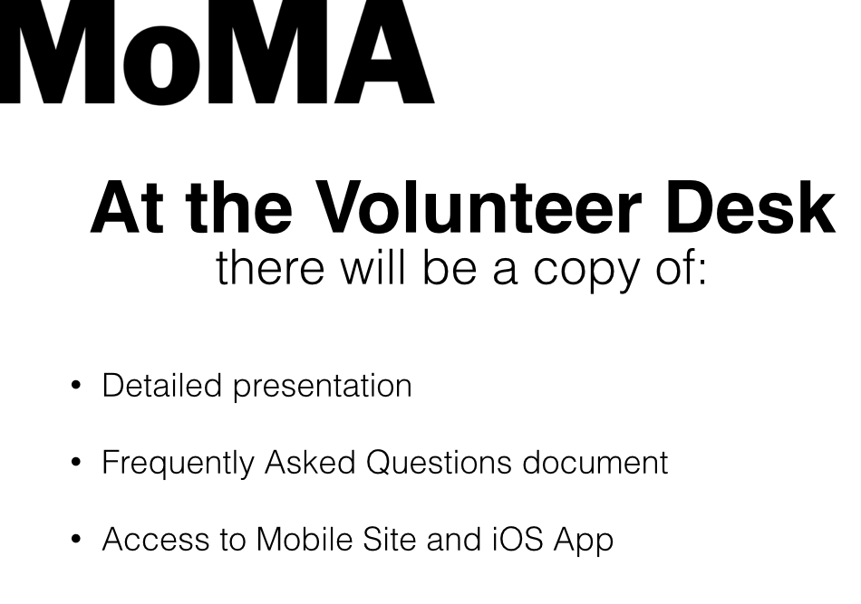
Staff training
Notes:
One of our main concerns was to train staff and volunteers at the information desks and make it easy for them to help visitors use audio on their devices. Not all volunteers are tech savvy and we provided multiple rounds of training for them, FAQ sheets, iPads at each desk to make them comfortable using technology. The main challenger was that we had multiple ways to access the same content, using the app, the mobile site and the audio device
400 volunteers

Slide 19
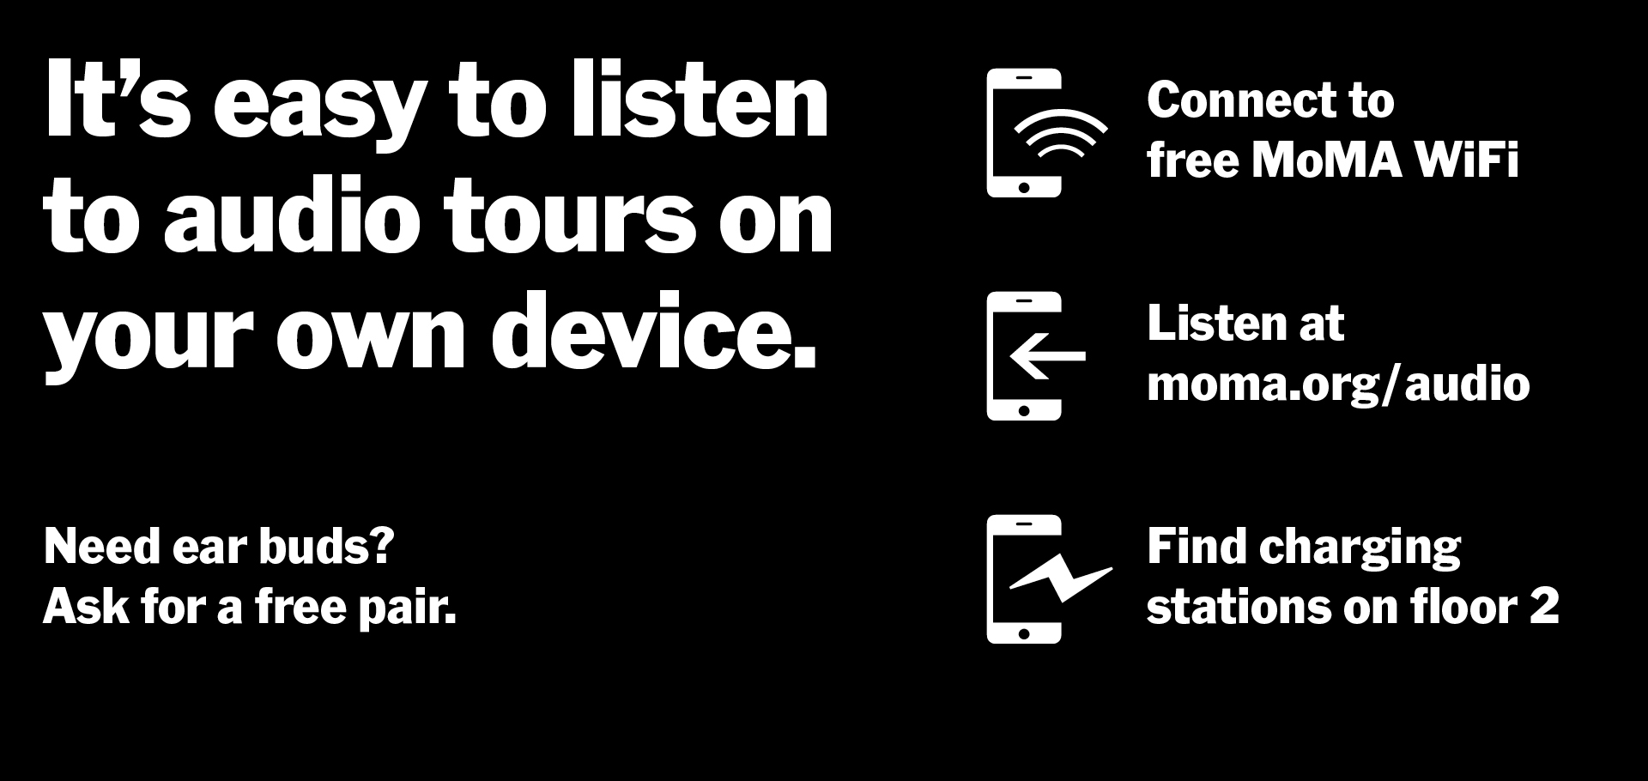
Simplified messaging for digital offerings
Notes:
We realized that we were overwhelming the visitors with too many options to choose from – and simplified the messaging to focus on listening to audio rather than also publicizing the app– we directed them to use the mobile site (which has the same content as the app minus the step of having to download the app)
We placed these messages
On the display screens
On the walls
On placemats

Slide 20
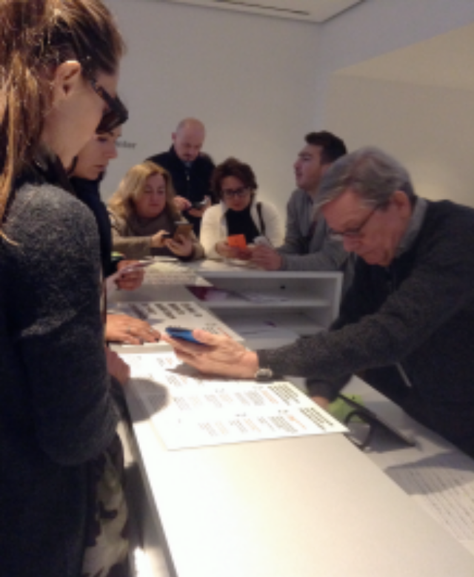
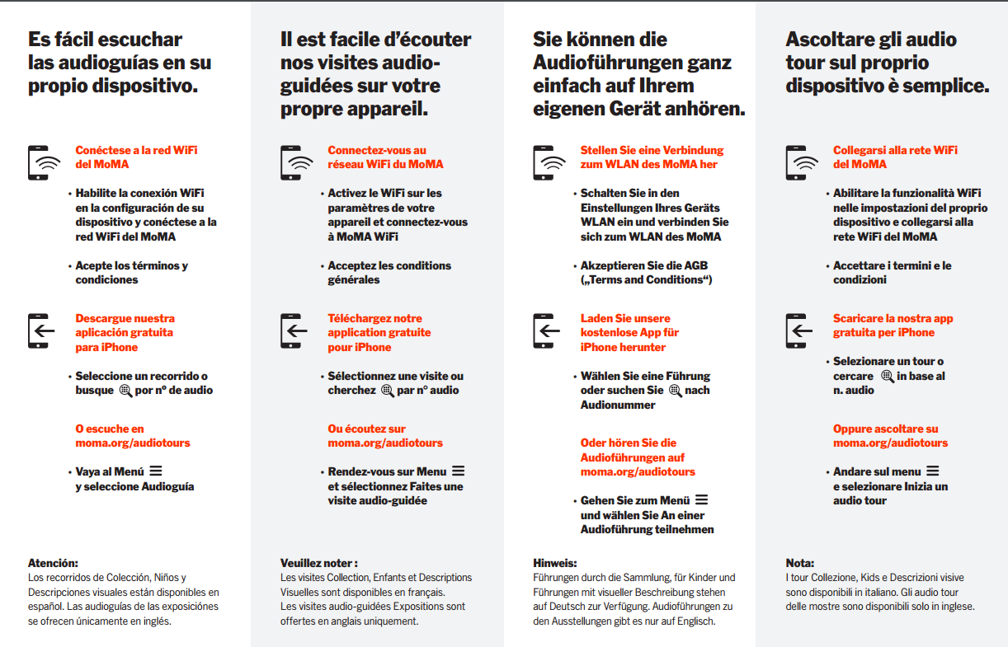
Translating messaging for digital offerings
Notes:
We also found out from our survey that most international visitors had difficulties understanding the steps they had to go through to liste do the audio tours. Translating the instructuons in the 8 languages we have our audio translated in and having them on placemats at the desk was essential and made the volunteers’ life easier.

Slide 21
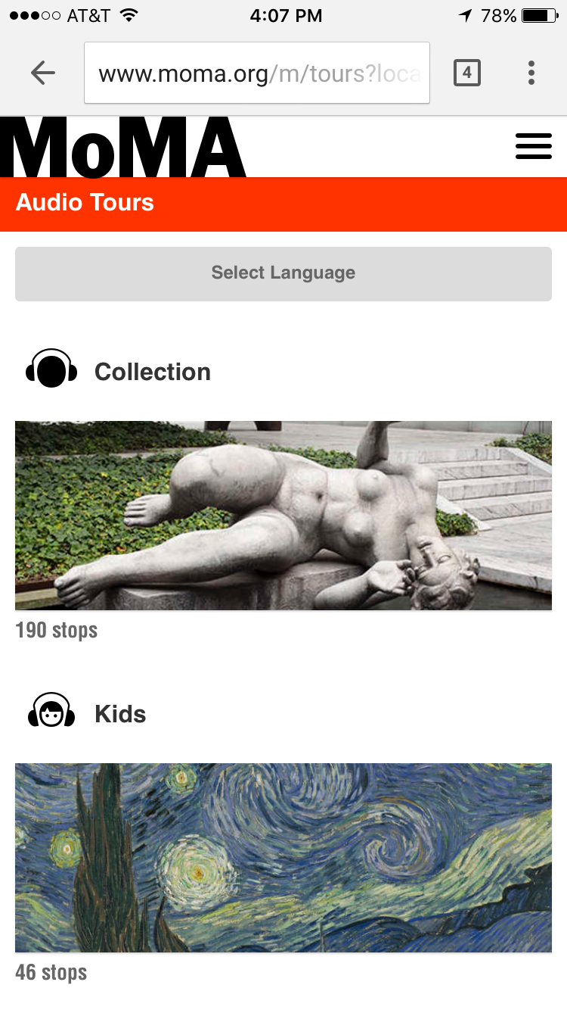
Automatic redirect to Audio tours
Notes:
As soon as you connect to the free wifi, you get redirect seamlessly to audio tours rather than the moma website homepage–
can’t completely control because it depends on the browser

Slide 22
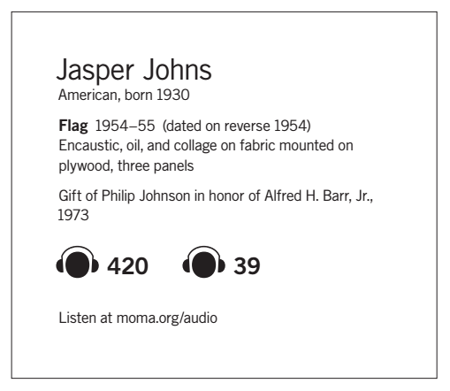
Additional messaging in galleries
Notes:
In the galleries, we found that it was really important for visitors to be reminded where they could listen to the audio tours, so we introduced a short URL on the label.
We got some push back from curators that wanted to keep labels as minimal as possible, but this is an initiative that proved to be very helpful to visitors (see results from Jackie’s survey)

Slide 23
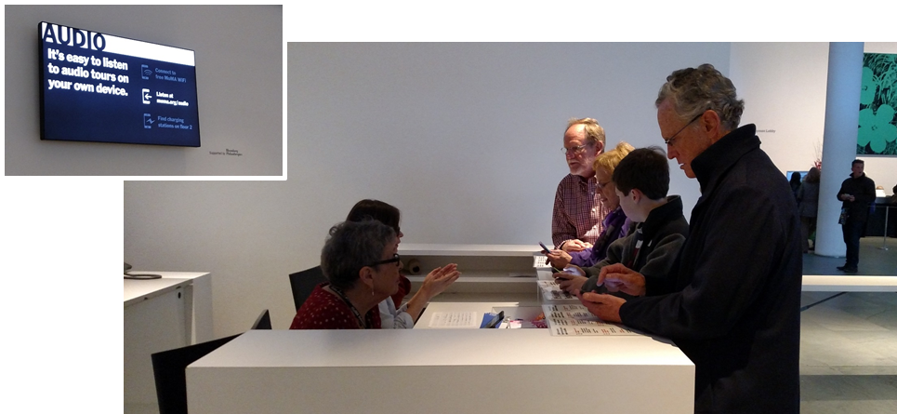
Moved audio desk to a less prominent area
and promoted use-your-own-device information
Notes:
Moved audio device distribution desk to a less prominent area (under the escalators), and promoted use-your-own-device information in a high-traffic location.
After observation we realized that there was still a lot of work to do to make sure that the visitors had a good experience, the current desks were not ideal and it was’t a smooth experience for staff and volunteers to switch, ultimately we decided to revert back to the initial position.
Visitors habits are hard to break

Slide 24
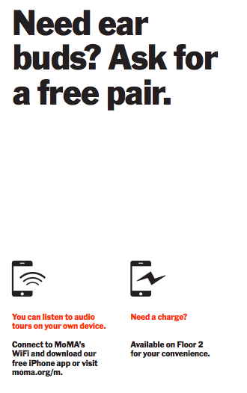
Notes:
After doing a pilot giving away free ear buds for a week, we have learned that 75% of users would use their own device again, and they had a very positive experience overall

Slide 25
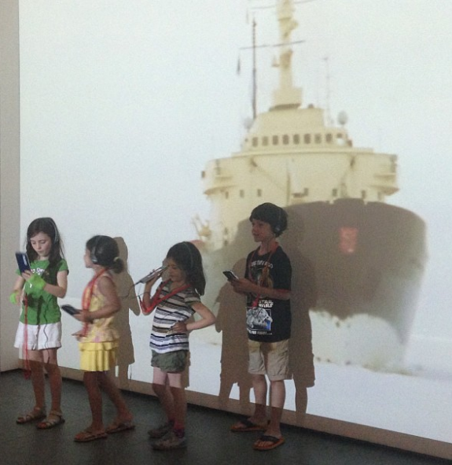
74% didn’t use their own devices. Barriers we need to address: battery concerns, no headphones, wifi issues, explanation and learning curve.
67% of people interviewed wanted to use their own devices: less things to carry, cleaner, don’t have to worry about ID or returning it, no lines, already know how to use it.
Certain groups still need audio devices (families, international visitors and not tech savvy).
Notes:
We defined a clear set of information visitors need to receive to make a choice whether to use their own device or not.
no - preferred to look - search later when I am home”
“no don’t have any earplugs”
“no time to use audio”
“No, not today - are familiar with Picasso”
“Phone was dying”
“Don’t want to use its battery power”
“No didn’t bring headphones”
“No but interested in doing this from home”
“no, wants to feel and think it and interpret the work herself, can real label - she isn't a "techno" person”
67% of visitors surveyed said that ideally they would like to use their own device and cited the following reasons:
“Less things to carry”
“Don't have to give ID”
“It’s cleaner”
“Don't need to worry about giving it back”
“Already know how to use it”
“I'm impatient and hate lines”
Of the group who listened to audio on their visit, 74% chose not to use their own device. The main barriers cited were:
Concern for battery use
They didn’t have earphones
Learning curve / didn’t understand how to use on own device
Both wifi and the server caused issues for people. For example when visitors experienced a slow connection or got bumped off the server they frequently gave up on using their own device. Visitors still demonstrated a concern for saving their battery even when charging stations were mentioned and frequently cited not having headphones a reason for not using their own device (the message that we have headphones to borrow wasn’t always made clear and some visitors did not want to use headphones that someone else had worn). Helping visitors to use their own devices to access audio content frequently took more time and effort than showing them how to use MoMA Audio+.

Slide 26
Question 3: How can we use technology to make the checkroom process more efficient and enjoyable?
Elements of test:
Partner with Chexology to test their technology-based approach to coat check
Analyse and compare the data from a previous study with current data and Chexology’s data
Determine whether this application of technology improves the efficiency and experience in coat check
Notes:
Eliana
Question 3:
How can we use technology to make the checkroom process more efficient and enjoyable?

Slide 27
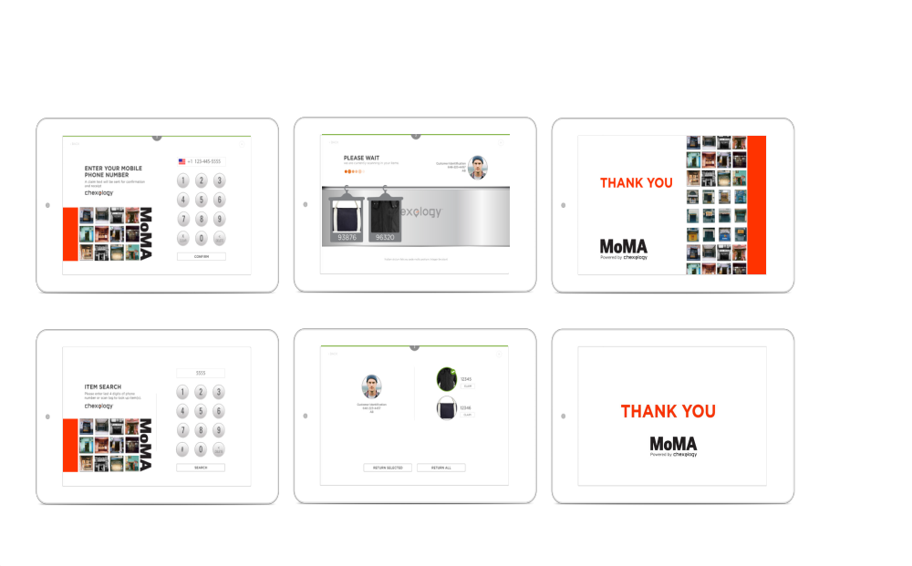
Test a technology-based approach
Notes:
We partnered with a start-up “Chexology,” to test their coat-check specific technology. They also brought in their own staff and we set them up on one side of the coat-check typically used for extremely busy days, the “auxillary coat check,” and kept the main coat check open with the Museum’s regular coat check staff. MoMA currently uses a more “analog” tag/ticket system, where the bag/coat is checked and the visitor gets a ticket for retrieval. Chexology developed an app where visitors could use their phone numbers to checkin and retrieve their belongings instead of using the tag/ticket system if they wished. Either the phone number or tag/ticket were entered or scanned into the ipad to complete the transaction.
The objective of the test was to find out whether using the app could cut down on the transaction time at coat check, and if it helped to provide a positive visitor experience. To see if this app technology delivered, we compared it to two other sets of data.

Slide 28
Analyse and compare data
Data Metrics | MoMA (Winter) | MoMA (Spring) | Chexology (Spring)
Check in Cycle | 0:00:53 | 0:00:45 | 0:00:26
Check out Cycle | 0:00:44 | 0:00:24 | 0:00:18
Length of stay in MoMA | 1:30:00 | 1:38:13 | 1:28:00
Number of items dropped off | - | - | 4055​­
Phone Numbers collected | - | - | 1062​­ (26%)
Weather | Cold | Rain | Spring / Sunny
Notes:
MoMA had collected data a few months prior to this test, and also collected data concurrent with the Chexology test. Both of these sets were recorded manually. The Museum then compared its data with the data that Chexology gathered.
The MoMA Stats were taken over 1 week, during random 2-5 hrs increments a day.
The data for Chexology was also taken over 1 week, but it was collected continuously and automatically for each coat-check transaction. The app was able to provide more complete data and resulted in some very interesting findings.

Slide 29
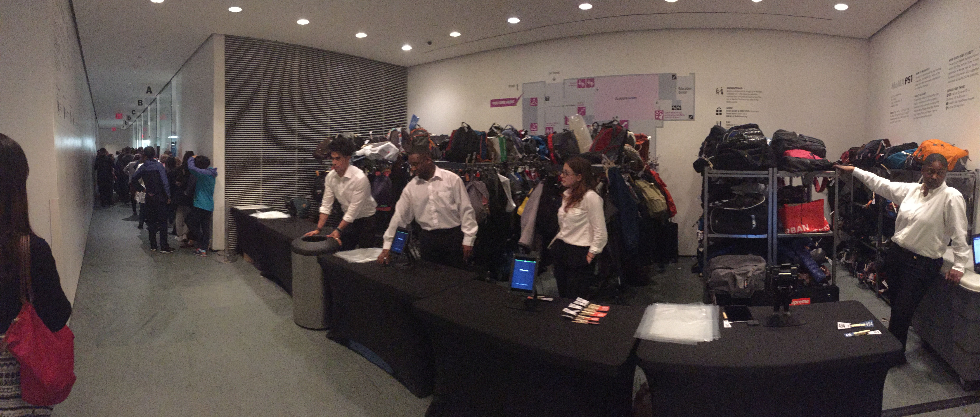
Observation and Data Results
Mixed reactions from the visitors, both positive and skeptical:
  “Easy check in and check out.”
  “Hey, look! It took a picture of me. Cool!”
  “This is my first time at MoMA. Excited about the technology.”
  “The old system worked fine.”
  “I can’t remember my phone number.”
  “I’m not sure which line to go to.”
  Tracking
  Security
Notes:
From our own observations, we found that visitors had mixed reactions to the test.
Some people thought it was great – easy checkin, easy checkout – people liked that the app took their picture as an additional way to id them for their checked item –and liked the technology.
However, others had a different take and thought the old system worked fine, or they couldn’t remember their phone number. Because we had the Chexology staff stationed in the auxillary section and kept the main coat check open, this test might also have been confusing to some.
A couple unexpected advantages of the Chexology technology system and the additional data collected become evident:
1) It helped to confirm the average amount of time people spent at the museum – 1.5 hrs.
2) it helped to quickly resolve a “lost item” claim by quickly providing the time frame that the visitor used the coat check.
Other potential advantages of using the technology was it’s a “novelty” appeal, contributing to a good first impression and overall experience for visitors. As well, with the improved data collection, there may be potential for other types of programming outreach to visitors.

Slide 30
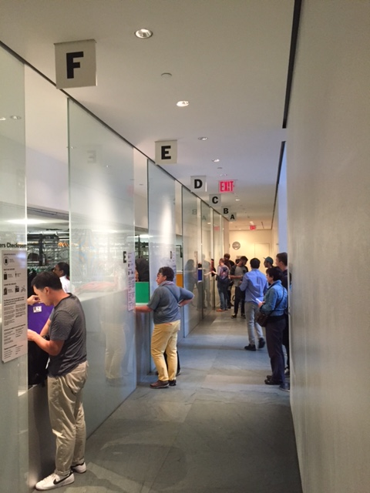
Based on our learnings
Continue to explore alternate conveyor options
Plan additional tests using technology
Notes:
Chexology is continuing to build out their app to integrate with specific coat check conveyor equipment. One outcome of this would be to make the equiment more automated to work seamlessly with the checkin and checkout process at the ticket window. Instead of a coat check staff person having to manually enter the ticket number into the conveyor and waiting for the item to come around, the visitor could enter or scan their ticket into the app device, which would then “call” the item automatically to come around on the conveyor.
We gained some valuable information with the first test and plan to do additional tests using the entire coat check space, and not only the auxilliary space.

Slide 31
How our experiences are helping to influence our organization and impacting plans for the future
Performing tests on a regular basis encourages experimentation and openness to change
Evidence-based recommendations make the implementation of larger projects more streamlined
Working collaboratively towards shared goals strengthens communication and understanding between departments
Notes:
Sonya:
Performing tests on a regular basis encourages experimentation and openness to change into the culture of the lobby staff and throughout the Museum
Working collaboratively towards shared goals strengthens communication and understanding between departments and helps us all to have a more big-picture perspective

Slide 32
Thank you!

