Slide 1
The Visitor Journey Map
The next step in defining the experience
Jessica Sharpe
Director of Visitor Operations and Membership

Slide 2

A journey map illuminates the holistic customer experience.
This work will unify an organization around the experience.
Creates a framework for cross departmental involvement in the visitor experience.

Slide 3

4 Steps to Experience Mapping

Slide 4
Step 1 – Know what you know
Do your research
who are your visitors
qualitative and quantitative
Pull together the data you have and supplement with new research if your budget allows
Notes:
We are lucky to have an Audience Research department that conducts surveys of visitors in general and around exhibitions.
We have a long running experience survey called Tell Us that we send to visitors and members after each visitor to gain some insight into their experience
We also needed to get the current staff more aware of what the museum actual feels like from the visitors perspective. This in house grass roots qualitative activity was incredibly fruitful in this process of setting up our journey mapping workshop. This material was shared with the meeting attendees prior to the workshop and it had a significant impact.

Slide 5

Museum Experience Assessment
Visitor Experience Committee

Slide 6
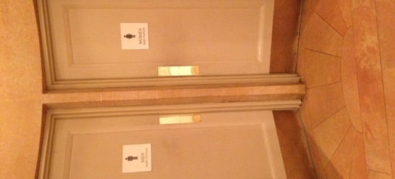
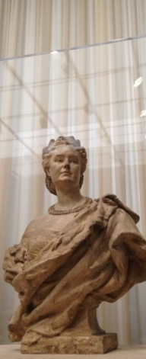
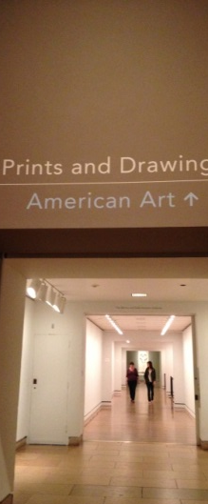
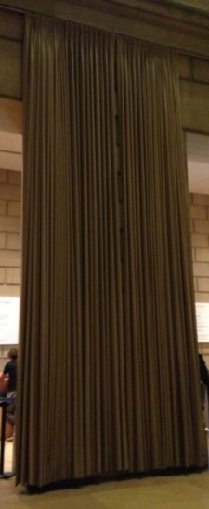
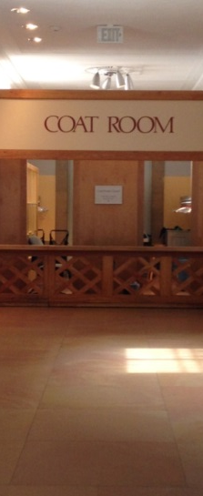

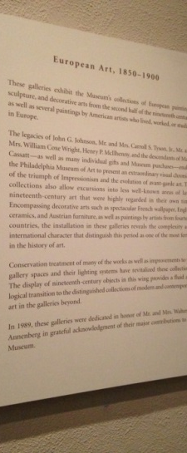
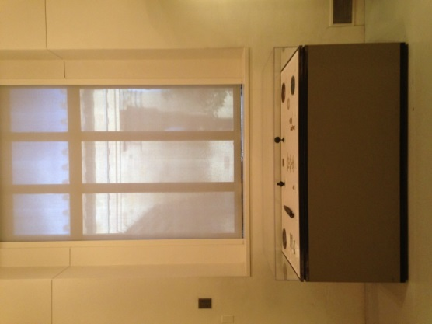
“50 Shades of Beige”
Museum Experience Assessment

Slide 7
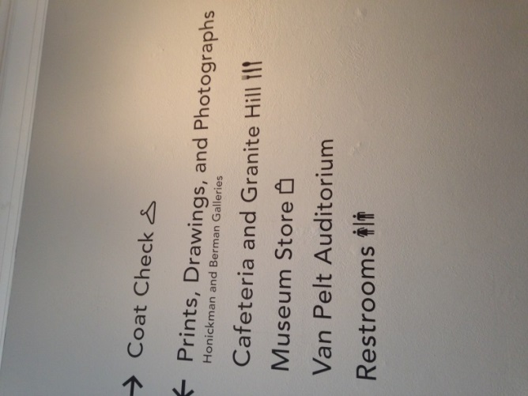
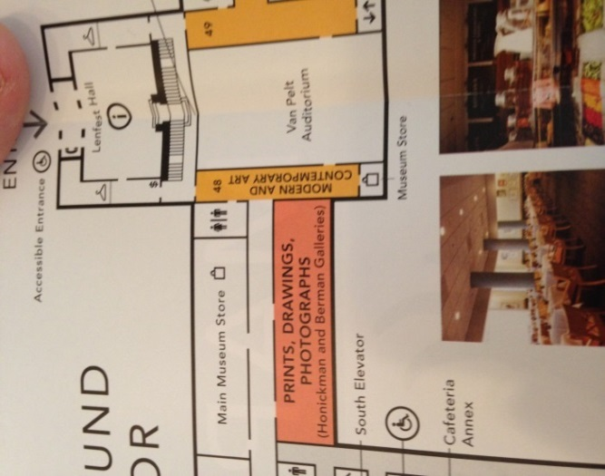
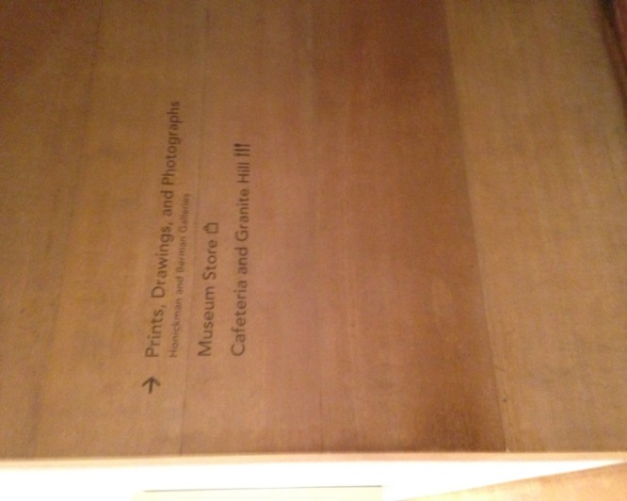
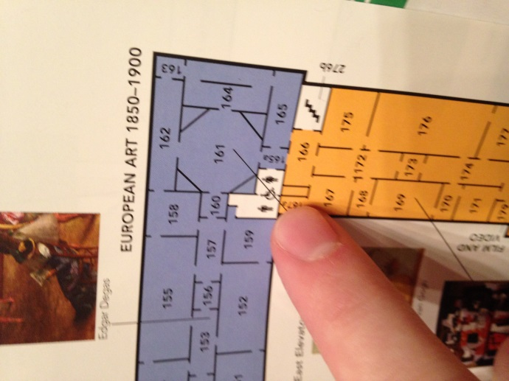

Finding you way
Museum Experience Assessment

Slide 8
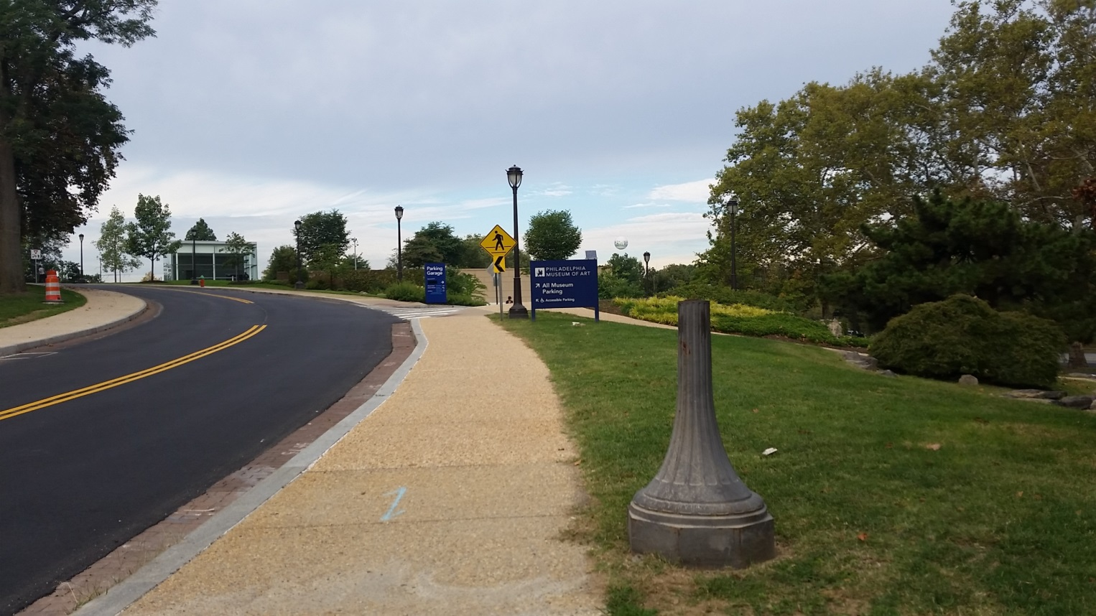
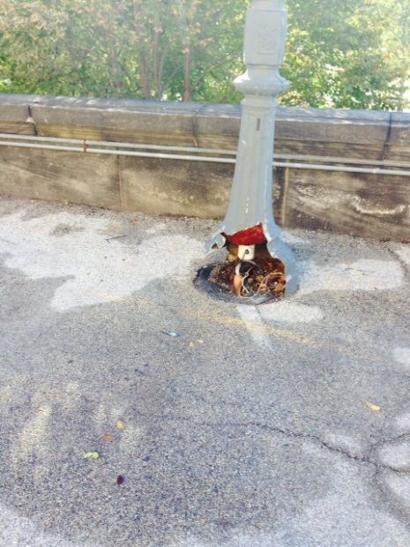
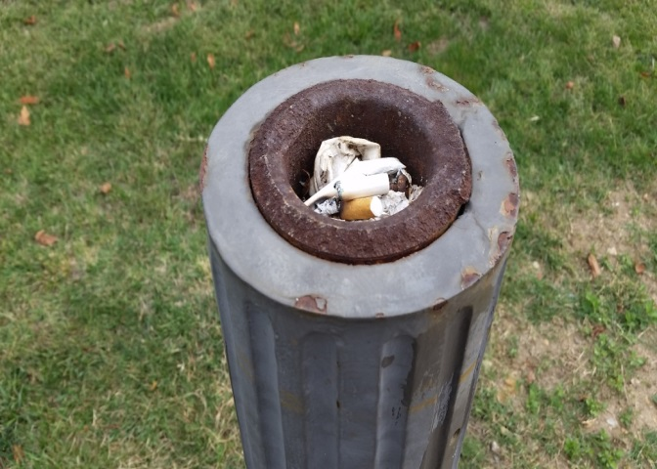
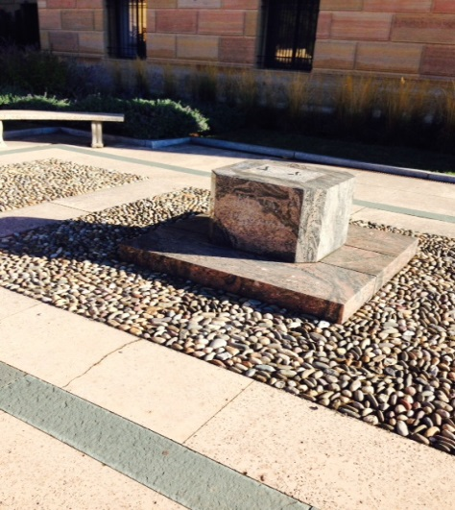
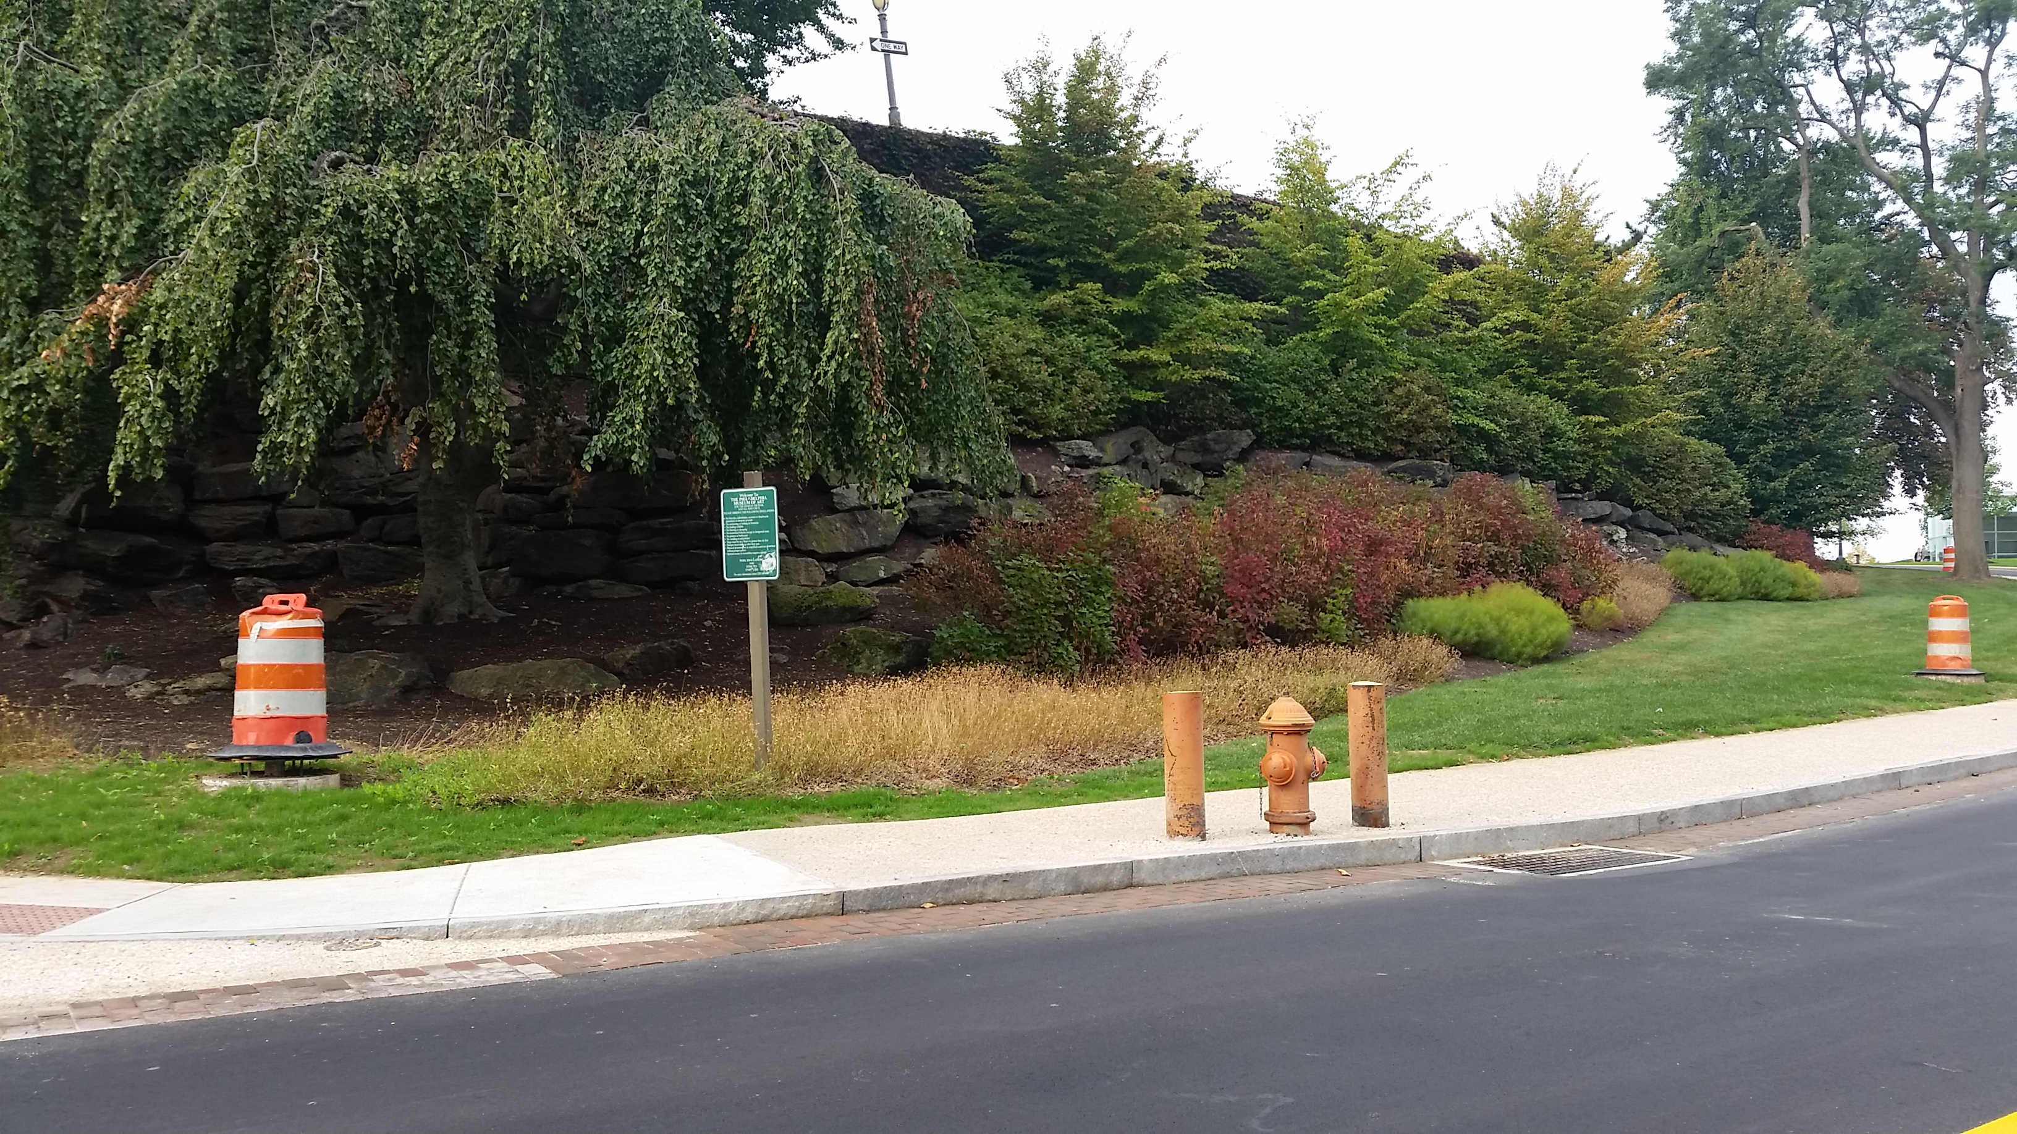
Our curb appeal
Museum Experience Assessment

Slide 9
Step 2 The Workshop
Get the right people in the room
Diverse perspectives and insights
Senior staff buy in
Give yourself enough time
Make it fun!

Slide 10
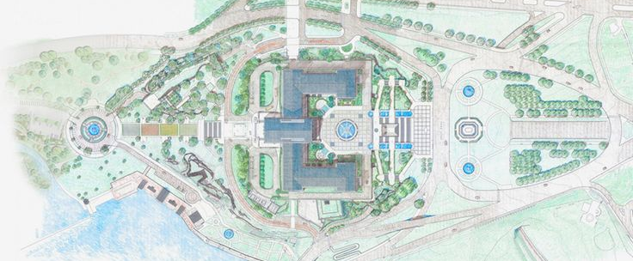
Workshop Prep
Planning is key to a successful mapping workshop

Slide 11
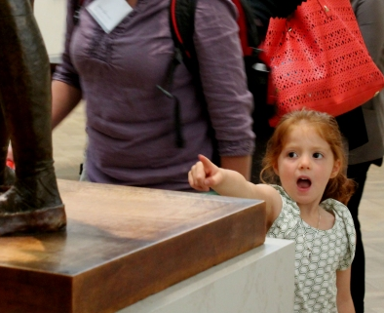
Audience Segments
Visitor personas
Visitor demographics
Visitor types
Understanding your organization and what information you have. Know what you know. Use the data at your disposal to identify the audience groups to use in your workshop.

Slide 12
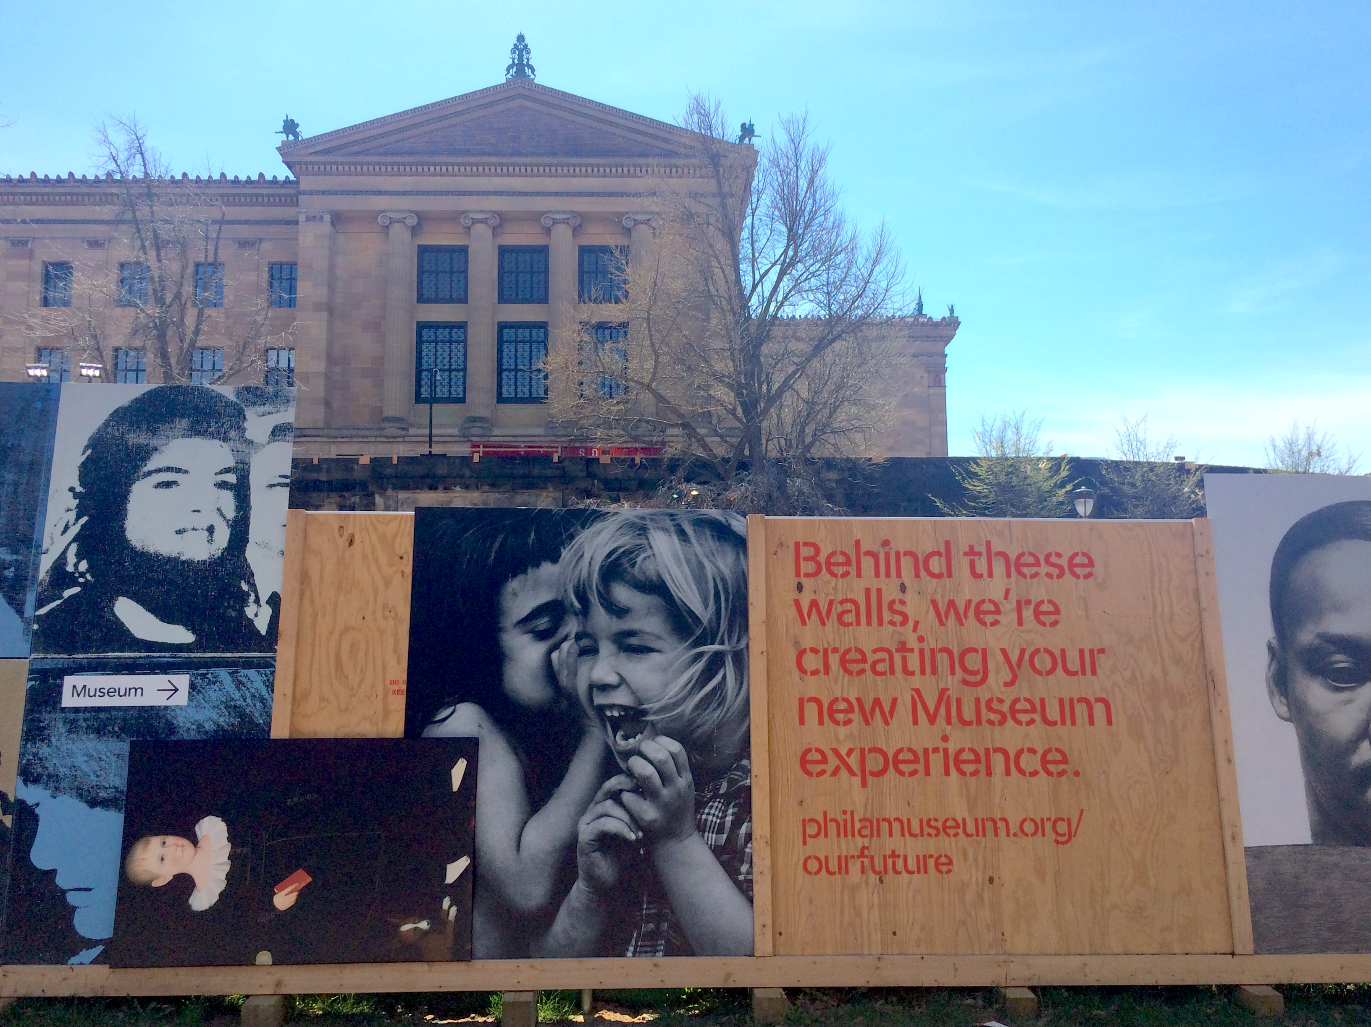
The Stages
Discover
Plan
Travel
Enter
Participate
Exit
Reflect
The Stages are the elements of the journey that every visitors encounters. The moments from beginning to end that the visitor experiences with your organization.

Slide 13
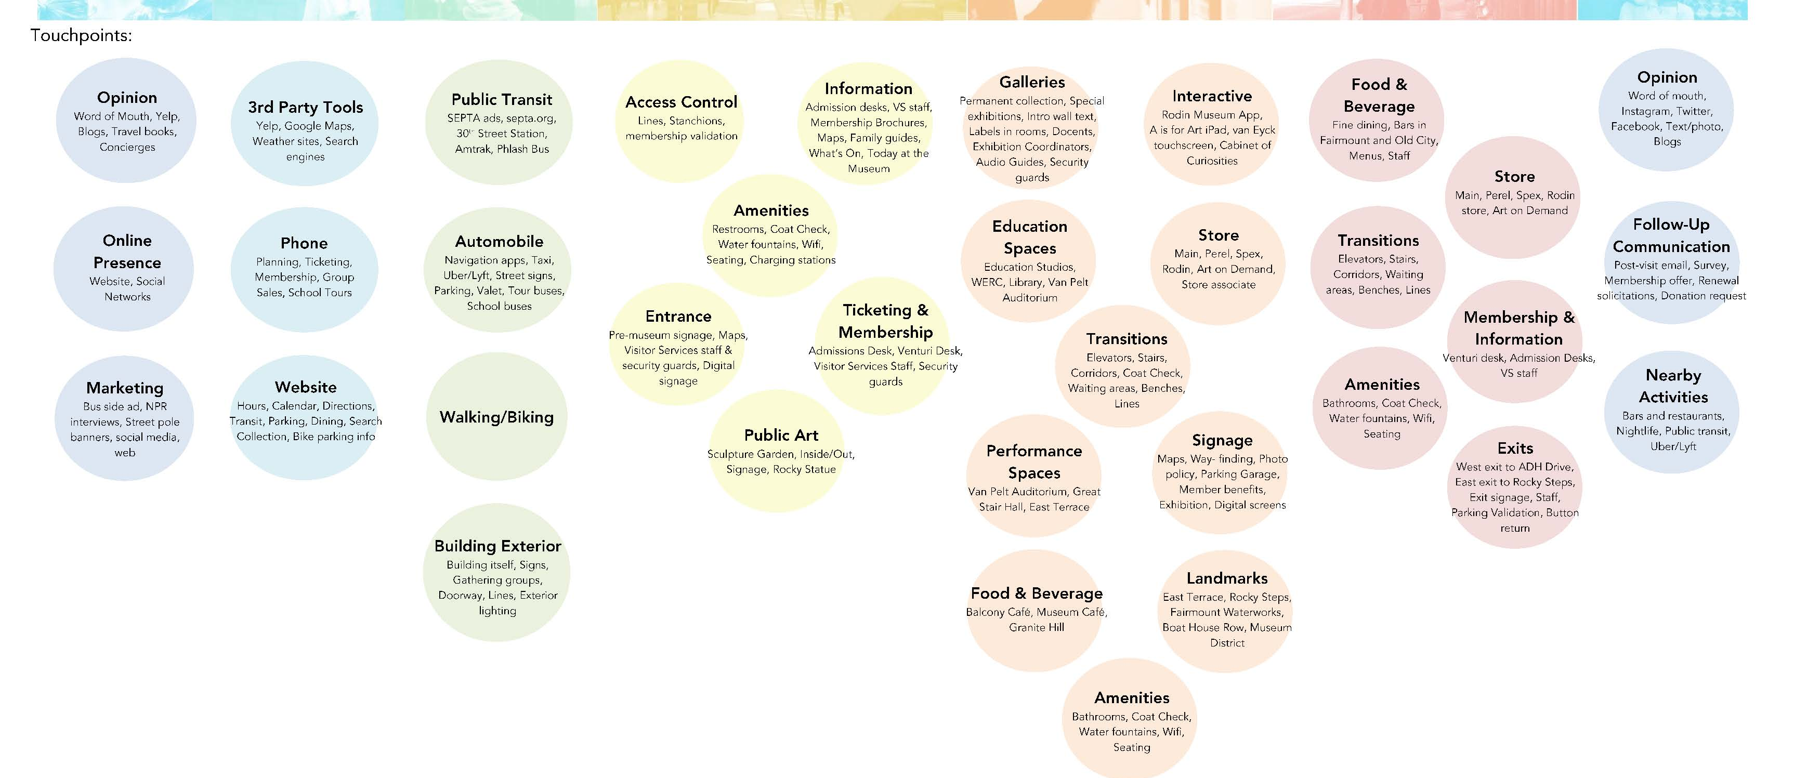
The Touchpoints
A touchpoint is HOW a visitor interacts with your organization at each stage of the journey. This is where each of us are different. These touchpoints are unique to your organization. There is overlap but think about these specific to your experience.

Slide 14

The Building Blocks
Actions
Needs
Emotions
Highlights
Pain points
Use the building blocks to provide structure to the journey map process. These help to center the discussion of the staff working on the journey.

Slide 15
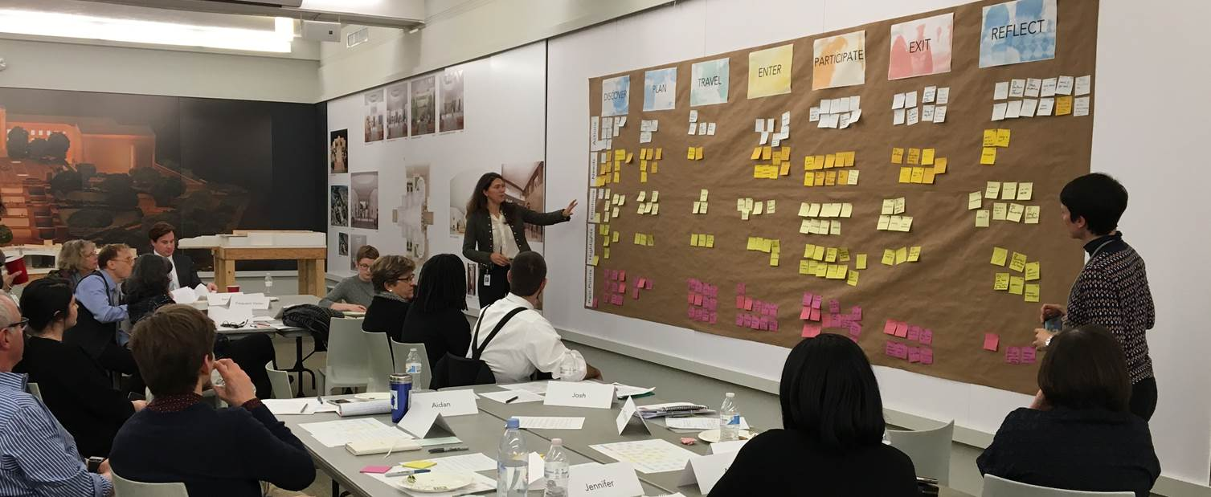
Build your journey

Slide 16
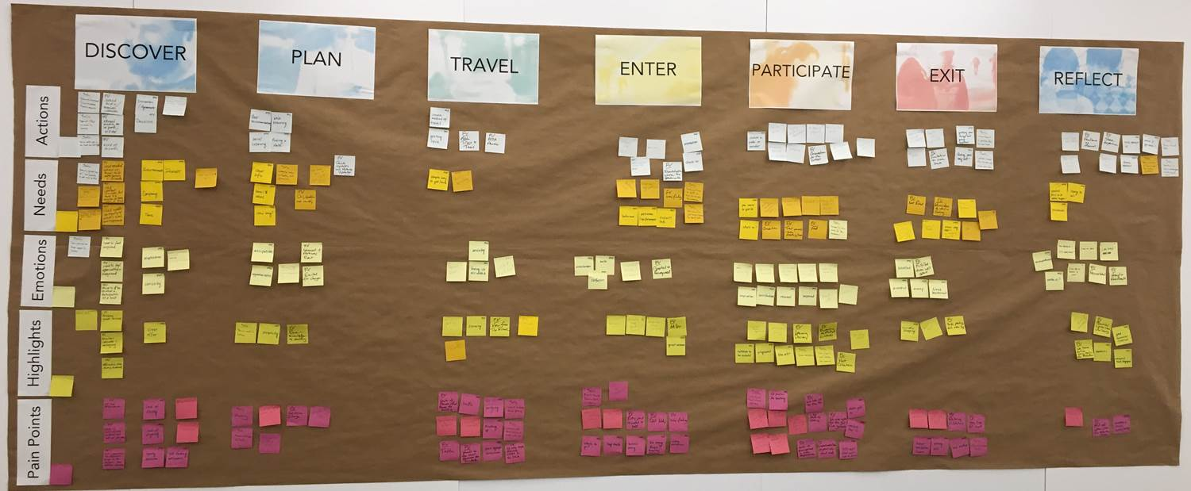
Visitor Experience Map

Slide 17
Step 3 – Create your story
Identify the areas of overlap by segment
Establish priorities around your pain points
Highlight what is working

Slide 18
Step 4 – Use it / Share it
Figure out how to represent the journey graphically
Use image to tell your story
Share it at department meetings, planning sessions, staff training. Use it as much as you can.

Slide 19
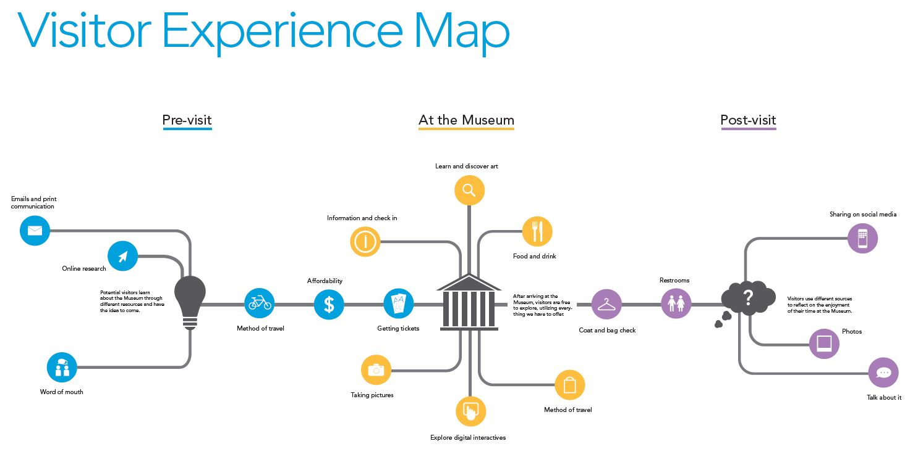

Slide 20

Step 1 – Research
Step 2 – Workshop
Step 3 – Create your story
Step 4 – Use it / Share it

Slide 21
Thank You

