Slide 1
We’re All Here for the Same Thing:
Mission Clarity and The Tenement Museum
Morris J. Vogel
Visitor Experience Conference
Philadelphia
October 9, 2017

Slide 2
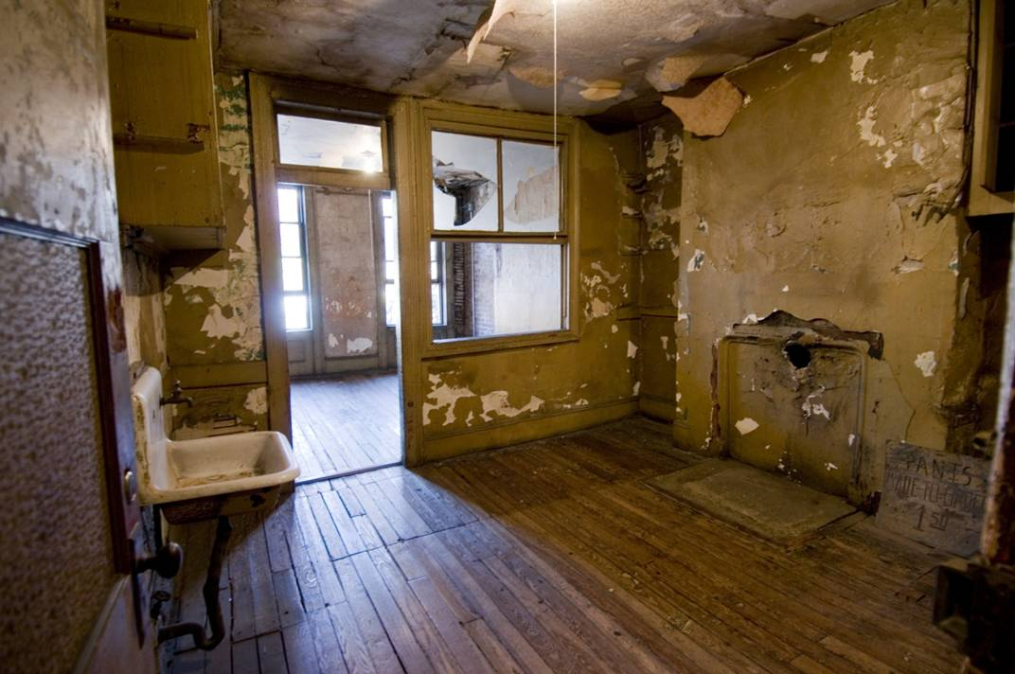
Lower East Side Tenement Museum
2nd-floor ruin apartment

Slide 3
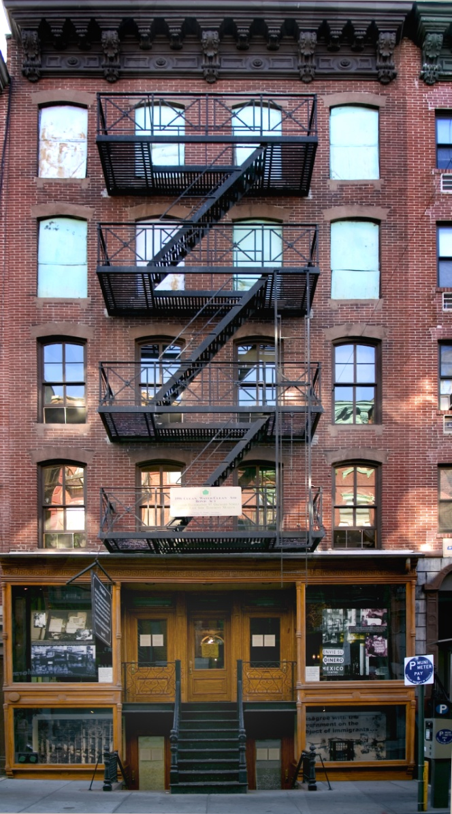
Lower
East Side Tenement Museum
97 Orchard Street

Slide 4
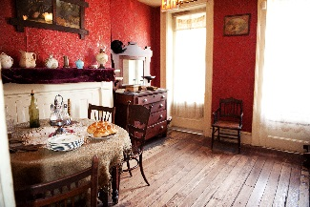
Lower East Side Tenement Museum
Rogasharsky parlor, c.1916

Slide 5
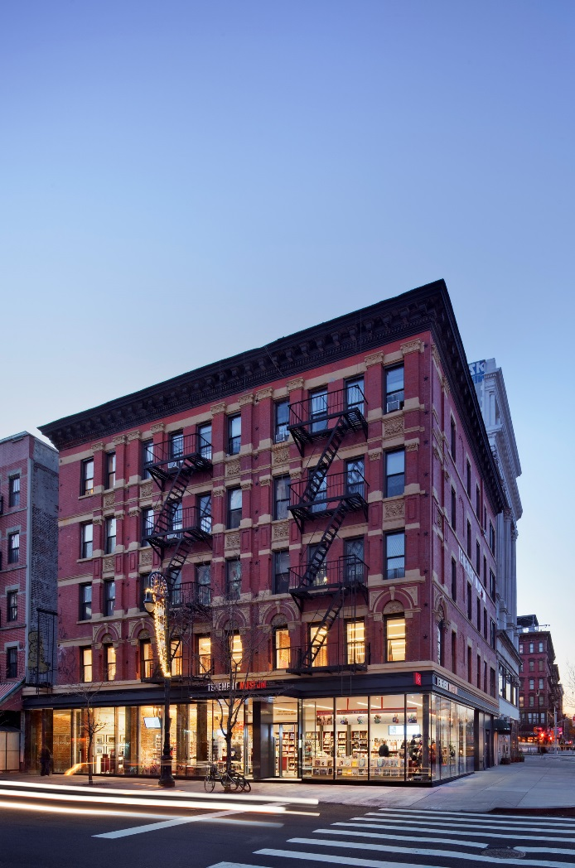
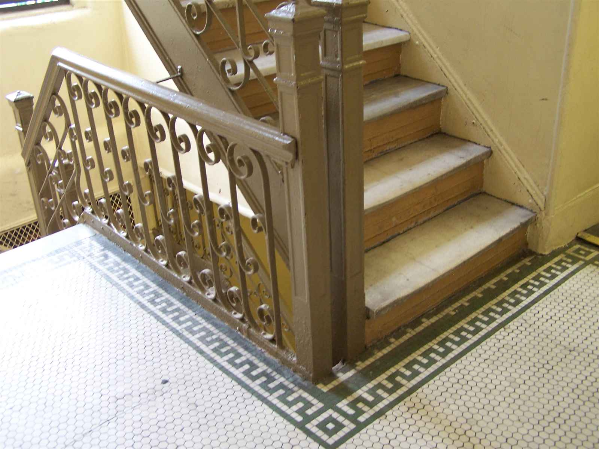
Lower East Side Tenement Museum
103 Orchard Street
Under One Roof

Slide 6
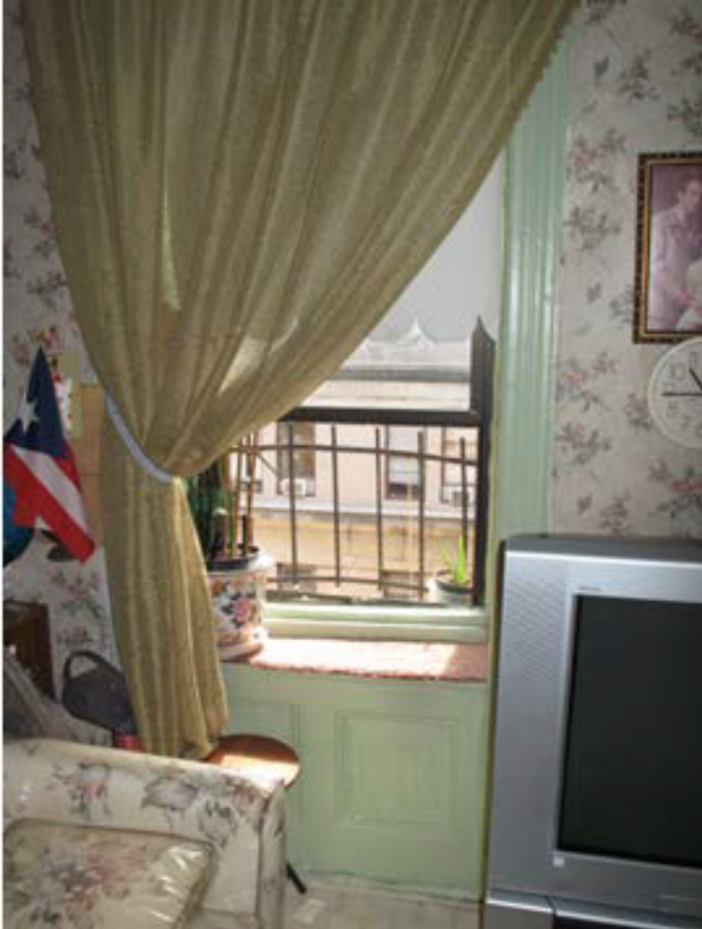
Lower East Side Tenement Museum actual Saez / Velez parlor, 2013

Slide 7
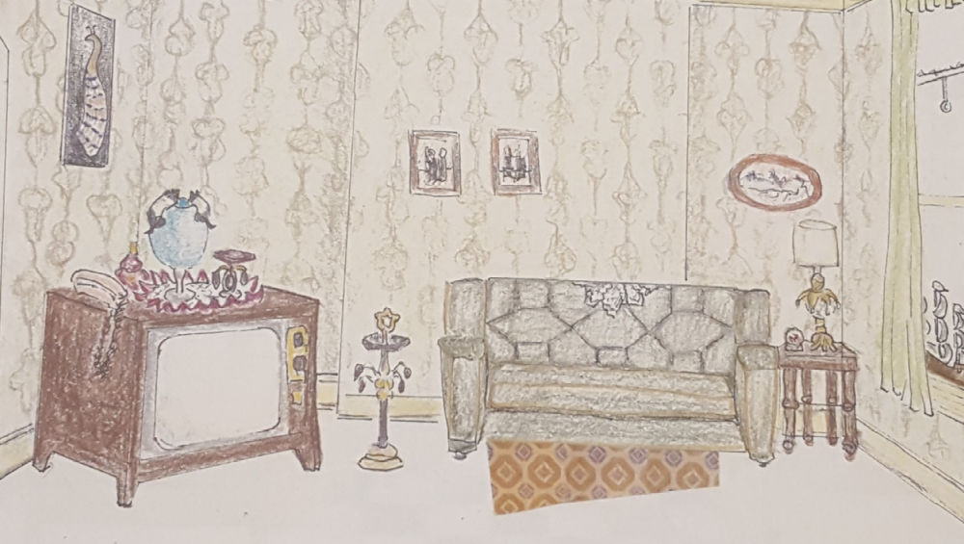
Lower East Side Tenement Museum
Saez / Velez furnishings plan, 2015
Under One Roof

Slide 8
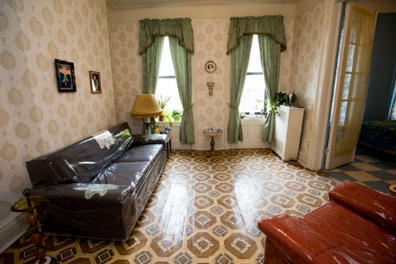
Lower East Side Tenement Museum
Saez / Velez parlor, 2017
Under One Roof

Slide 9
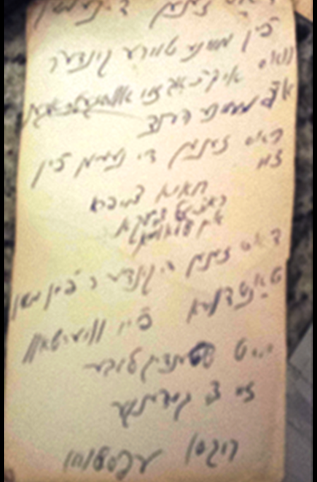
Rivka Epstein, names of murdered family members

Slide 10
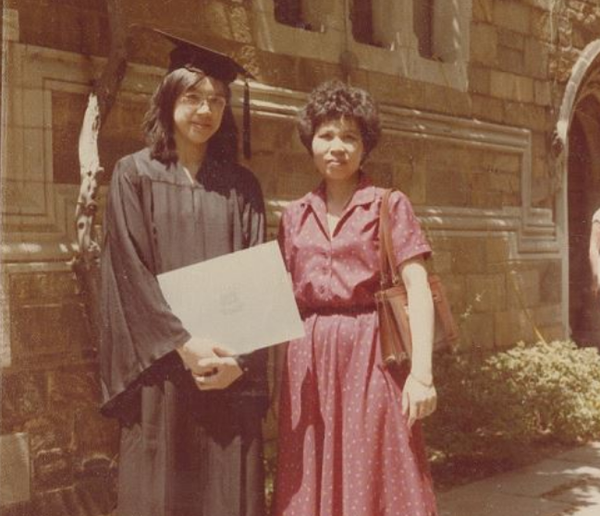
Yat-Ping Wong and Mrs. Wong

Slide 11

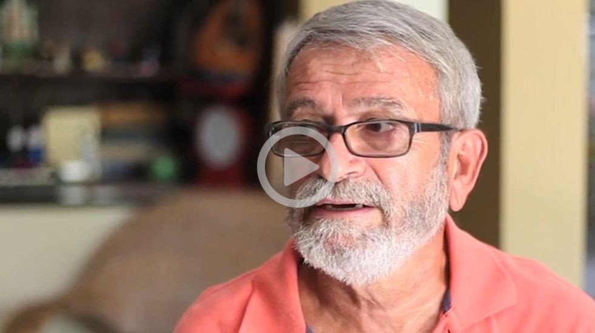
https://player.vimeo.com/video/192343529

Slide 12
Mission statement
Forge emotional connections between visitors and immigrants past and present
Enhance appreciation for the profound role immigration has played and continues to play in shaping America’s evolving national identity

Slide 13
Vision statement
Demonstrate to visitors and the larger public, viscerally and intellectually, that America’s open society, democratic institutions, cultural creativity, economic vitality, and ability to accommodate difference owe to our experience as an immigrant nation.

Slide 14
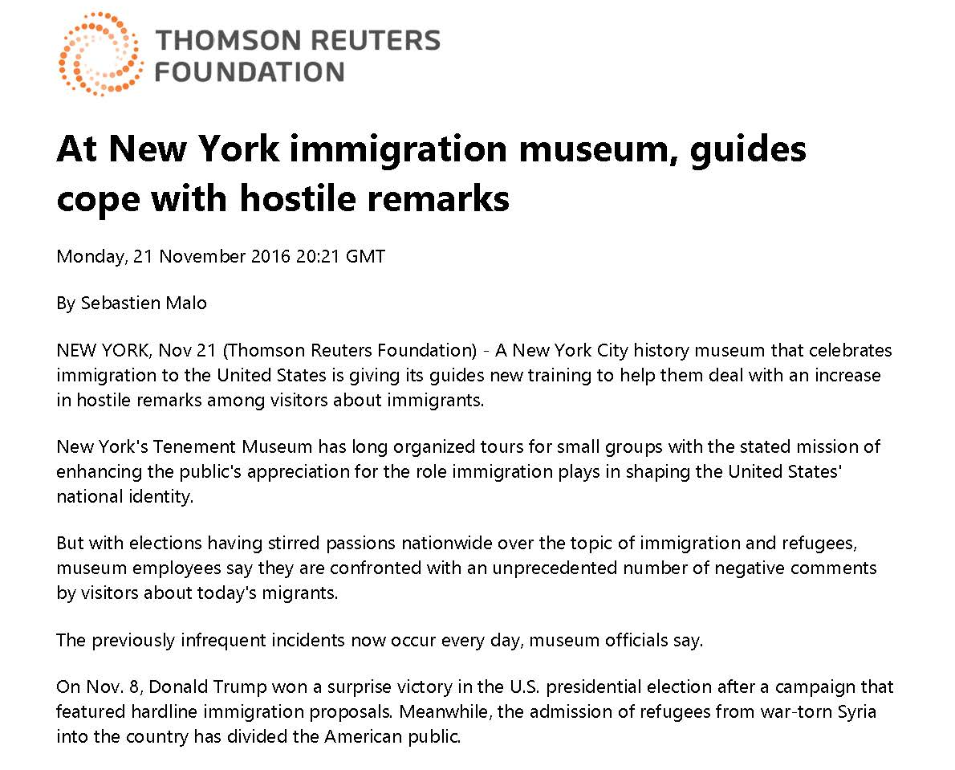

Slide 15
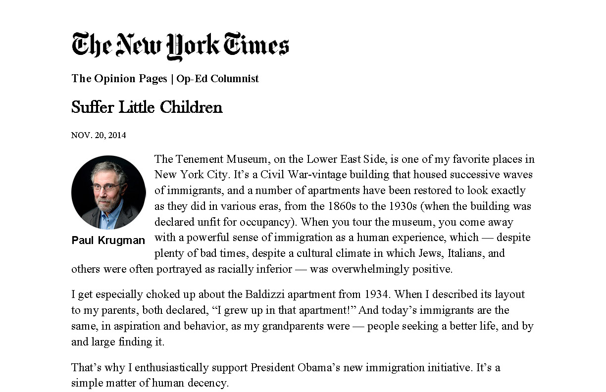

Slide 16
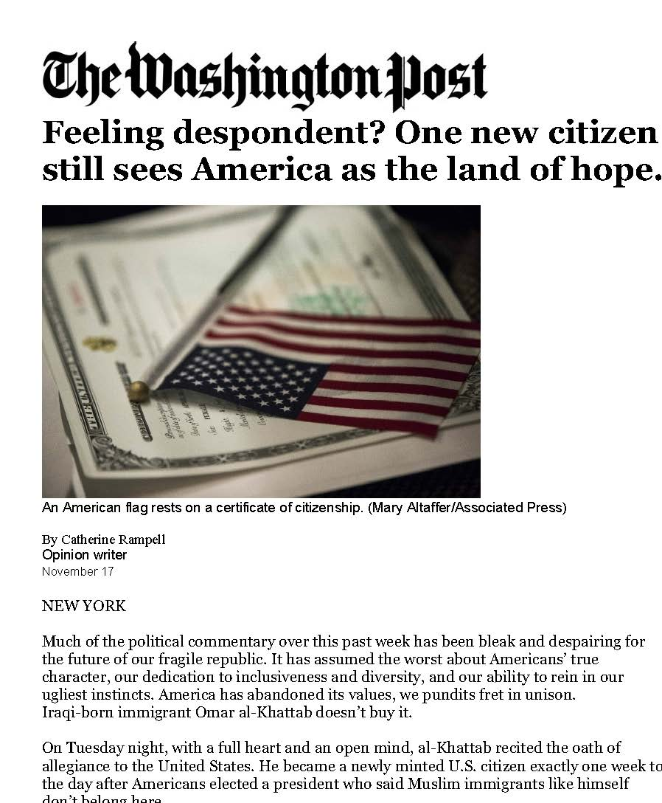

Slide 17
We’re All Here for the Same Thing: Mission Clarity
and The Tenement Museum

